Slide 1
MODULE 12
EVALUATION & IMPACT

Slide 2
CONTENTS
01
Introduction to Evaluation and Impact Assessment
The module highlights the importance of evaluation and impact assessments in sustainable food businesses. By systematically assessing waste streams you can contribute positively to environmental, economic, and social outcomes.
02
Types of evaluation - Formative, Summative, Process, Outcome, Impact
03
Setting Objectives: Key Performance Indicators (KPIs)
04
Data Collection Methods for Evaluation
05
Evaluating Economic Impact

Slide 3
01
Introduction to Evaluation
& Impact Assessment

Slide 4
Introduction to Evaluation & Impact Assessment
Evaluation & Impact Assessment are crucial processes used to measure relevance, effectiveness and outcomes in programmes, projects, or policies.
Evaluation can be categorised into several types, each serving different purposes and contexts.
Different evaluation types can be used independently or in combination, depending on the goals of the evaluation effort.
TYPES OF EVALUATION
See section 2
Formative Evaluation
Summative Evaluation
Process / Outcome Evaluation
Impact evaluation
Developmental Evaluation
Participatory Evaluation

Slide 5
Key Steps in Evaluation & Impact Assessment
Key types of impact assessments include environmental assessments global level, policy level, strategic programme/plan level, and project level.
IMPACT ASSESSMENT
Focus examining both intended and unintended effects, providing a comprehensive understanding of an activity’s contribution to change.
Utilisation of quantitative & qualitative methods, such as surveys, experiments, statistical analysis measuring changes in metrics, interviews, focus groups, case studies capturing experiences – Section 4
Purpose evaluating the changes that can be attributed to an activity, directly or indirectly.

Slide 6
Key Steps in Evaluation & Impact Assessment
Collect Data: Use various methods to gather relevant information.
- Section 4
Report Findings: Share results with stakeholders to inform decision-making and future actions.
Define Objectives: Clearly outline what the program aims to achieve – Section 3
Analyse Data: Evaluate the data to understand outcomes and impacts.
- Section 5
Use Findings: Implement changes based on insights gained to enhance program effectiveness.
Develop Indicators: Establish metrics to measure success – Section 3

Slide 7
Introduction to Evaluation & Impact Assessment
Case Study: Corporate responsibility tools by Finnish Business & Society - FIBS
FIBS accelerates responsibility changemakers towards more sustainable world.
CSRD Pulse Self-Assessment Tool The AI-based CSRD Pulse self-assessment tool allows businesses to review their level of responsibility and support their responsibility development work. SMEs can also use the tool to assess their reporting readiness in responsibility and anticipate, for example, customer requests for information regarding the business's responsibility. | Corporate responsibility self-assessment tool CRSA The online free of charge tool allows companies to systematically assess and develop their responsibility activities. The tool is suitable for all companies, regardless of size or industry.

Slide 8
Case Study: International Association of Impact Assessment - IAIA
Impact assessment, simply defined, is the process of identifying the future consequences of a current or proposed action. IAIA is the leading global network on best practice in the use of impact assessment for informed decision-making regarding policies, programs, plans and projects. Environmental impact assessment is a practical tool for helping meet today's needs without compromising the opportunities of future generations.
What is impact assessment?
EXERCISE: Check out the latest publications of International Association of Impact Assessment.

Slide 9
02
TYPES OF EVALUATION
Formative, Summative, Process, Outcome & Impact

Slide 10
Types of Evaluation
Formative Evaluation: Conducted during the development or implementation of an activity to improve its design and performance.
Summative Evaluation: Conducted after completion to assess its overall impact & outcomes.
Process Evaluation targets to the implementation.
Outcome evaluation analyses results of an activity. To watch this video click on link: Outcome Evaluation | Definition & Examples - Video | Study.com

Slide 11
Types of Evaluation
Impact evaluation underlines broader effects and long-term changes. What is Impact Evaluation?
Developmental Evaluation enables adaptation of activities in challenging systems utilizing continuous feedback and learning. Brief Introduction to Developmental Evaluation (3 minutes)
Participatory Evaluation notices attendants’ perspectives. Participatory Evaluation

Slide 12
Case Study - Tools for measuring and developing a company’s circular economy performance
The Circular Transition Indicators (CTI) Tool by the World Business Council for Sustainable Development (WBCSD) containing two parts: a guiding framework and an online self-assessment tool.
Circulytics is a circular economy measurement tool launched by the Ellen MacArthur Foundation to take advantage of several indicators, such as designing out waste, enhancing the circulation of materials and products, and promoting the use of renewable natural resources.

Slide 13
03
Setting Objectives and Key Performance Indicators (KPIs)
Setting Objectives &
Key Performance Indicators

Slide 14
Setting Objectives - Key Performance Indicators KPIs
A key performance indicator (KPI) is a type of performance measurement helping an organisation define and measure progress toward organisational goals.
KPIs assess the achievements of an organisation or particular actions, like projects, programmes, products.
KPIs provide a focus for:
strategic and operational development,
creating an analytical basis for decision-making
helping focus attention on what matters most.

Slide 15
Setting Objectives - Key Performance Indicators (KPIs)
Based on food SME functions, KPIs can be divided into
Core Circularity Indicators,
Supplementary Indicators,
Commercial Information.
Main categories, for example:
Material footprints
Consumption footprints
Circular material use rate
Waste generation and decoupling
Diversion of waste from landfill
Waste recycling

Slide 16
Possible KPIs Related to Improving Food Waste Management Efforts
Total Food Waste Volume
Waste Diversion Rate
Food Waste by Type:
Measure the total amount of food waste generated over a specific period, e.g., daily, weekly, monthly.
The percentage of food waste diverted from landfills through composting, recycling, or donation compared to total food waste.
Categorize food waste, e.g., fruits, vegetables, meat, dairy, to identify which types contribute most to overall waste.
Cost of Food Waste
Waste Reduction Targets
Calculate the monetary value of food waste generated, including disposal costs, lost revenue, and potential savings from waste reduction efforts.
Measure progress against established waste reduction goals, e.g., 20% reduction in waste over one year.

Slide 17
Possible KPIs Related to Improving Food Waste Management Efforts
Using these KPIs can help organizations understand their food waste streams better and implement effective strategies for reduction and sustainability for more valuable usage.
Food Donation Rate
Waste Generation per Meal
The percentage of edible food that is donated rather than wasted. Tracking employee participation in food waste reduction initiatives, such as training sessions or programs.
Analyze the amount of food waste generated per meal served, helping to identify areas for portion control or menu adjustments.
Customer Feedback on Waste Reduction Initiatives:
Carbon Footprint of Food Waste
Estimate the greenhouse gas emissions associated with food waste, providing insight into environmental impacts.
Gather data on customer perceptions and satisfaction regarding efforts to reduce food waste.

Slide 18
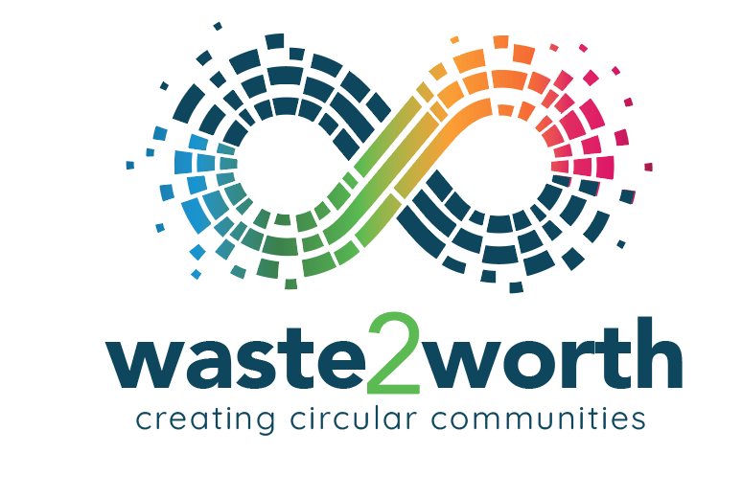
Learners exercise.
Please find and check the economy country profile 2024 of your own country.
European Topic Centre on Circular economy and resource use:
Case Finland. Circular economy country profile 2024 – Finland

Slide 19
04
Setting Objectives and Key Performance Indicators (KPIs)
Data Collection Methods for Evaluation

Slide 20
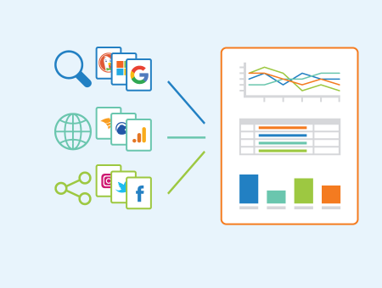
Data Collection Methods for Evaluation
Generally, data collection can be categorised by:
QUALITATIVE METHODS:
SURVEYS, INTERVIEWS, FOCUS GROUPS, OBSERVATION
QUANTITATIVE METHODS:
SURVEYS, QUESTIONNAIRES, SECONDARY DATA ANALYSIS
Depending on the purpose of the data collection, also customer feedback, market research and several other data collection methods are available.
Let’s take one Waste2Worth topic to demonstrate the methods of data collection that can be considered to measure and improve waste management efforts when assessing food waste streams. See some possible data collection methods in the next slides.

Slide 21
Data Collection Methods for Evaluation
Overview of the Product Environmental Footprint (PEF) method - What is PEF?
Specifically, the effects of circular economy strategies including increased use of secondary raw materials (SRMs), can be assessed by adopting different methods, including:
Material Flow Analysis (MFA)
Life Cycle Assessment (LCA)
Product Environmental Footprint (PEF)
Resource Efficiency Assessment of Product REAPro.
What is Life Cycle Assessment?

Slide 22
Data Collection Methods for Evaluation
Surveys and Questionnaires - Collect data from households, restaurants, or institutions about food purchasing, preparation, and disposal habits.
Waste Audits - Physically sort and weigh food waste to categorize it by type, e.g., fruits, vegetables, grains.
Interviews & Focus Groups - Conduct interviews or group discussions with stakeholders, e.g., consumers, restaurant staff, to gain insights into behaviors and attitudes towards food waste.
Observation - Food waste practices in real-time at various locations, e.g., homes, restaurants, to document behaviors.
Photographic Documentation - Take photos of food waste before and after disposal to visually assess types and amounts.
EXERCISE: Please identify if the methods above are quantitative and/or qualitative and find research articles related to each method.

Slide 23
Data Collection Methods for Evaluation
Tracking Digital Data - Description: Use apps or digital platforms to track food purchases, consumption, and waste over time.
Weight-Based Measurements - Weigh food waste on a regular basis, e.g., daily, weekly, to quantify the total amount generated.
Case Studies - Conduct in-depth analysis of specific organizations or communities to explore food waste practices.
Experimental Studies - Implement interventions, e.g., composting programs, and measure changes in food waste behavior and quantities.
EXERCISE: Please identify if the methods above are quantitative and/or qualitative and find research articles related to each method.

Slide 24
Case Study: Data Collection Methods for Evaluation
Digital product passports
Digital Product Passports: catalysing Europe’s sustainable growth - publication
Digital product passport playbook - in Finnish
Digital product passports are a way of bringing together data on product sustainability, raw materials, materials and safety. They inform consumers in a transparent way, promote responsible business and can accelerate the transition to a circular economy. Sitra funded several pilot projects and published a playbook for digital product passports.

Slide 25
05
Evaluating Economic Impact
Setting Objectives and Key Performance Indicators (KPIs)

Slide 26
Evaluating Economic Impact
What is the Point of Economic Impact Analysis?
Economic impact analysis (EIA) usually consists of 4 metrics:
1) employment,
2) household earnings,
3) economic output, and
4) value added.
It typically measures: income (financial inputs to economic outputs), direct spending, and visitor indirect spending.
EIA generally includes:
- regional impact analysis (RIA) describes the size and nature of the effects on local, regional and state economies
- cost–benefit analysis (CBA), is used to identify the costs and benefits of the project.
Money Circulating Through An Economy: Economic Impact Analysis - Direct, Indirect, & Induced Effects

Slide 27
EXAMPLE: Evaluating Economic Impact
Let’s take one Waste2Worth topic; assessing the economic impact of food waste streams. See the roadmap for identifying costs, methods for food waste streams in the next slides.
IDENTIFYING COSTS ASSOCIATED WITH FOOD WASTE
Direct Costs - Disposal Costs, Production Costs, Indirect Costs - Lost Revenue, Environmental Costs
CALCULATING THE ECONOMIC VALUE OF FOOD WASTE
Volume Measurement - Quantify the total volume or weight of food waste generated over a specific period.
Market Value Assessment - Estimate the market value of the wasted food based on current prices, which helps quantify the economic loss.
BENEFITS OF FOOD WASTE REDUCTION
Cost Savings - Reduced Disposal Fees, Lower Purchase Cost, Revenue Generation, Food Donation Value, Environmental Savings

Slide 28
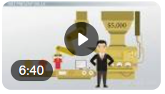
Evaluating Economic Impact - methods
Investment Analysis Tools - Video | Study.com
RETURN ON INVESTMENT (ROI)
Investment Analysis - Calculate the costs of implementing food waste reduction initiatives (e.g., composting systems, staff training), Compare these costs to the financial benefits gained from waste reduction efforts.
ROI Calculation - ROI = Net Profit / Cost of the investment * 100
ECONOMIC IMPACT MODELING
Input-Output Analysis - Use economic modeling techniques to assess how food waste reduction initiatives affect the local economy, considering jobs created and economic activity stimulated.
Scenario Analysis - Analyze different scenarios, e.g., full implementation of composting, to predict potential economic impacts under various conditions.
Input-Output Analysis (IOA)

Slide 29
Evaluating Economic – Environmental – Social Impact
EXAMPLES OF METHODS OF IMPACT ASSESSMENT
Cost-Benefit Analysis: Compares the economic impact - costs of waste management practices against their benefits.
Life Cycle Assessment (LCA): Evaluates the environmental impact of waste from cradle to grave. See Video on Slide 21
Stakeholder Engagement: Illustrates the social impact - involves community input and perspectives to inform assessment outcomes.
What is a Cost Benefit Analysis? (Easy Explanation)
Stakeholder Engagement in 5 Slides // Stakeholder Management

Slide 30
For example, evaluating the environmental-socio-economic impact of food waste streams is essential for understanding the KPIs of waste management practices.
Each evaluation method serves a unique purpose and contributes valuable insights to the overall assessment process with carefully selected KPIs.
For example, by quantifying costs, benefits, return on investment, SMEs can make informed decisions about implementing food waste reduction strategies that lead to economic savings and sustainability.
Combining multiple methods can enhance the robustness of the evaluation, provide a comprehensive view of food waste streams and inform effective interventions contributing positively to environmental, economic, and social outcomes.
Final remarks

Slide 31
A LITTLE PROGRESS EACH DAY ADDS UP TO BIG RESULTS

Slide 32
Follow our journey
li
in
yt
www.waste2worth.eu

