Slide 1
MODULE 10
MARKETING & STORYTELLING

Slide 2
CONTENTS
This module explores how storytelling can be integrated into marketing to create strong brand identities and drive customer engagement. We explain how storytelling can be used as a tool to attract new consumers, increase profit and build a base for stable and predictable sales.
This module also explores the process of brand development, providing you with some practical tools to enhance your business’s branding.
01
Introduction to Storytelling
02
Integrating Storytelling in Marketing
03
Brand Development
04
Food Waste Marketing approaches

Slide 3
01
INTRODUCTION TO STORYTELLING

Slide 4
Conceptual framework
Storytelling is the art of connecting events in a narrative and compelling way (Einam et.al, 2024).
Stories are highly effective in transmitting a message because they Entertain, Evoke and Build
Storytelling is therefore the tool to transmit a message. Acknowledging the power of storytelling in marketing is highly relevant, but….
How can we create good stories?
This Photo by Unknown Author is licensed under CC BY-NC-ND

Slide 5
Key elements for storytelling
Stories call for attention, as they abstract the subject from the reality and engage the human mind into imagination – A story that entertains must engage through curiosity, escapism and imaginary.
Entertain
Stories trigger dopamine, cortisol, oxytocin and endorphins, (Harvard Business publishing, 2017) which all together evokes an emotional response, which may be pleasurable – A story that evokes must develop emotional connection, relatability, and emotion stimulation
Evoke
Stories call for attention, as they abstract the subject from the reality and engage the human mind into imagination – A story that entertains must engage through curiosity, escapism and imaginary.
Build

Slide 6
The Two layers of Storytelling
First Layer: Structure, connecting events through a narrative
Core Idea
Establishing the core sense of the story –love, adventure, tragedy, mystery… This means establishing the underlying values and morals
Narrative
The narrative method chosen (Hero’s Journey, Freytag’s Pyramid…). These narratives are based on coherent stages; presentation/development/resolution
Conflict
Establishing a conflict – with or without solution- and how the characters are related to that conflict and if there is any character development

Slide 7
The Two layers of Storytelling
Second Layer: Delivery, the way the story is presented to the listener
Channel
The same story can change completely depending on if it’s delivered orally, written or simply visual. Choosing the right channel is key to transmit the message
Tone
Words, colours or rhythm can be very powerful when transmitting an idea. The style in which the story is presented is crucial as it is determinant for evoking emotions and feelings in the audience
Engagement
Adopting the correct techniques (pauses, pitch, long paragraphs, dialogues, body language…) is highly important to create and attract engagement

Slide 8
‘Baby shoes, never worn’ – The shortest story ever, Ernest Hemingway
Entertains, evokes and builds
This story calls for attention due to its shortness –how can just a phrase be a story? It evokes emotion due to the word ‘baby’ which changes the interpretation –the lack of detail allows for each person to bring their own emotions to the story. Lastly, it construct identity as it recalls human empathy and could express relatability through shared experiences
Structure
The underlying value of loss, is grief. The structure follows Hemingway’s short-story’s own style. He believed in these type of stories, the reader must fill the faps. Conflict and characters are, however, easier to identify – a baby which may have died, or never born.
Delivery
We can perfectly observe how powerful the delivery can it be with this story, which is based on implication rather than exposition. It’s a written channel in which the selection of words and paragraph length is crucial to provide sense to the story. Engagement is therefore achieved through delivery techniques

Slide 9
Learners exercise
CREATE YOUR OWN STORY
Following the provided material, try to create a small story that combines all the elements mentioned
Be creative!!

Slide 10
02
INTEGRATING STORYTELLING INTO MARKETING

Slide 11
Marketing and customer engagement
Attract
Satisfy
Retain
Customers feel inclined or curious to try out your product
Customers express satisfaction after they have consumed your product
Customers desire to stick to your product, rejecting other similar ones from different sellers
Marketing is fundamental for maintaining and growing any business. Marketing is based under three basic principles:

Slide 12
Customer Engagement
Through marketing businesses grow bigger and establish themselves as a reliable entity in their market sector. What determines if the marketing strategy is effective is customer engagement – the degree of involvement with the products, not just purchasing, but also providing feedback, expressing loyalty, promoting among peers, etc. The more effective the marketing, the greater the positive engagement/interaction with the product or service being offered.
Thus, the primary goal of marketing is to engage a broad customer base by effectively attracting, satisfying, and retaining the maximum number of customers possible

Slide 13
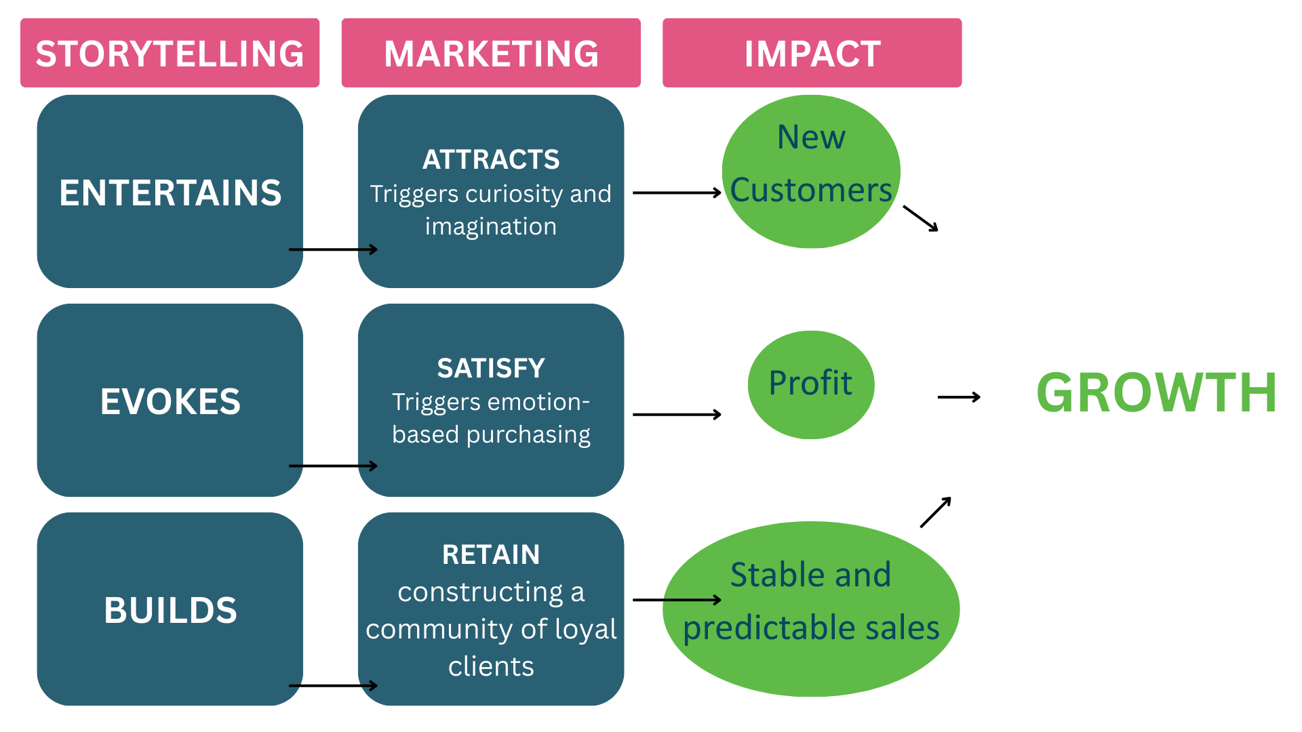
How can storytelling influence in your business
Notes:
Link for translation: https://www.canva.com/design/DAGg29kmSVA/xvPvwzMtGFtl2xdPNlbJvA/edit?utm_content=DAGg29kmSVA&utm_campaign=designshare&utm_medium=link2&utm_source=sharebutton

Slide 14
Case Study – Bia Oisin
Bia Oisin and Ainar
Here we can see how Oisin Kenny shares his story of his businesses Bia Oisin.
In this short video it is possible to observe the elements mentioned previously, aiming at attracting, satisfying and retaining audience.

Slide 15
Case Study – Leaf and Root farm
Leaf and Root and Loam
Fergal Anderson is the owner of Leaf and Root farm, an organic-certified horticulture farm that produces organic plant-based products for the community
In the video, we can observe how he engage and connect with the audience via the important elements of a good story

Slide 16
03
BRAND DEVELOPMENT

Slide 17
Brand development tools
Brand development tools refer to those instruments that are used in the process of developing and building your brand. There are several types of tools, which can be divided under two groups:
Analytical: These tools provide a framework for a reflective exercise in order to think and develop a strong sense of ‘state of the art’ of your brand as a whole – not just how you present it, but how do you want it to be perceived. Some examples are:
Golden Circle
Brand Archetypes
Practical: These tools refer to all those hands-on instruments that are available for creating your logo, branding style, visual message but also to promote it through your stakeholders and peers. Some examples:
Canva
Adobe Creative Cloud
Mailchimp
Buffer

Slide 18
The product(s) that you offer through that brand
What
Analytical
Tools
The approach that differentiates your business
How
Golden
Circle
Why
The belief that drives your business
The Golden Circle

Slide 19
Analytical Tools
Brand Archetypes (I)
Innocent: Simple but happy. Sense of optimism and honesty.
Examples: Coca-Cola, Disney
Creator: Innovative and artistic, placing importance in the imagination
Examples: Apple, Vans
Explorer: Free and adventurous, portraying curiosity and independence
Examples: GoPro, Red Bull
Ruler: Praising control and leadership, showcasing confidence and power
Examples: Rolex, American Express
Sage: Intelligent and analytical, depicts desire for wisdom
Examples: BBC, Wikipedia
Magician: Dreamy, mystic and visionary, with hints of futurism
Examples: Tesla, Airbus

Slide 20
Analytical Tools
Brand Archetypes (II)
Caregiver: Helpful and caring, willing to protect and support
Examples: Nestle, Scott
Rebel: Rule breaker, challenging the authority, disrupting the system
Examples: MTV, Revolut
Hero: Determined and courageous, aiming to make a difference
Examples: Nike, BMV
Lover: Passionate and intimate, building emotional connections
Examples: Tiffany & Co., Chanel
Everyman: Relatable, homy, developing sense of belonging
Examples: IKEA, Budweiser
Jester: Funny, carefree, promoting entertainment and humour
Examples: Old Spice, Doritos

Slide 21
Practical tools
Mailchimp
Link here
Canva
Link here
User friendly and versatile: Canva is a free, easy-to-use graphic design app ideal for users with little or no design experience, offering tools like templates and brand kits for creating professional content
Advanced and professional: ACD is a powerful tool for design and media production, offering access to advanced software like Photoshop, InDesign, and Premiere Pro, ideal for users with graphic design knowledge.
User friendly and Email marketing focus: Mailchimp is centered on email marketing, offering customizable templates and simple design tools to create and send content directly to stakeholders.
Social Media management: Buffer is designed for scheduling, publishing, and analysing content across multiple social media platforms, helping maintain consistency in brand messaging.
Title Three
Click to type
Title Four
Click to type
Adobe Creative Cloud
Buffer
Link here
Link here

Slide 22
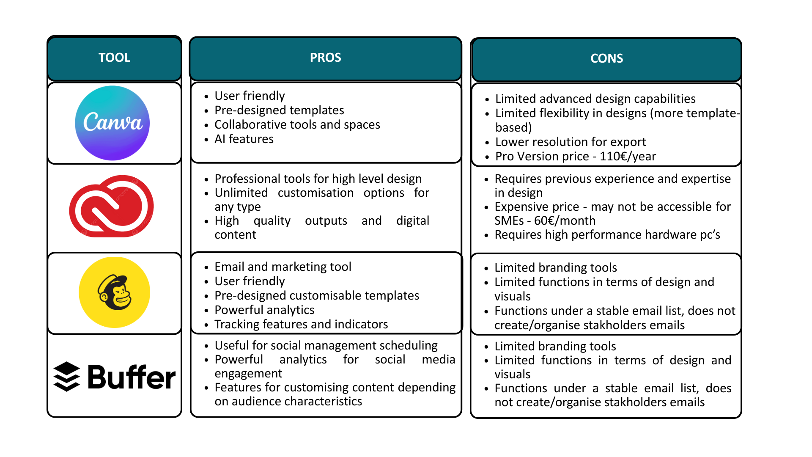
Notes:
Link for translation: https://www.canva.com/design/DAGhD2zpUkc/zqhQ1GbFNHUPj8Qa-ac29g/edit?utm_content=DAGhD2zpUkc&utm_campaign=designshare&utm_medium=link2&utm_source=sharebutton

Slide 23
Learners exercise
CREATE YOUR OWN BRAND
Following the provided material, try to create A brand logo and motto that represents your business using all the elements mentioned
Be creative!!

Slide 24
04
FOOD WASTE MARKETING APPROACHES

Slide 25
Rediscovering tradition
As seen, stories are important when spotlighting your brand. Using storytelling should be considered for promoting your food waste approach. Food waste stories are unique messages about food stories, that need to be shared in the form of new narratives for them to be efficient.
They key to create a new efficient narratives is to connect the past with the present and imagine the future (Pearson, 2024). Creating a story out of those traditional techniques involving food reuse in your business can represent a solution.
Through storytelling, it is possible to highlight cultural heritage, framing traditional waste-avoidance techniques as sustainable and modern solutions to current issues. Moreover, they emphasize connection by building a sense of identity, nostalgia and belonging. Furthermore, stories about these traditional techniques would reinforce local values, strengthening the community.

Slide 26
Rediscovering tradition – Case Study
Delikatetxe is a cooperative that produces broths from free-range hens at the end of their egg-laying cycle, reviving a tradition of slow-cooked dishes once prized for their high-quality meat.
Industrial farming has made this meat less popular, but Delikatetxe highlights traditional Basque farming practices by sourcing ingredients from local producers who raise animals with care and respect for the environment, connecting the past traditions with present practices.
Through storytelling, they preserve cultural heritage and farming traditions, embodying their motto: "Hens are back on our tables. Let’s get back to the good old ways."
https://delikatetxe.eus/es/
More information on Delikatetxe available on the W2W Compendium of Best Practices

Slide 27
Innovation
Presenting innovative food waste reduction techniques can also act as a framework for increasing your presence in the market. Innovation creates Unique Selling Points and can differentiate you from other businesses that refer to sustainability in general terms. Moreover, innovation can be tailored to creativity, which would place your brand in a different scale.
Innovation is often perceived through appropriate words (re-engineered, bio-designed, next-gen products). Thus, aim to provide a sense of cutting-edge solutions through language
Lastly, presenting your innovation techniques as something that can be transferred to other areas (not just food waste, but also production, home cooking…) could grant your brand with a more comprehensive and meaningful sense, providing possible solutions for addressing the same problem in other sectors

Slide 28
Innovation – Case study
Orange Fiber stands out for its patented process of extracting cellulose from citrus pulp, transforming food waste into high-end fashion textiles.
By focusing on innovation as their Unique Selling Point, they showcase how food waste solutions can be transferred to other sectors like textiles.
Moreover, they merge technology with creativity, linking sustainability to fashion design.
Their branding is infused with cutting-edge keywords such as ‘Limited Edition,’ ‘redesigning fashion,’ and ‘patented process,’ reinforcing their innovation-driven identity.
https://orangefiber.it/
More information on Orange Fiber available on the W2W Compendium of Best Practices

Slide 29
Partnerships
Expanding networks and reaching out to peers with marketing purposes represents an interesting strategy that build up your brand. Collaborating with peers allows to access their customer base, which can further provide more insights and feedback from different audiences about your brand.
Moreover, sharing marketing campaigns can reduce efforts when developing branding arrangements, message, visual and reaching out indicators. This is particularly efficient within food waste, as it could further optimise the already established techniques – by learning from other partners’ campaigns.

Slide 30
Partnerships
Partnerships must have synergies from which a comprehensive outcome for all parties can be extracted. This means that it is strategically important to choose wisely who do you partner with.
For example, the farming industry with local markets –selling farming food surplus – or supermarkets with hospitality businesses – non-consumed goods into creative dishes…

Slide 31
Partnership- Case study
FoodCloud collaborates with major retailers like Tesco, Aldi, and Lidl to expand its food redistribution network, gaining access to more charities and food businesses. These partnerships also enhance marketing efforts, increasing visibility through shared sustainability initiatives.
By integrating with retailers and social enterprises, FoodCloud optimizes logistics, streamlining surplus food distribution while promoting sustainability awareness. Through these synergies, it maximizes impact, reduces waste, and strengthens its role in sustainable food management.
https://food.cloud/
More information on FoodCloud available on the W2W Compendium of Best Practices

Slide 32
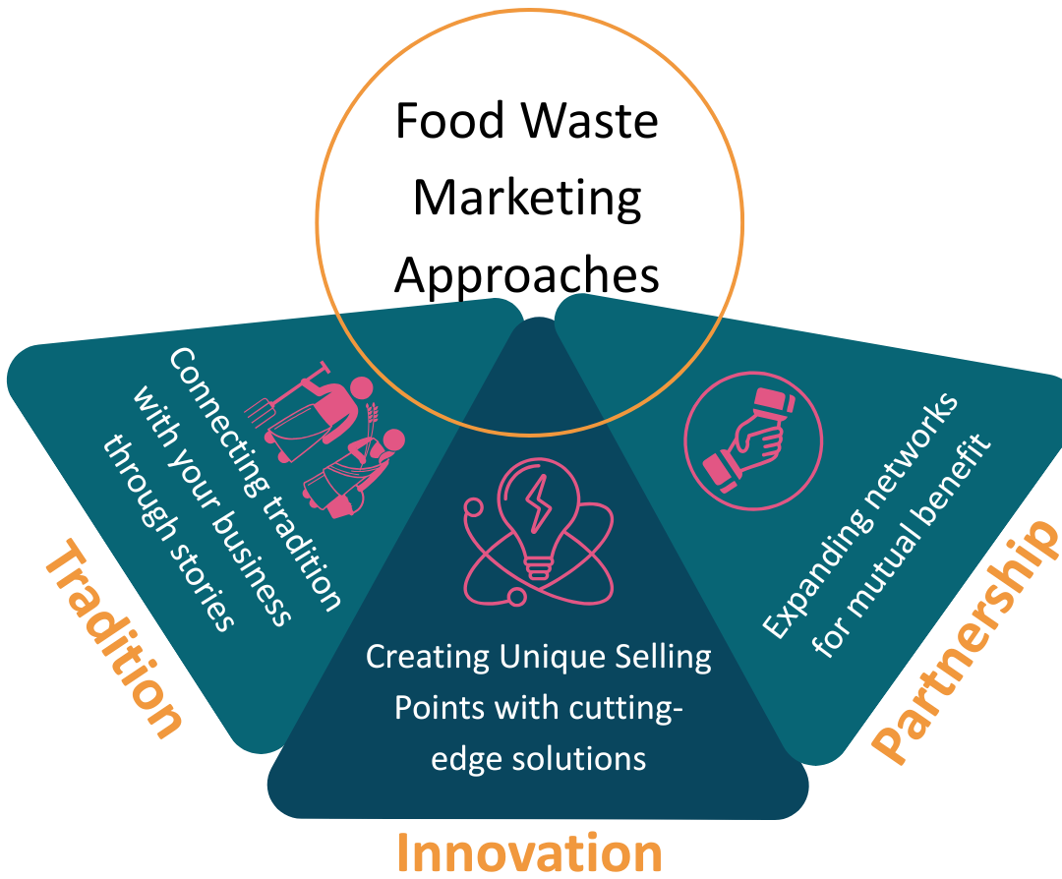
Combining these marketing strategies allows businesses to differentiate themselves in competitive markets.
Together, these strategies create a well-rounded approach that drives long-term success and growth.
Notes:
Link for translation: https://www.canva.com/design/DAGhbz75hdE/5BgbMheNjpLcyN3LAMgZ8Q/edit?utm_content=DAGhbz75hdE&utm_campaign=designshare&utm_medium=link2&utm_source=sharebutton

Slide 33
Storytelling is a powerful marketing tool that helps businesses build strong brands and connect with their audience.
By integrating storytelling into marketing, companies can create emotional engagement, differentiate themselves, and communicate their values effectively. This module has provided you with hands-on knowledge, accompanied with visually engaging content, external resources and case studies showcasing the learning materials.
This module has deepened into strategies of marketing, paying special attention on how can storytelling be integrated into an efficient marketing approach, as well as other interesting insights on other approaches.
Final remarks

Slide 34
Follow our journey
li
in
yt
www.waste2worth.eu

