Slide 1
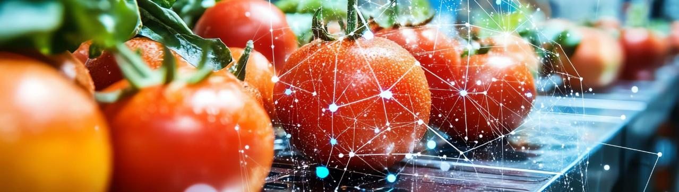
MODULE 8
INNOVATION & TECHNOLOGY

Slide 2
CONTENTS
This module will analyse and explore different types of innovations that are applied in the food sector to optimise processes and minimise waste.
It will delve into digital solutions designed for food waste avoidance, including artificial intelligence and smart technology to improve supply chain efficiency and resource management.
In addition, a section will be devoted to biotechnology, highlighting its impact on food production and preservation.
01
Introduction to Innovation & Technology
02
Digital solutions for Food Waste reduction
03
AI - Automation and Intelligent Technology
04
Biotechnology and Food Preservation

Slide 3

01
INNOVATION AND TECHNOLOGY IN THE FOOD SECTOR

Slide 4
Innovation and technology in the food sector
Innovation and technology have become essential in addressing the challenges faced by the food sector such as:
Climate change
Population growth
Resource use
…affecting agricultural production and threatening global food security
…which is expected to exceed 9 billion by 2050
…critical resources such as water and land
Food loss & waste
Food security
Globalisation
…which in recent years has been up to 30–40%.
…and nutrition trying to ensure equitable access to healthy food
and complex supply chains that require current systems to be more resilient and transparent.

Slide 5

Innovation and technology in the food sector
All the above challenges require sustainability, food safety, consumer demands, and efficiency in production and therefore, the food industry is undergoing a transformation driven by advancements in technology, ensuring that it remains competitive, resilient, and aligned with global sustainability goals.
In this section, we will explain the Key drivers of Innovation and Emerging technologies in the food sector, Biotechnology, and finally Innovations in food production.
How New Technology is Transforming the Food and Beverage Industry

Slide 6

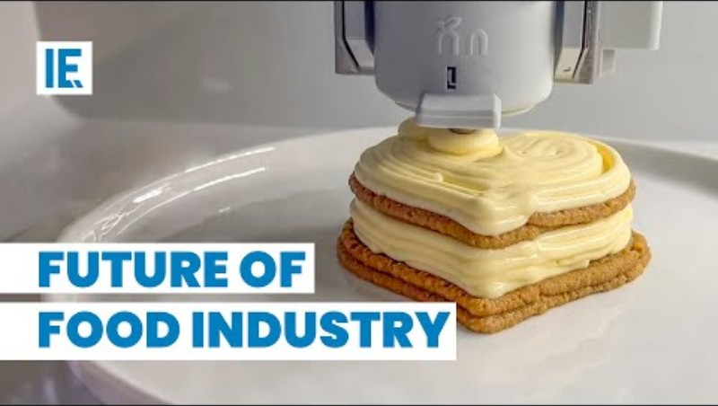

Check out this fascinating video on food innovation! The food and beverage industry is experiencing rapid advancements in creating healthy, sustainable, and unique products. From 3D food printers like Foodini to automated pizza makers like the Picnic Pizza Station, these innovations are revolutionising the way we prepare and consume food.

Slide 7
Emerging Technologies in the Food Sector
Biotechnology
Blockchain Technology
3D Printing
Sustainable Packaging
  - Genetically modified organisms (GMOs) to improve crop yields and resistance.
  - Lab-grown meat and alternative protein sources like mycoprotein and insect-based foods.
  - Improving traceability across the food supply chain.
  - Ensuring transparency in sourcing, production, and distribution.
  - Producing custom-designed food items for specialised diets.
  - Reducing food waste by utilising excess ingredients.
  - Biodegradable materials, edible packaging, and recyclable plastics.
Reducing environmental impact and aligning with consumer preferences.
Addressing global food security and sustainability challenges
Building consumer trust and reducing food fraud.
Promoting innovation in food design and consumption.

Slide 8



Innovation in Food Production
Here are three innovative ways that have increased productivity and reduced the environmental footprint, and the reliance on traditional farming with significant cost savings and sustainability.
Precision Agriculture
Food Waste Reduction
Leveraging GPS, drones, and sensors to optimise farming practices.
Increased productivity and reduced environmental footprint.
Alternative Protein Sources
Innovations like AI-powered inventory management and Apps connecting surplus food to consumers or charities.
Significant cost savings and sustainability.
Plant-based meat, lab-grown meat, and insect protein are gaining popularity.
Reduced reliance on traditional livestock farming

Slide 9
Challenges in Implementing Innovations & a Future Outlook
High initial costs for adopting advanced technologies.
The food sector will continue evolving as technological advancements improve efficiency, sustainability, and consumer satisfaction. Collaboration between tech companies, governments, and the food industry will be crucial for driving innovation forward. Initiatives such as smart cities, sustainable farming, and circular economies will shape the future of food production and distribution.
By adopting cutting-edge technologies and fostering a culture of innovation, the food sector can address global challenges and ensure a sustainable, secure, and equitable food system for future generations.
Regulatory barriers for new products like lab-grown meat or GMOs.
.
Resistance to change from traditional stakeholders in the food supply chain.
Ensuring data security and privacy in digital innovations.

Slide 10



Hosted by Michael Wolf , this podcast delves into food tech, future food, and ag tech, featuring interviews with industry leaders and discussions on emerging trends.
Join host Michael Wolf and The Spoon, editors as they explore the world of food tech, future food, ag tech and more!
Edible Planet is the ecosystem that connects voices and visions to develop the global food infrastructure we need for a resilient and productive world.
Foodtech Junkies takes a 360-degree view of the latest developments and picks the brains of entrepreneurs, investors, chefs, authors, experts , advocates, visionaries, and troublemakers.

Slide 11

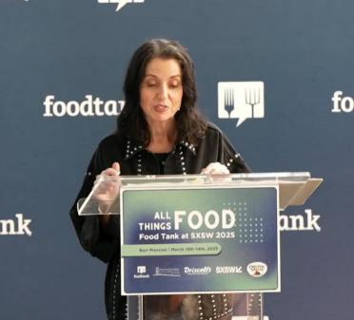
In 2013, Danielle Nierenberg, a world-renowned researcher, speaker, and advocate, on all issues relating to our food system and agriculture, co-founded Food Tank with Bernard Pollack, a nonprofit organisation focused on building a global community for safe, healthy, nourished eaters. Food Tank is a global convener, thought leadership organisation, and unbiased creator of original research impacting the food system.

Slide 12
Learners exercise
Task: In small groups, research one major global challenge (e.g., climate change, food security, resource depletion) and present how food sector innovations can help mitigate its impact.
Output: 5-minute presentation + 3-minute Q&A from peers.
Debate: "Traditional agriculture vs. Tech-enabled agriculture: Which is more sustainable in the long term?"

Slide 13
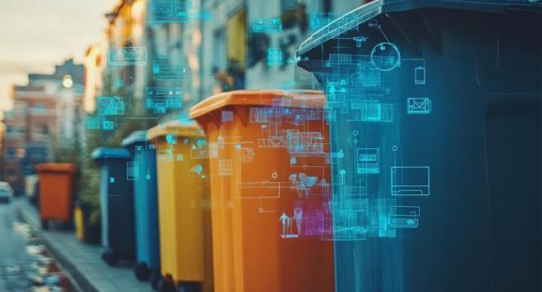
02
DIGITAL SOLUTIONS FOR REDUCING FOOD WASTE

Slide 14
Digital solutions for reducing food waste
Digital technologies play a crucial role in reducing food waste by improving monitoring, tracking, and redistribution. The main three innovative solutions are: IoT-based real-time monitoring systems, digital platforms, and the use of QR codes.
By integrating these digital solutions, stakeholders across the food supply chain can collaborate effectively to reduce food waste and create a more sustainable system as their impact and benefits are essential…
Businesses
Consumers
Society
reduces waste,
saves costs,
enhances sustainability credentials
encourages mindful consumption
provides information to reduce waste at home
supports food security by redistributing surplus to those in need
Reduces environmental impact

Slide 15
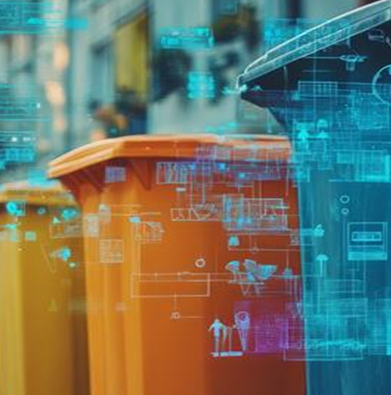
IoT (Internet of Things) solutions enable the continuous monitoring of food quality and inventory, providing data to reduce waste or loss.
Real-Time Monitoring with IoT
Key Features and Benefits:
Temperature and Humidity Sensors:
Devices monitor storage conditions in real-time, ensuring optimal environments for perishable items.
Alerts are triggered if conditions deviate, preventing spoilage. Example: IoT systems in cold storage facilities or refrigerated transport.
Inventory Management:
IoT-enabled smart shelves and bins track inventory levels, expiration dates, and food movement.
Automatic reordering systems optimize inventory to prevent overstocking.
Data Analytics:
AI-driven analytics identify patterns, such as frequently wasted items, and suggest adjustments in purchasing, storage or production.

Slide 16

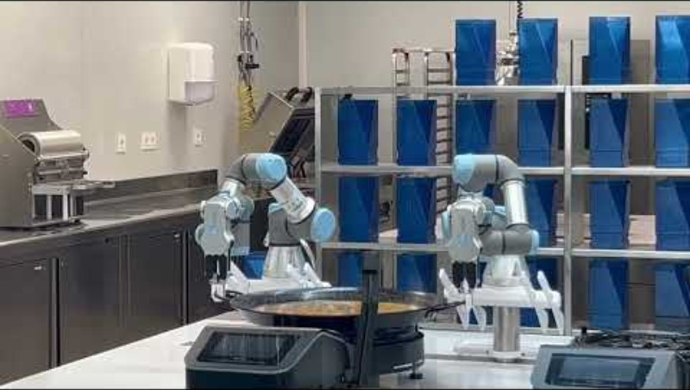
The CIFP Escuela de Hostelería de Leioa (Leioa Catering School) is at the forefront of culinary innovation. In the video a fully autonomous kitchen robot making Paella.

Slide 17
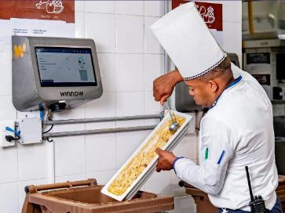
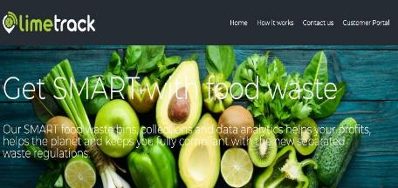




Examples of IoT Tools:
Limetrack
SMART bins weigh your deposits
Winnow
This tool uses smart scales, cameras, & sensors to automatically record the type of food that is wasted. The information collected by IoT is analysed to adjust menus, portions, and purchasing planning. In hotels in the Balearic Islands, food waste was reduced from 11% to 2.5%.
A disruptive food waste technology company, adding value to food waste by effortlessly capturing data about it. The data is into the palm of your hand to help you make SMART decisions. save money and do something great for the planet.
https://limetrack.earth/

Slide 18
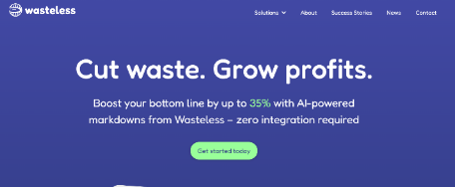
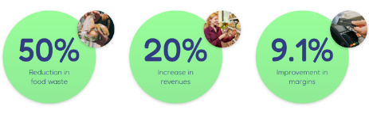

Examples of IoT Tools:
Kitro
Swiss platform that automates the collection of
data on food waste in kitchens.
Oscillum
A startup from Alicante, Spain, creates biodegradable labels that change colour depending on the condition of the food
Wasteless
Offer dynamic pricing based on expiration date using connected electronic labels. It uses electronic tags and IoT sensors to offer dynamic pricing based on expiration dates.
Supermarkets could implement this technology to optimise the turnover of fresh products.
Impact: Helps food sell before it spoils, significantly reducing waste.

Slide 19
Digital Platforms for Food Redistribution
Digital platforms facilitate the redistribution of surplus food to those in need or allow businesses to sell surplus at reduced prices.
Food Sharing
Community Engagement
B2B Redistribution
  Platforms connect food donors (e.g., restaurants, supermarkets) with charities or individuals.
  Online marketplaces for surplus food sales between businesses.
  Apps allow local communities to share food resources and reduce waste collectively.

Slide 20
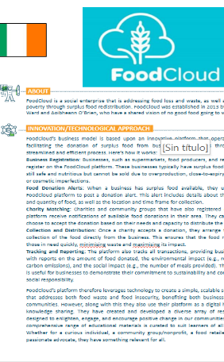

Be inspired…
FoodCloud’s business model is based upon an innovative platform that operates by facilitating the donation of surplus food from businesses to charities through a streamlined and efficient process.
Featured in our Good Practice Compendium, FoodCloud’s platform leverages technology to create a simple, scalable solution that addresses both food waste and food insecurity, benefiting both businesses and communities. Visit their website for more information!

Slide 21
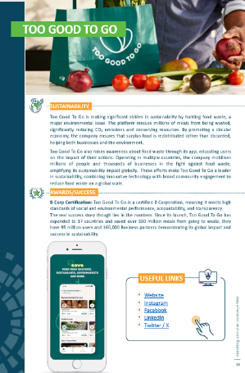
Be inspired…
Too Good To Go operates in several countries and has a strong focus on sustainability and community engagement. The company is part of a broader movement to promote a circular economy by turning potential waste into a valuable resource.
Through the app, users can purchase “Surprise Bags" of unsold food at a significantly reduced price, preventing it from being discarded.
Find out more in our Good Practice Compendium, or visit its website.

Slide 22
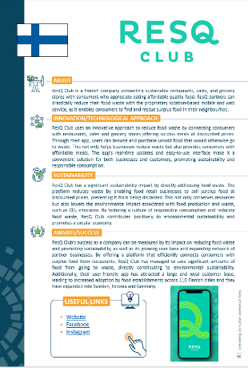
Be inspired…
ResQ Club uses an innovative approach to reduce food waste by connecting consumers with restaurants, cafes and grocery stores offering surplus meals at discounted prices.
The app's real-time updates and easy-to-use interface make it a convenient solution for both businesses and customers, promoting sustainability and responsible consumption.
Find out more in our Good Practice Compendium, or visit its website.

Slide 23

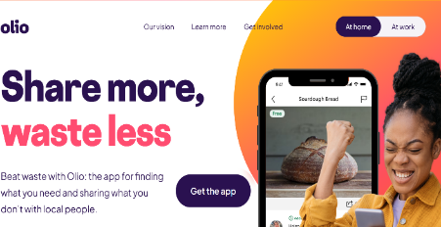
Examples of Digital Platforms for Food Sharing:
OLIO allows individuals and businesses to share food and other items they no longer need with people nearby. The platform promotes community connection and waste reduction and is particularly useful for redistributing food that is close to its expiration date.

Slide 24
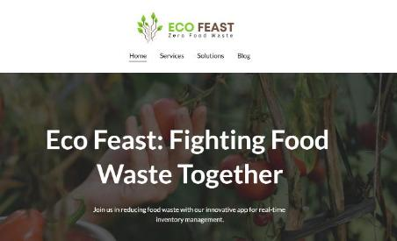

Examples of Digital Platforms for B2B Redristribution:
Foodiverse is a technology platform that directly connects food companies with community organizations to redistribute surplus food of good quality.
ECOFEAST is a digital platform developed to provide a sustainable solution to food waste. It facilitates the redistribution of surplus food from suppliers such as hotels, restaurants, and residential communities to NGOs and community volunteers who ensure that it reaches food-insecure populations.
Be inspired by Platform Get Wasted from surplus vegetables into soup for Antwerp schools.

Slide 25

QR codes provide instant access to information about a product, helping reduce waste by improving transparency and encouraging informed decisions.
QR Codes for Traceability and Consumer Awareness
Expiration and Storage Information
  QR codes provide clear guidance on proper storage and usage, reducing confusion over "best before" and "use by" dates.
Supply Chain Traceability
Improving traceability across the food supply chain.
Ensuring transparency in sourcing, production, and distribution.
3. Recipes and Tips
  Producing custom-designed food items for specialized diets.
  Reducing food waste by utilizing excess ingredients.

Slide 26

QR codes provide instant access to information about a product, helping reduce waste by improving transparency and encouraging informed decisions.
QR Codes for Traceability and Consumer Awareness
4. Combined Solutions
IoT + QR Codes
Smart packaging with IoT sensors tracks product freshness and updates QR code information dynamically for consumers
Digital Platforms + IoT
Redistribution platforms use IoT to track surplus food and optimise logistics for redistribution
IBM Food Trust and Walmart: Ensuring Food Safety and Transparency

Slide 27

Examples w QR Codes for Traceability and Consumer Awareness
Dynamic QR Codes adjust expiration dates or storage instructions based on real-time conditions, using IoT data.
Explore how dynamic QR codes are revolutionising payment solutions, improving security, and enhancing customer experience across industries like retail, hospitality etc.

Slide 28
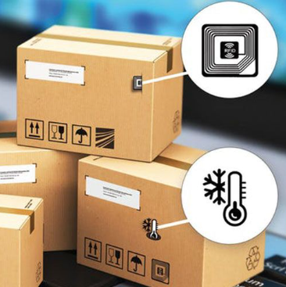
Examples w QR Codes for Traceability and Consumer Awareness
Smart packaging is revolutionising the way brands and customers interact. It integrates QR codes to provide freshness indicators or suggestions for optimal usage.
Explore the benefits and future potential of smart packaging here

Slide 29
Learners exercise
Task: Each group selects one digital solution from the presentation (e.g., IoT, QR codes, or digital food redistribution platforms like Too Good To Go).
Deliverable: Create a poster or infographic explaining how it works, its impact, and suggest improvements.
Extension: Invite learners to download and test one of the apps (e.g., OLIO, ResQ Club), then reflect on the experience in a short blog entry or video diary.

Slide 30
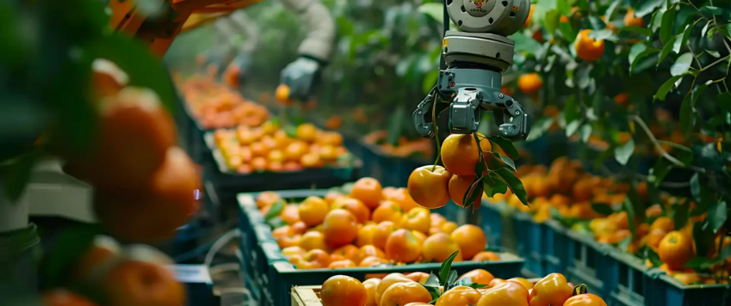
03
AI - AUTOMATION AND INTELLIGENT TECHNOLOGY FOOD PROCESSING

Slide 31

AI, Automation, and Smart Technology (Blockchain)
The integration of AI, Automation, and Blockchain in the food processing industry is revolutionising operations, enhancing efficiency, ensuring food safety, and meeting sustainability goals. These technologies are transforming the food processing industry by optimising processes, ensuring quality, and fostering transparency.
Their adoption helps businesses meet regulatory requirements, enhance consumer trust, and achieve sustainability goals, making them essential for the future of food processing.
An Advanced Inventory Management System Powered by IoT and AI for Real-Time Tracking and Optimization
Technologies for automating and optimizing food processing

Slide 32
AI in Food Processing
AI technologies analyse data, automate decision-making, and improve production efficiency in food processing...leading to:
Applications:
Quality Control: AI-powered image recognition systems detect defects in food products (e.g., discoloration, shape irregularities) on production lines. Eg: AI can identify spoiled produce in real-time, reducing further waste and ensuring high-quality output.
Predictive Maintenance: AI monitors machinery performance and predicts maintenance needs, reducing downtime and improving efficiency. Eg: Sensors collect data on temperature, vibration, and pressure to alert operators of potential failures.
Demand Forecasting: AI analyses market trends, weather patterns, and historical sales data to predict demand, optimizing production schedules and inventory management.
Recipe Optimisation: Machine learning models adjust recipes to improve nutritional content, flavour, or shelf life based on consumer preferences and regulatory requirements.
Increased production efficiency.
Reduction in waste and operational costs.
Enhanced food quality and safety.

Slide 33
Automation in Food Processing
Automation technologies streamline operations, reduce human intervention, and increase productivity...leading to:
Applications:
Robotics: Robotic arms automate repetitive tasks such as sorting, packaging, and palletising. Eg: High-speed robotic systems can package and label products faster than manual processes.
IoT-Enabled Sensors: IoT devices monitor conditions like temperature, humidity, and pressure during food processing and storage. Eg: Real-time monitoring ensures optimal conditions, preserving food quality.
End-to-End Automation: From raw material handling to final product packaging, automation creates seamless workflows, reducing errors and labour costs.
Enhanced production speed and accuracy
Lower labor costs and reduced human error
Consistent product quality & compliance with regulations.
How AI Is Transforming The Food Industry With Automation?

Slide 34

Blockchain in Food Processing
Blockchain technology provides transparency, traceability, and security in the food supply chain...leading to:
Applications:
Traceability: Blockchain records every step of the food production and supply chain, from farm to table. Eg: Consumers can scan QR codes on products to view details about sourcing, processing, and transportation.
Food Safety: Blockchain identifies contamination sources quickly during food recalls, minimizing health risks and financial losses.
Smart Contracts: Automates transactions between suppliers and buyers, ensuring payments are made only when agreed conditions are met. Eg: Blockchain-powered contracts in food supply chains ensure fair trade and timely payments.
Sustainability Certification: Tracks and verifies adherence to sustainability practices, such as organic farming or fair trade.
Enhanced trust and transparency
Improved compliance with safety regulations
Reduced fraud and food mislabeling.
EATABLE ADVENTURES: Startups and innovations like blockchain in food traceability.

Slide 35

Challenges & Opportunities
Challenges:
High initial investment costs for technology implementation.
Skill gaps among the workforce for managing and maintaining advanced systems.
Integration complexities with existing infrastructure.

Slide 36

Challenges & Opportunities
Opportunities:
Increasing consumer demand for transparency and sustainability creates a market for blockchain adoption.
AI and automation provide scalability to meet growing food demands while minimising waste.
Collaboration with technology providers and training institutions can address the skills gap.
Supports food security by redistributing surplus to those in need.

Slide 37
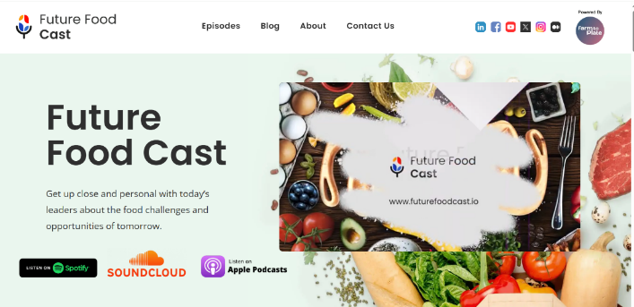
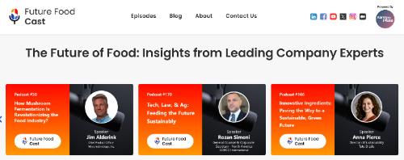
Among the topics explored:
Consumer interest in product origin
Product traceability adventures
Supply chain digitisation stories
Sustainability strategies and challenges
Food recall horror stories and mitigation strategies
Operational impact of increased regulations
E-commerce in the food industry.
Future Food Cast is a powered-by-Farm-to-Plate community and podcast that shares insights from Food & Beverage industry leaders worldwide about the future of food. Its Podcast series and Blogs gives listeners a huge serving of facts and insights into what’s going on with some of the latest trends in the food industry.

Slide 38
Learners exercise
Task: Imagine you are collaborating with a food tech startup, developing a new AI or blockchain solution for food processing.
Instructions:
- Define a problem/challenge that your Business experiences.
- Ideate on potential technological solutions.
- Highlight the benefits for sustainability and transparency.
Deliverable: 3-slide pitch deck

Slide 39

04
BIOTECHNOLOGY AND FOOD PRESERVATION

Slide 40

Biotechnology in Food Preservation
Biotechnology plays a pivotal role in food preservation by enhancing the safety, shelf life, and nutritional value of food products. It continues to revolutionise food preservation, providing safer, more sustainable, and more efficient ways to maintain food quality and reduce waste while meeting the growing demands of global populations. Modern biotechnological applications leverage microorganisms, enzymes, and genetic engineering to address challenges concerning food spoilage and preservation. Its role in waste reduction involves:
Prolonging Shelf-Life
Valorisation of
By-Products
  Biotechnological techniques reduce spoilage and waste in supply chains and households.
Biotechnology converts food waste into bio-based products like animal feed, biofuels, or bioplastics.

Slide 41
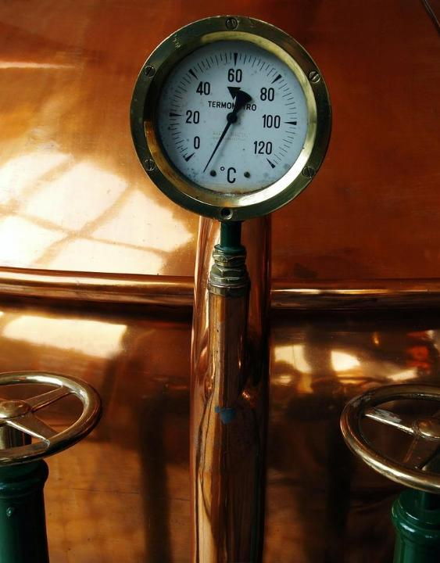
Key Biotechnological Applications in Food Preservation
Fermentation Technology
Microbial Fermentation:
Uses beneficial microorganisms (e.g., lactic acid bacteria, yeast) to preserve food through natural processes.
Eg: Sauerkraut, yogurt, kimchi, and pickles.
Extends shelf life by lowering pH and preventing the growth of spoilage organisms.
Is fermentation the secret weapon in a shifting food landscape?

Slide 42
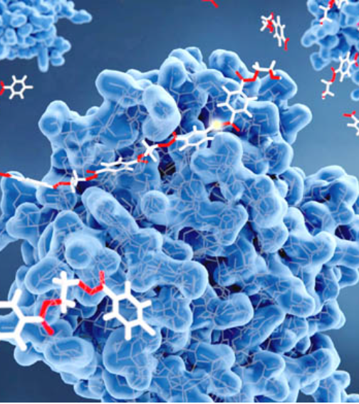
Key Biotechnological Applications in Food Preservation
Enzyme Applications
Natural Preservation:
Enzymes like lysozyme are used to inhibit bacterial growth in dairy and meat products.
Proteases and lipases improve food texture and prevent spoilage.
Shelf-Life Extension:
Enzymatic browning inhibitors (e.g., polyphenol oxidase blockers) preserve fruits and vegetables.

Slide 43

Key Biotechnological Applications in Food Preservation
Genetic Engineering
GMO Crops:
Genetic modifications in crop growth, improve resistance to pests, spoilage, and environmental stress.
Eg: Tomatoes engineered for delayed ripening (Flavr Savr tomatoes) to reduce waste.
Biosensors:
Detect microbial contamination or spoilage in real-time, enhancing food safety.

Slide 44
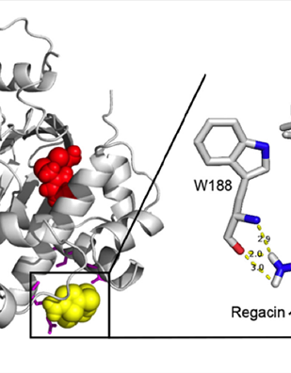
Key Biotechnological Applications in Food Preservation
Antimicrobial Agents
Natural Biopreservatives:
Compounds like bacteriocins (e.g., nisin) produced by microbes inhibit pathogens and spoilage organisms in dairy and meat products.
Plant-derived antimicrobials, such as essential oils, also provide natural preservation options.

Slide 45
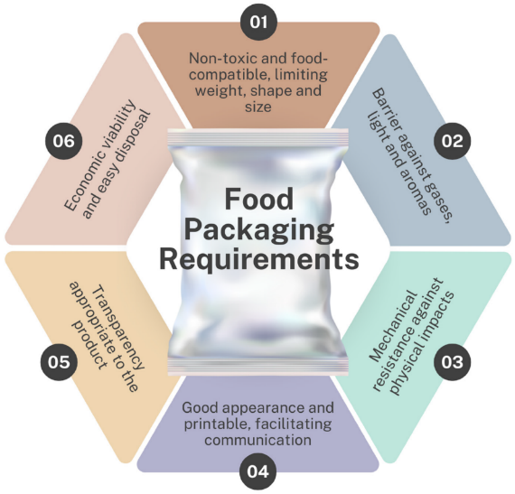
Biotechnological Advances for Food Packaging
Food packaging is a material or system used for the protection, containment, transportation, storage, and/or final use of semi-finished or finished food products. These materials play a fundamental role in guaranteeing that products reach the end consumer in good quality, ensuring protection against physical, chemical, and biological factors, such as light, humidity, and the presence of microorganisms, in addition to controlling the internal atmosphere, thus slowing down processes such as oxidation and giving the product a longer shelf life.

Slide 46
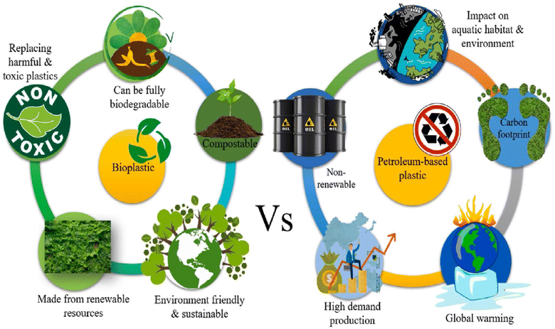
Biotechnological Advances for Food Packaging

Slide 47
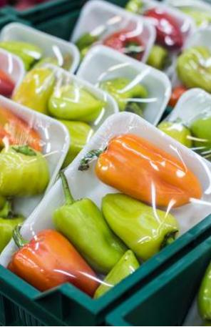
Biotechnological Advances for Food Packaging
Active Packaging:
Incorporates antimicrobial agents or oxygen scavengers to inhibit spoilage.
Edible Coatings:
Biodegradable films are enriched with bio-preservatives to prolong freshness.
Eg: Coatings for fruits that delay ripening and reduce water loss.
Smart Packaging:
Biosensors embedded in packaging to monitor freshness, pH, or microbial contamination.

Slide 48
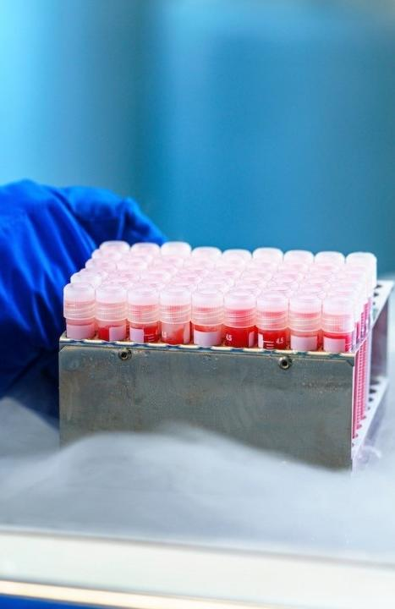
Biotechnology and Cold Chain Preservation
Cryoprotectants:
  Use biotechnological solutions like trehalose to protect frozen food from structural and flavour changes during freezing and thawing.
Modified Atmosphere Storage:
  Adjusting gas composition in storage environments is used to inhibit microbial growth and slow enzymatic processes.

Slide 49


.
From minimalistic designs to futuristic materials, sustainable packaging trends in 2025 are explored in this blog. Here’s everything you need to know to stay ahead in the world of eco-conscious packaging.

Slide 50
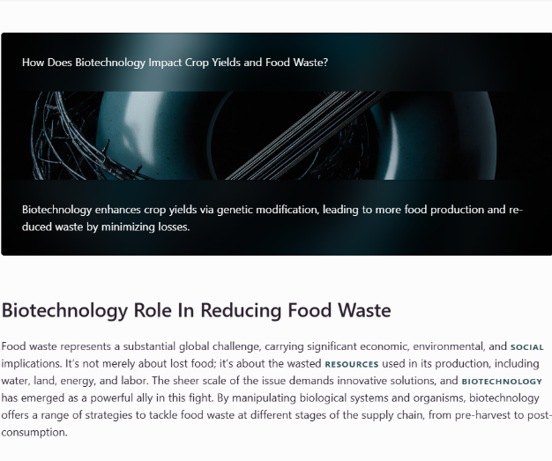
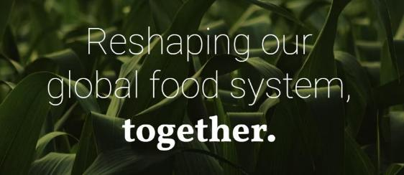
For further reading, check out the
Sustainability Directory
to learn more about the decrease in post-harvest losses and increased efficiency in resource utilisation due to biotechnology.

Slide 51
Learners exercise
Task: Organise a panel discussion where students assume roles (biotech scientist, consumer advocate, environmentalist, policymaker).
Topic: “Should genetically modified organisms be used to prevent food waste?”
Goal: Debate the ethical implications and present arguments from each perspective

Slide 52
Future Directions of Biotechnology & Food preservation
Biotechnology has succeeded in improving the taste, freshness, and safety of food, and led to crops that are more resistant to diseases with prolonged shelf-life. However, it may threaten the disappearance of natural species and even lead to potential impacts on human health due to food modifications. Some of its FUTURE OPPORTUNITIES are:
Probiotic Preservation
Nano
Biotechnology
Synthetic Biology
Incorporating probiotics into food systems to enhance both preservation and health benefits.
Using nanoscale materials for antimicrobial coatings and smart packaging.
  Engineering microbes to produce novel preservatives or extend shelf life.

Slide 53
Learners exercise
Reflection and Assessment
Activity: Personal Innovation Log
Each learner keeps a journal throughout the module noting:
  - What innovation impressed them most and why
  - One idea they would implement in their business or community to reduce food waste
  - How their views on food technology evolved

Slide 54
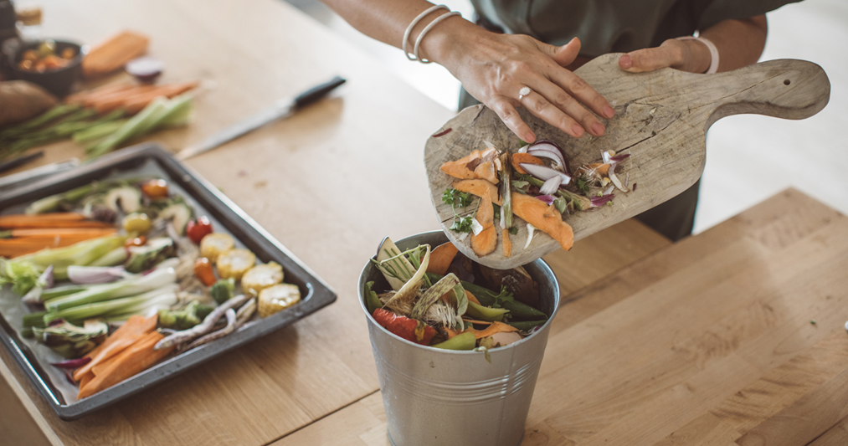
A LITTLE PROGRESS EACH DAY ADDS UP TO BIG RESULTS

Slide 55
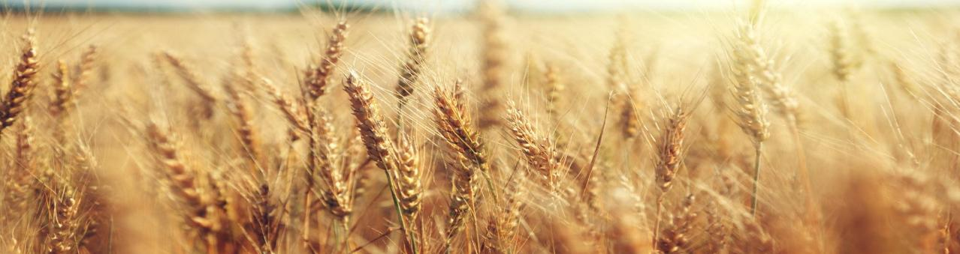
Follow our journey
li
in
yt
www.waste2worth.eu

