Slide 1
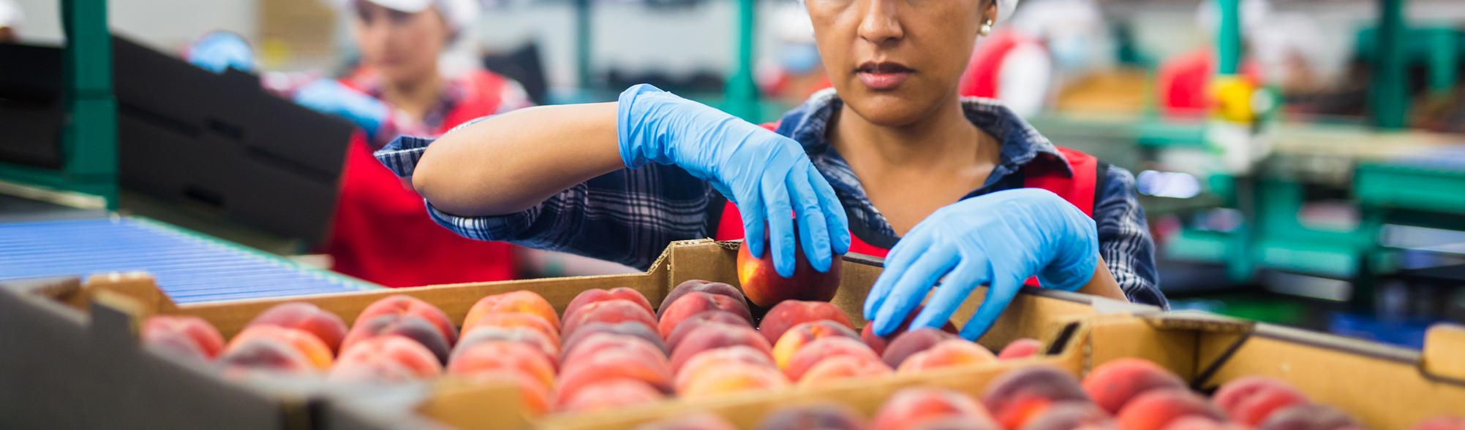
MODULE 7
OPTIMISING PRODUCTION PROCESSES

Slide 2
CONTENTS
01
Concept and definition
This module focuses on the concept of optimisation and how it can be applied to the food sector in order to prevent and manage waste. Optimisation strategies are fundamental to address waste at all stages.
This module will explore a conceptual framework, revising key concepts and addressing in a visually engaging way, how a business can optimise their processes to become more efficient.
02
Optimisation Processes
03
Strategies for optimisation
04
Self-Assessment

Slide 3
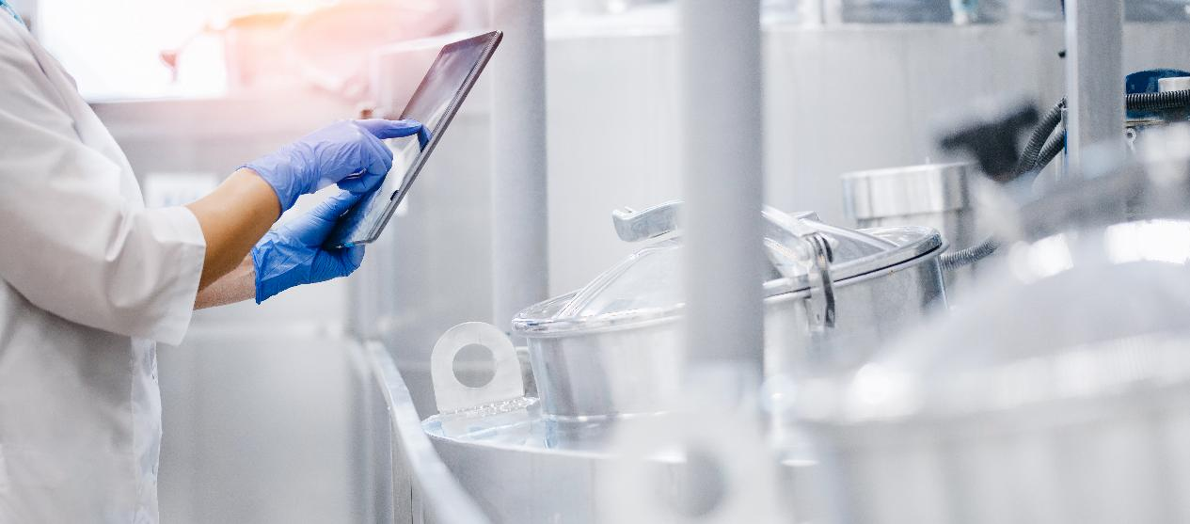
01
CONCEPT & DEFINITION

Slide 4

Optimisation
Optimisation means making something work at its best. In food production, it involves improving how tasks and processes are carried out, including the systems that support them.
The aim is to raise production standards—both in terms of quality and quantity. How successful this often depends on how well different activities are coordinated.

Slide 5
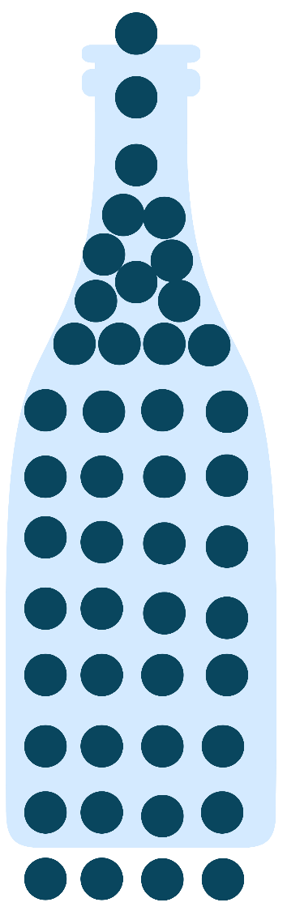


Identifying the Bottleneck
A bottleneck is referred to that process in the chain production whose limited capacity reduces the capacity of the whole chain (Grznar et. Al, 2019). Bottlenecks are normal, as no system is perfect. However, minimising the impact that bottlenecks have in the final performance is fundamental. Otherwise, the final product would never reflect the resources invested:
Chain production
Bottleneck
Production Operation
Output
Input

Slide 6
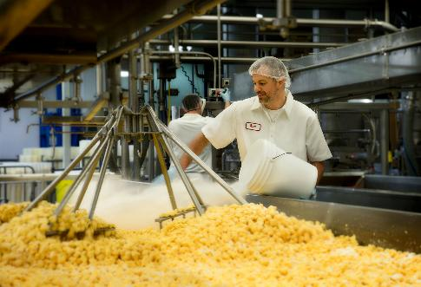
Waste Management Systems
In a food business, waste can slow things down and cost money. That’s why many small producers use waste management systems to spot problems (bottlenecks) and find better ways to handle waste.
These systems can help reduce the amount of unused ingredients or turn leftover materials into something valuable.
A big part of this is knowing your waste stream—that’s the full path your waste takes, from where it starts to where it ends up. By understanding this, you can make smarter decisions, cut costs, and run your production more efficiently.
Mapping the waste stream
Measuring waste weight
Identification of the causes of waste
Analysis and conclusion on actions to be taken
Implementation
Monitoring and mapping future waste streams

Slide 7




Understanding your Waste Stream
Understanding your Waste Stream is fundamental, because it allows you to identify opportunities to reduce costs, improve resource efficiency, minimise environmental impact, and uncover potential for reuse or valorisation.
Measuring waste weight
Analysis & conclusion on actions to be taken
Mapping the waste stream
Monitoring & mapping future waste streams
Identify the causes of waste
Implementation

Slide 8
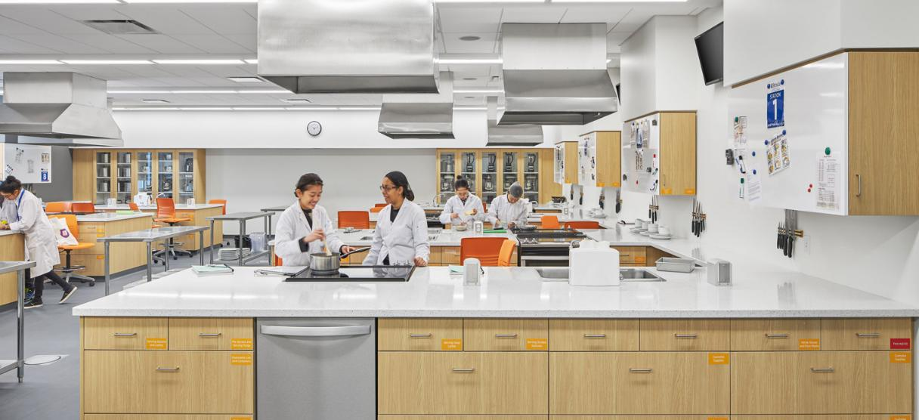
02
OPTIMISATION PROCESSES

Slide 9
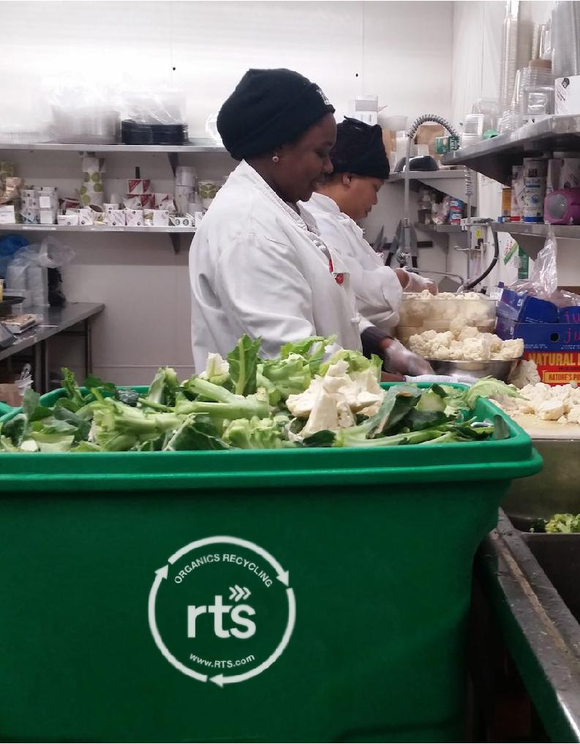
Why does waste occur?
The process of maximising output development requires concrete strategies, but it is fundamental to engage in process optimisation for sustainable and efficient food management, avoiding waste and delivering a more effective input performance.
It is important first to address where and how waste occurs, so the solutions implemented are based under their specific and tailored cases. Most of inefficiencies occur in critical phases (Dewi et.al, 2021):

Slide 10
Why does waste occur?
Storage
Improper temperature control
Lack of organisation
Failure to track expiration dates
Procurement
Inaccurate demand forecasting
Non-planned bulk forecasting
Supplier-driven overordering
Preparation
Excessive trimming
Overproduction
Inconsistent portioning
Failure to align/manage purchased items correctly
Failure to adjust production with consumption
Failure to align purchases with consumption
Older items being forgotten and discarded
Fresh produced products not consumed
Unused products
Waste

Slide 11
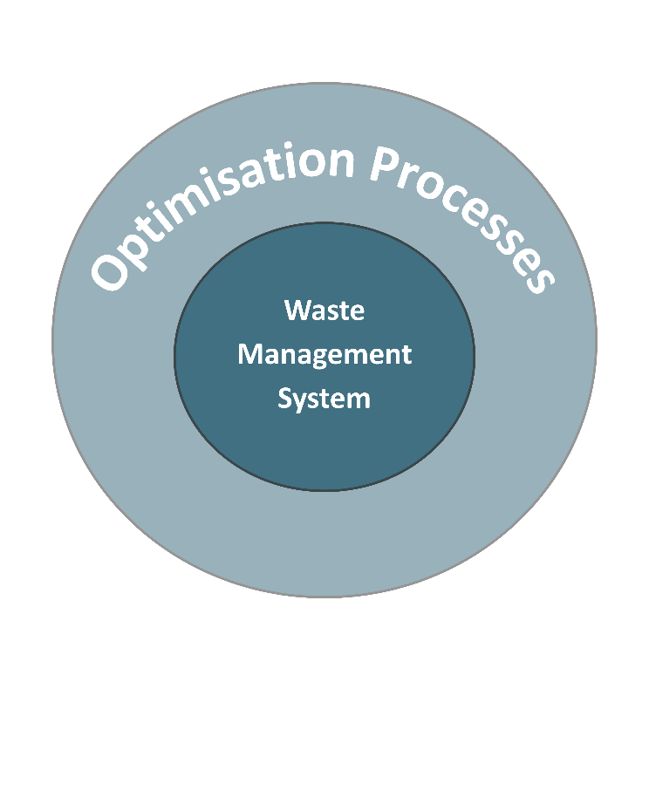
Optimisation process vs Waste Management System
Waste management focuses on tracking and handling waste through defined systems and steps (the waste stream), often used in technical contexts.
Optimisation, on the other hand, is a broader, more flexible approach that can be applied in various situations to improve overall efficiency.
Optimisation provides the foundation for more adaptable waste strategies, while waste management is better for specific, technical waste challenges. Understanding both helps food SMEs plan effectively and reduce waste in practical, manageable ways.
Title Two
Title Four
Click to type
Title Four
Click to type
Click to type
Notes:
Link for translation: https://www.canva.com/design/DAGgN4sssJ0/O2KWmcIH0_7bkzgFbaYQbQ/edit?utm_content=DAGgN4sssJ0&utm_campaign=designshare&utm_medium=link2&utm_source=sharebutton

Slide 12
Optimisation process – General Steps
Definition and Data collection
If we're unsure where waste occurs, we must first collect data to identify it. In all cases, understanding the problem, system, and current performance is key to assigning the right specialist to manage the process.
The first step in optimisation is identifying what needs improvement. Once we know where waste occurs, we must collect and analyse data to understand each part's function.
Click to type
Selecting a Method
Title Two
Duration: Set a clear timeframe—delays undermine optimisation.
KPIs: Define ‘SMART’ goals to track progress.
Risk & Control: Identify potential risks and outline how they’ll be managed.
Optimisation methods vary by company, so each business should develop its own plan based on the following general guidelines:
Title Four
Click to type
Click to type
Click to type
Title Four
Click to type
Click to type

Slide 13
Optimisation process – General Steps
Implementing actions
While economic impact is common, actions may also target quality or wellbeing. Regardless, they must aim at optimisation—whether through cost-saving, investing in machinery, hiring or replacing staff, developing new products, or cutting inefficient ones. All actions begin here.
Once the plan and team are in place, actions should begin—often focusing on economically improving waste management and reducing bottlenecks..
Click to type
Ongoing observation
Most KPIs and goals, ensure actions align with timelines, indicators, and risk management. Technical checks and data evaluations are essential to confirm that real change is occurring.
During optimisation, observation and close communication among the team are key, serving as the most direct form of monitoring.
Click to type
Title Four
Click to type
Click to type

Slide 14

03
STRATEGIES FOR OPTIMISATION
This Photo by Unknown Author is licensed under CC BY-SA-NC

Slide 15
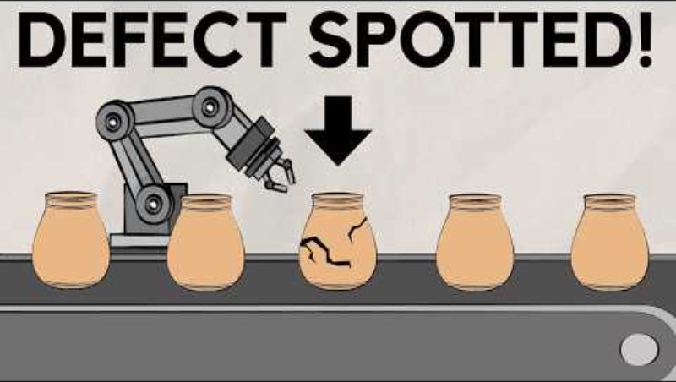
Manufacturing industry Overview – Optimisation
This video explores and explains operational optimisation strategies, focusing on methodologies such as Lean, Six Sigma, Total Quality Management…, tailored to improved efficiency and reduced waste, including supply chain optimisation, process improvements and real-world examples

Slide 16
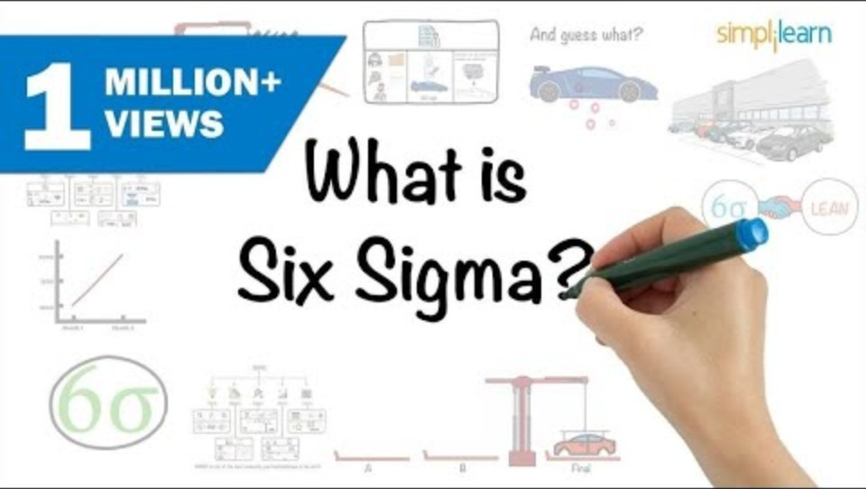
What is Six Sigma?
This 8-minute video explains the concept behind the optimisation strategy Six Sigma.
Six Sigma is a data-driven methodology that aims to reduce variation and eliminate defects, including waste in any processing process.
Applied to the food business, Six Sigma is described as an efficient method that enhances quality performance

Slide 17
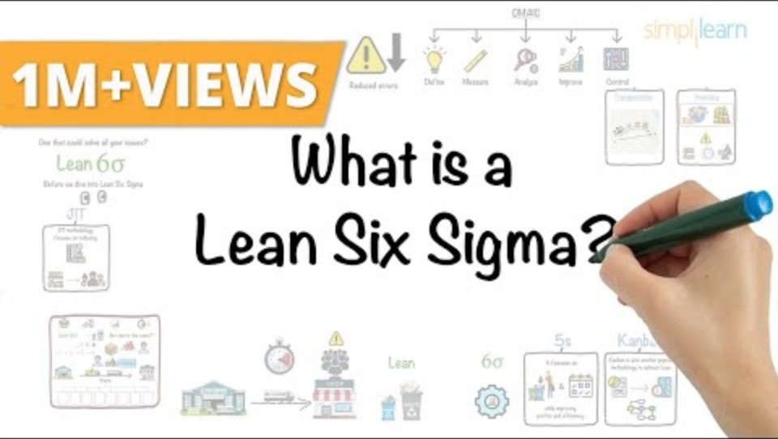
What is Lean Six Sigma?
This video is a variation of the Six Sigma optimisation process that can be better applied to food businesses in order to tackle waste.
This is because the Lean Six Sigma methodology focuses specifically on eliminating waste and improving flow in production processes.

Slide 18



Optimisation Strategies
Stock
Space utilisation: Maximising space through vertical storage, dynamic racking, cross-docking, etc.
Periodic stock checks: Weekly for perishable items, monthly for raw materials, quarterly for all stock. Daily updates as well
First in first out: Older items should be given priority over new ones
Procurement
Production
Strategic partnerships: Long term relationships may lead to better conditions, such as discounts
Forecast demand: Using AI and specialised tools/knowledge to forecast demand, aligining it with the planned purchase
Adjust batch timing: Minimise leftover stock and ensure freshness.
Monitor demand: Align production with working schedules and actual demand
Optimisation mindset: Foster an internal culture of continuous improvement

Slide 19
Procurement | Stock | Production
Sourcing local suppliers AI Data analytics to predict demand | First in, first out Centralised storage, facilitating stock monitoring | Recycling and reusing non manufactured items. Standardising packaging
Sourcing local suppliers Bulk purchasing, based on previous/usual demand | Reduced perishable sock, increasing non-perishable stock Leftovers reused in production | Batch cooking Creation of marketing strategies for non consumed goods (special plates, organic)
Monitoring non-perishable suppliers, switching when better deals arise Bulk purchasing | First in first out Adjusting stock allocation to demand | Discounts for ‘about to expire’ Fresh ingredients offered based under demand Energy optimisation in fresh ingredients
Weekly meals preparation Increase non-perishables shopping Seasonal and local ingredients | First in first out Labelling-expiring dates Increase freezing food | Repurposing leftovers Portion control Energy control and efficiency
Food processing
Restaurants
Supermarkets
Households
Notes:
Solutions.
1 – c
2 – a
3 - c

Slide 20

04
SELF-ASSESSMENT

Slide 21
LEARNER’S
EXERCISE
Think about a food product and reflect on the waste stream, according to the following prompts:
Business process
Types of waste
Is it avoidable?
Disposal/Reuse method
For example:
Product: Cheese
Business process: Curd Cutting
Types of waste: Whey loss, curd fines in whey
Is it avoidable? Yes
Disposal/Reuse method: Use for animal feed

Slide 22
Where do most food waste inefficiencies occur?
Marketing, customer service and delivery
Procurement, storage and production
Procurement, storage and preparation
Which of the following is a common mistake in procurement?
Buying before ordering
Checking inventory before ordering
Overordering due to poor forecasting
How does food preparation contribute to waste?
Portion control
Using all edible parts of ingredients
Overproduction
LEARNER’S
EXERCISE
Notes:
Solutions.
1 – c
2 – a
3 - c

Slide 23
In the given situation:
‘A restaurant is experiencing high levels of food waste. The owner notices that the ingredients often go bad before they are consumed, and that many times they are overprepared, leading to the storage area frequently being disorganised.’
Where do you think the main bottleneck is? Choose the most likely:
Ordering too much food without forecasting demand
Organising poorly, failing to track expiration dates
Overportioning in final dishes
LEARNER’S
EXERCISE
Notes:
Solutions.
1 – c
2 – a
3 - c

Slide 24
LEARNER’S
EXERCISE
Action Plan
Create a simple action plan to reduce food waste and optimise production at your workplace, based on the concept of procurement storage and production, observed before:
How can you ensure that you are procuring the right amount?
What changes can you make in the storage process?
How can you optimise production?

Slide 25
Final remarks
This module provides insights and relevant information about Optimisation and key strategies and concepts for increasing efficiency. Crucial concepts such as Bottlenecks, Waste Management Systems, Optimisation Methodologies and Strategies were addressed and explained, using hands-on examples and how can be applied in real life.
Optimisation must be developed specifically to each concrete case, as each business and system has its own particularities. However, approaching optimisation can be done following several general steps, that can be further reshaped according to the concrete case is applied.

Slide 26
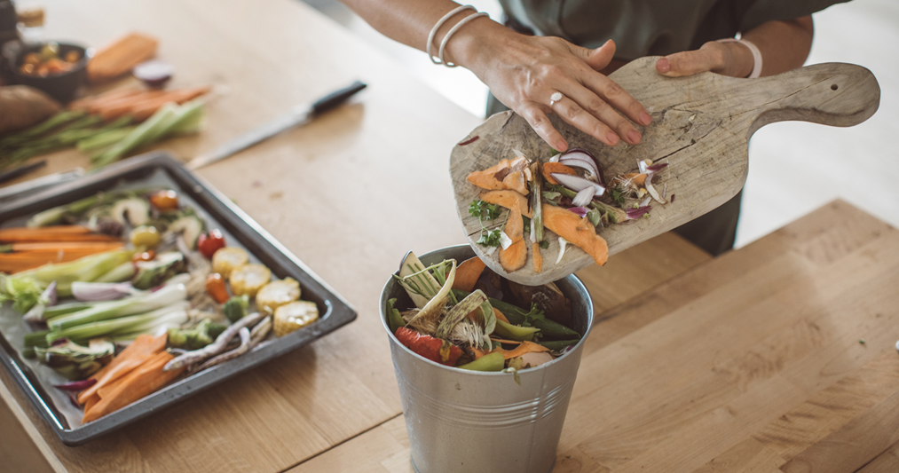
A LITTLE PROGRESS EACH DAY ADDS UP TO BIG RESULTS

Slide 27

Follow our journey
li
in
yt
www.waste2worth.eu

