Slide 1
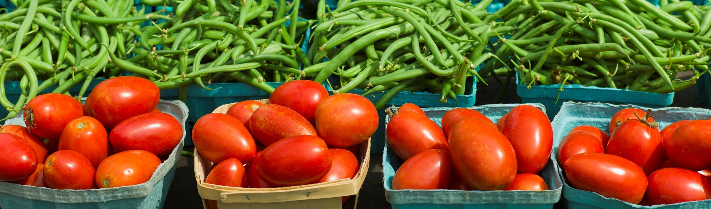
MODULE 6
REDIRECTING FOOD SURPLUS
PP

Slide 2
CONTENTS
01
What is Surplus Food?
This module aims to help learners understand the concept of food surplus, its types, causes, and its significant role in contributing to food waste. It explores practical strategies and innovative initiatives for redirecting surplus food within the food system, aligned with circular economy principles. Learners will gain insights into the environmental and social benefits of surplus redistribution, while also examining the challenges posed by food regulations.
02
Initiatives for the Reduction of Food Surplus
03
Climate Change and Challenges
04
Disadvantages of strict food standard regulations

Slide 3
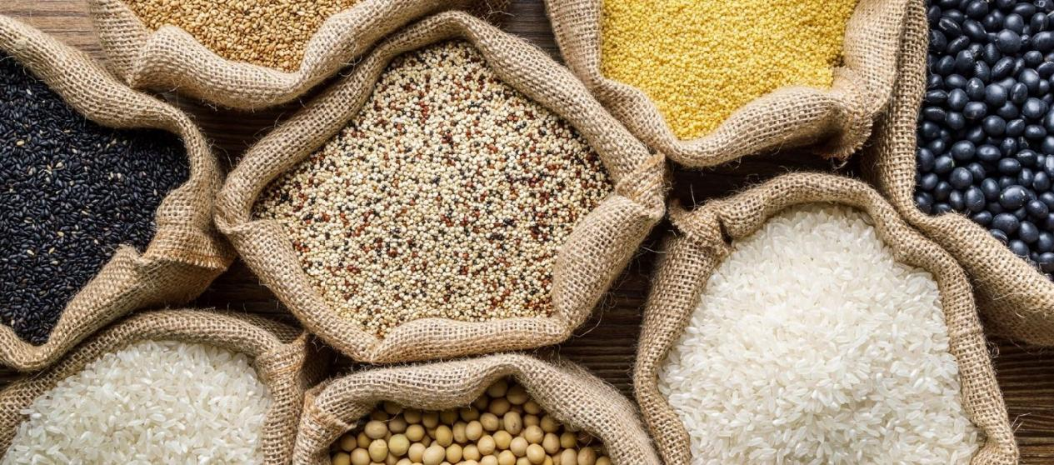


01
What is Surplus Food?

Slide 4
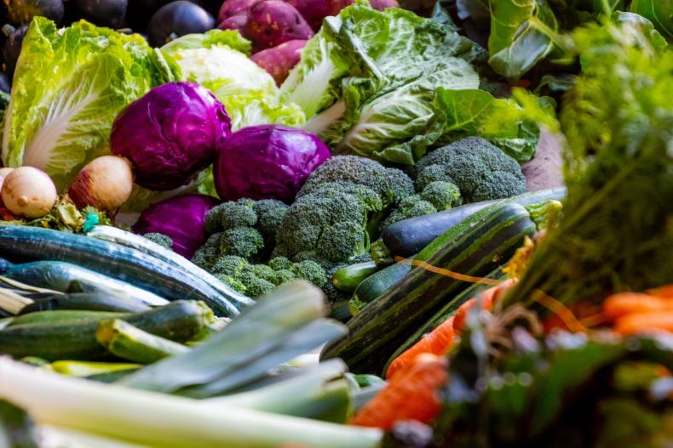
Definition of Food Surplus
Food surplus refers to edible food that is produced, harvested, or prepared but is not consumed for various reasons. It typically includes excess food generated throughout the supply chain, from production and processing to retail and consumption
While food surplus is still fit for consumption, it often goes to waste unless redirected or repurposed.
Tackling this waste is a key strategy for the prevention and reuse of food for human consumption. Proper management of these surpluses is crucial to reducing food waste and promoting sustainability in the food system.

Slide 5
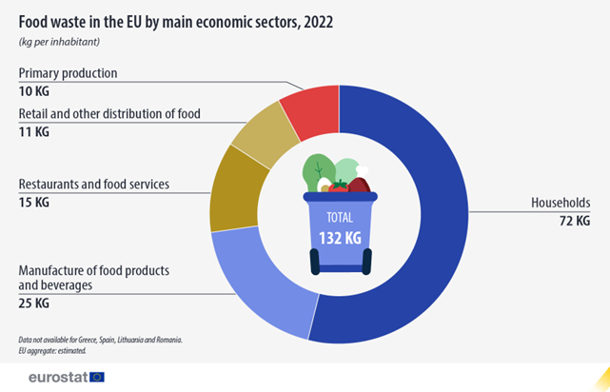

Data on Surplus Food
In 2022, around 132 kg of food per inhabitant was wasted in the EU. In total, the EU generated 59.2 million tonnes of food waste, which includes edible and inedible parts.
Household waste accounted for 54% of all food waste, the equivalent of 72 kg per inhabitant. The remaining 46% was waste generated upwards in the food supply chain: 19% by the manufacture of food products and beverages (25 kg per inhabitant), 11% by restaurants and food services (15 kg per inhabitant), 8% in the retail and other distribution of food (11 kg per inhabitant), and 8% in the primary production (10 kg per inhabitant).
More info on ec.europa.eu/

Slide 6
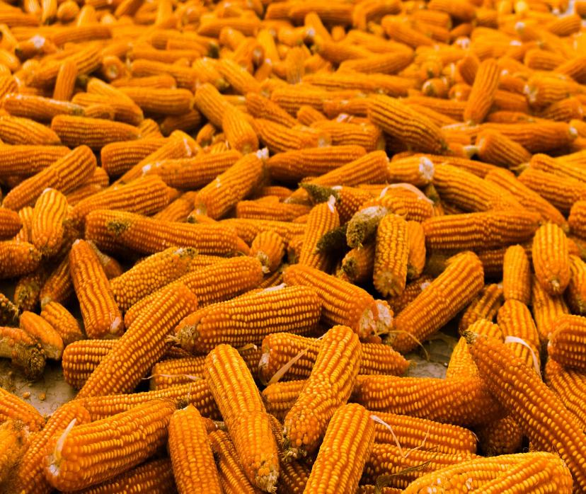
Types of food surplus
Agricultural Surplus
  Crops produced on farms that exceed market demand or cannot be sold due to imperfections or overproduction.
  Includes: Fruits, vegetables, or grains left unharvested or discarded due to size, shape, or quality standards.
  Due to:
Overproduction
Market price drops making harvesting unprofitable
Weather-related oversupply.

Slide 7
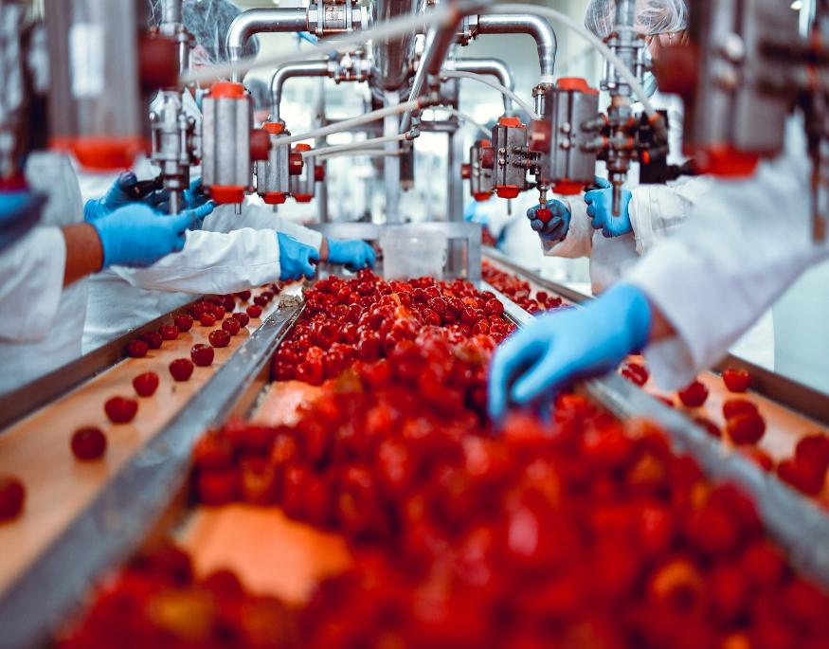
Types of food surplus
Processing Surplus
Food that remains after production or processing, often due to inefficiencies or overproduction.
Includes: Offcuts, surplus dough, or by-products like whey in cheese production.
Due to:
Inefficient production lines/practices
Overestimated consumer demand.

Slide 8
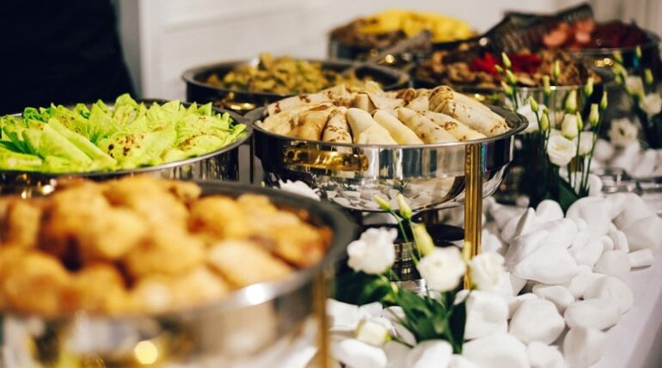
Types of surplus
Hospitality and Food Service Surplus
  Unused or leftover food from restaurants, hotels, or catering services.
  Includes: Buffets, over-prepared meals, or unsold portions.
  Due to:
Overestimation of customer demand
Strict food safety regulations limiting redistribution.

Slide 9
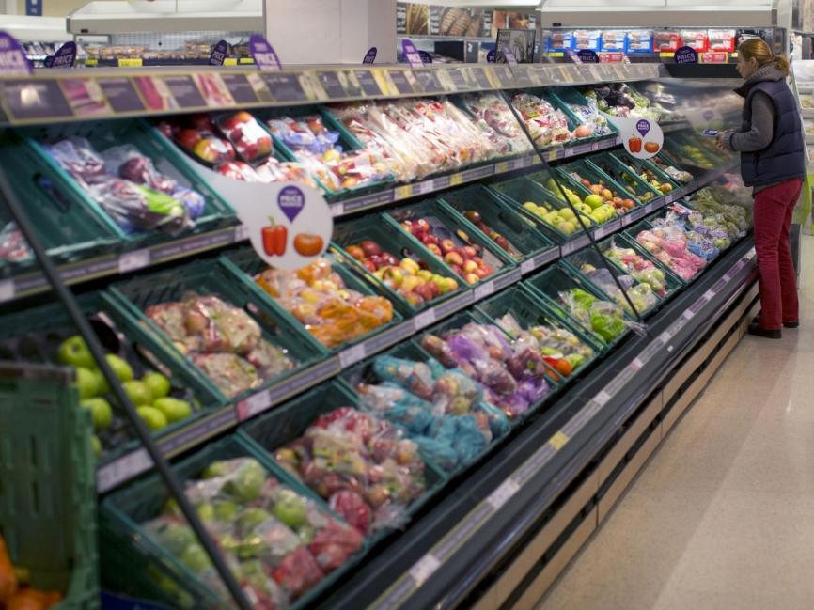
Types of surplus
Retail and Distribution Surplus
Edible food left unsold in supermarkets, grocery stores, or warehouses.
Includes: Bread nearing expiry, fresh produce with cosmetic imperfections, or excess seasonal products.
Due to:
Overordering by retailers
Stock mis-management
Consumer preferences for aesthetically perfect products.

Slide 10
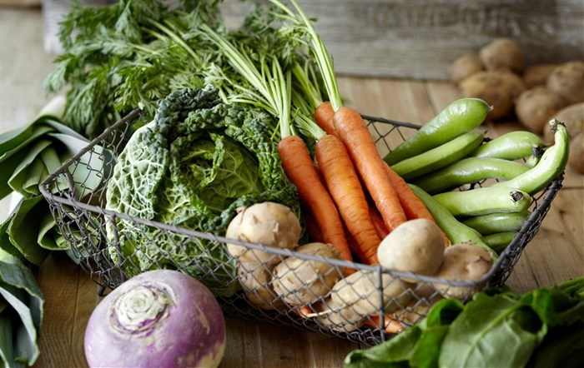
Types of surplus
Household Surplus
  Food purchased but not consumed by individuals or families.
  Includes: Expired products, leftovers, or ingredients bought in bulk.
  Due to:
Poor meal-planning
Misunderstanding of expiry labels
(e.g., "best before" vs. "use by").

Slide 11

Reflection exercise:
Q1. Which of the following is not a type of food surplus?
A. Agricultural Surplus
B. Processing Surplus
C. Educational Surplus
D. Hospitality and Food Service Surplus
Q2. What percentage of food waste in the EU was attributed to households in 2022?
A. 25%
B. 54%
C. 11%
D. 8%

Slide 12
Reflection exercise:
Match the food surplus type with its primary cause:
Surplus Type | Causes
A. Agricultural Surplus | 1. Over-purchasing, poor label understanding
B. Processing Surplus | 2. Cosmetic standards, overstocking
C. Hospitality Surplus | 3. Inefficient production, forecast errors
D. Retail Surplus | 4. Leftovers from restaurants and buffets
E. Household Surplus | 5. Overproduction, price drops

Slide 13

02
Initiatives for the reduction of food surpluses

Slide 14






Different initiatives for the reduction of food surpluses
Redistribution of Food Surplus
Federación Española de Bancos de Alimentos (FESBAL): A nationwide network of food banks in Spain that redistributes surplus food from supermarkets, restaurants, and producers to those in need.
Rexcatering is a comprehensive project focused on the recovery of surplus food from central kitchens and collective canteens.
Food Sharing Platforms
OLIO A global app that allows individuals and businesses to share surplus food for free.
Yo No Desperdicio (I Don’t Waste): A Spanish initiative encouraging individuals to share excess food locally.
Partnerships with Supermarkets and Restaurants
Eroski (Basque Country) A supermarket chain in the Basque Country that implements food waste reduction strategies
Mercadona collaborates with food banks and NGOs to ensure surplus food is donated rather than discarded.

Slide 15



Different initiatives for the reduction of food surpluses
Educational Campaigns and Awareness Raising
“La Alimentación No Tiene Desperdicio” (Food Is Not to Be Wasted): A campaign by AECOC (Spanish Association of Manufacturers and Distributors) that promotes responsible food consumption among households and businesses.
Policy and Legislation
Ley de Prevención de Pérdidas y Desperdicio Alimentario (Food Loss and Waste Prevention Law): Enacted in Spain, this law mandates businesses to donate surplus food and implement measures to minimize waste.
Research and Innovation
AI-driven inventory systems and apps help businesses predict demand more accurately, reducing overproduction and waste:
Wasteless AI pricing platform for supermarkets; Dynamically adjusts prices based on expiry dates.
FoodCloud & KPMG AI Labs Irish nonprofit using AI to match surplus food with charities; AI engine recommends best routes and timelines

Slide 16

Different initiatives for the reduction of food surpluses
Circular Economy Approaches
Composting and Recycling: Food waste unsuitable for consumption is often redirected for animal feed, re-pruposed into non-edible products, composting or biogas production, promoting circular economy practices as featured in our Good Practice Compendium.
Social Enterprises: Organisations like Espigoladors in Catalonia collect surplus food directly from farms and redistribute it to communities or process it into new products.
Consumer Awareness
Date Labeling Education: Initiatives aimed at educating consumers about the difference between "best before" and "use by" dates to reduce unnecessary waste.
Workshops and Events
VET centers and NGOs regularly organize workshops to raise awareness about food surplus and provide practical tips for sustainable consumption.
European Commission – Date Marking Explanation
Feedback Global – Awareness Campaigns
Food Waste & Education
FAO’s “Do Good: Save Food!” Toolkit: Tailored for schools and youth groups.
EPA’s Food Too Good To Waste: Free curriculum and community templates.

Slide 17
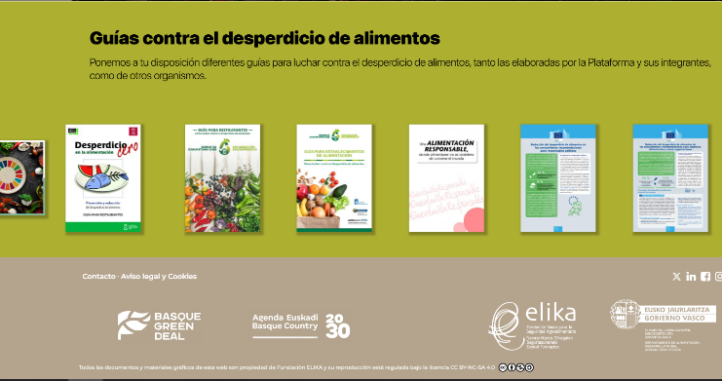
Be inspired…
The ELIKA No Desperdicio program, also known as Zerodespilfarro, is an initiative promoted by ELIKA Fundazioa in collaboration with the Basque Government. Its main objective is to combat food waste in the Basque Country by promoting a more sustainable and efficient food system.
The strategy is based on the 4R principle: Reduce, Reuse, Redistribute, and Revalue food surpluses. This involves acting at all stages of the agri-food chain, from production to final consumption, involving all actors in the Basque food system.

Slide 18

Be inspired…
The Recircular platform offers a space where different companies can register and upload their surplus for free. Using artificial intelligence, it analyses available resources and automatically identifies opportunities for reuse and recycling, notifying companies that could benefit from them.
In addition, companies generate economic savings and environmental and social benefits.

Slide 19

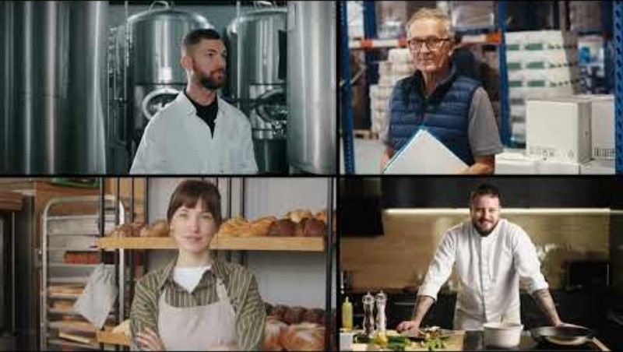
Be inspired…
Plan B is an innovative initiative launched by the Federación Española de Bancos de Alimentos (FESBAL) to enhance the efficiency of food banks across Spain. This project aims to modernise food donation processes, improve the management of surplus food, and ensure that aid reaches those in need more effectively.
Lanzamiento PLANB - YouTube

Slide 20

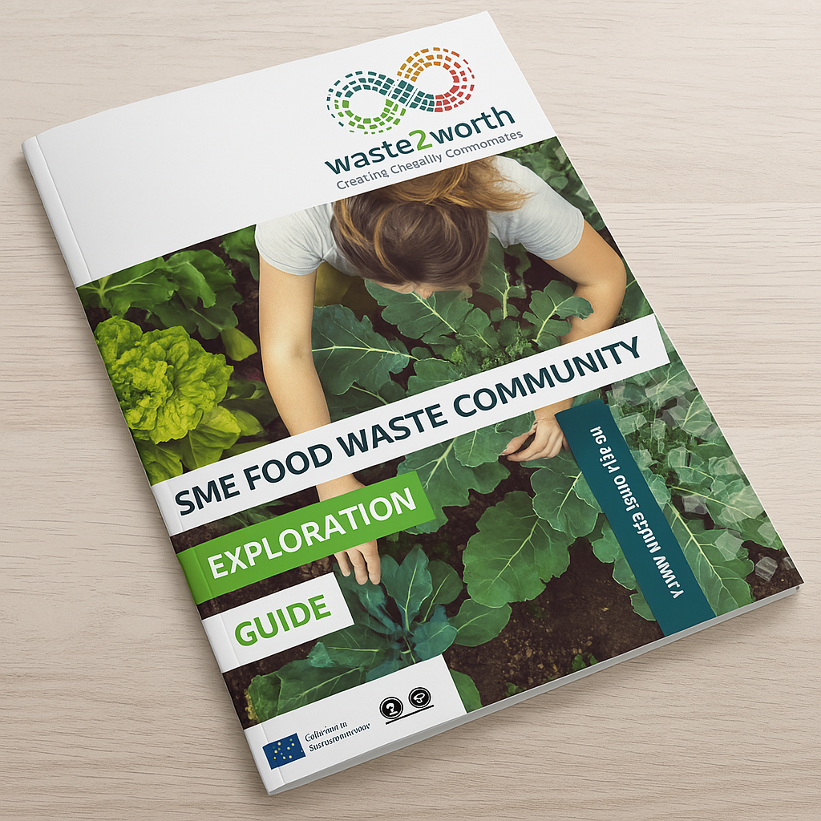
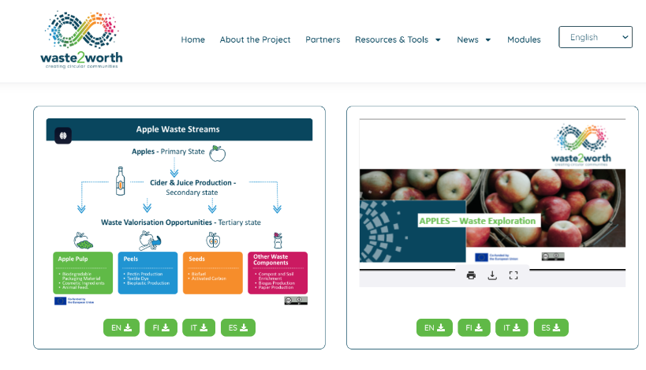
Be Inspired…
Check out the Waste2Worth website to discover the SME Food Waste Exploration Guide and Regional Community maps…designed to build awareness and motivation in the benefits of circular communities

Slide 21
Reflection exercise:
What kind of initiative would you propose to avoid or reduce food surpluses throughout the food chain?

Slide 22

02
Climate Change and Challenges

Slide 23
  Climate change significantly affects food production, distribution, and surplus management, leading to numerous challenges from which the main three are:
Reduced Agricultural
Productivity
Food Distribution
Challenges
Environmental Costs
Extreme Weather Events: Droughts, floods, and heatwaves disrupt crop yields and livestock production, leading to imbalances in food availability and surplus.
Unpredictable Growing Seasons: Shifts in climate patterns affect planting and harvesting schedules, increasing food waste due to mismatches in supply and demand.
Supply Chain Disruptions: Extreme weather damages infrastructure, making it harder to transport surplus food to where it is needed.
Storage Issues: High temperatures and humidity reduce the shelf life of food, increasing waste, especially in regions lacking cold storage facilities.
Increased Emissions: Surplus food that goes to waste contributes to greenhouse gas emissions during decomposition in landfills.
Resource Waste: Producing surplus food that is wasted, consumes water, energy, and land unnecessarily, exacerbating environmental degradation.

Slide 24
Challenges of Managing Food Surplus
Inadequate systems for collecting, storing, and redistributing surplus food lead to high levels of waste, particularly in perishable goods.
.
Lack of Infrastructure
Managing food surplus presents a unique set of challenges that span logistical, economic, regulatory, and behavioural dimensions. While surplus food holds significant potential for reducing food insecurity and environmental impact, effective handling requires coordinated action across the supply chain.
Banner
Infographic
Regulatory Barriers
Food safety regulations can restrict the donation and redistribution of surplus food, even if it is still consumable.
Misinformation about "best before" vs. "use by" dates contributes to food being discarded prematurely.
Over-purchasing habits exacerbate household food waste.
Consumer Behaviour
Food surpluses in wealthy countries often coexist with food scarcity in low-income regions, highlighting inefficiencies in global food systems
Global Inequities

Slide 25
Addressing the Challenges
Climate change exacerbates food surplus challenges by disrupting production and distribution systems, yet innovative policies, technologies, and community actions can mitigate these impacts. By addressing these challenges, we can reduce waste, enhance sustainability, and ensure equitable food distribution globally.
Policies and Legislation
Technology and Innovation
Incentives for Food Donations:
  Encourage businesses to donate surplus food through tax breaks or reduced disposal fees.
Waste Reduction Targets:
  Implement national and regional targets for food waste reduction, aligned with the UN's Sustainable Development Goal (SDG) 12.3.
AI and IoT:
Tools like AI can predict surplus food production, helping suppliers adjust production and prevent waste.
Internet of Things (IoT) devices monitor food freshness in storage facilities, extending shelf life.
Food Sharing Apps:
Platforms like Too Good To Go and Olio connect consumers with surplus food from businesses.

Slide 26
Addressing the Challenges (cont.)
Community-Based Solutions
Sustainable Farming Practices
Food Banks and Redistribution:
  Strengthen networks of food banks to ensure surplus food reaches vulnerable populations.
Educational Campaigns:
  Raise awareness about sustainable consumption and how to interpret food labels.
Promote agroecology and regenerative farming to reduce the impact of climate change on food production.
These challenges require sustainable strategies to reduce waste, optimise distribution and improve the resilience of the food system to climate change.

Slide 27
Food Surplus Opportunities Amid Challenges
Despite challenges, food surplus can be a resource if managed properly:
Animal Feed
Circular Economy
Composting
  Innovations like upcycling surplus food into new products (e.g., jams, soups) create value while reducing waste.
  Redirecting surplus food to livestock can reduce waste and cut feed costs.
  Transforming food waste into compost improves soil health and reduces landfill emissions.
GLASGOW DECLARATION ON FOOD AND CLIMATE, states: "A commitment by local and regional governments to address the climate emergency through integrated food policies, along with a call for national governments to take action“ is needed.

Slide 28
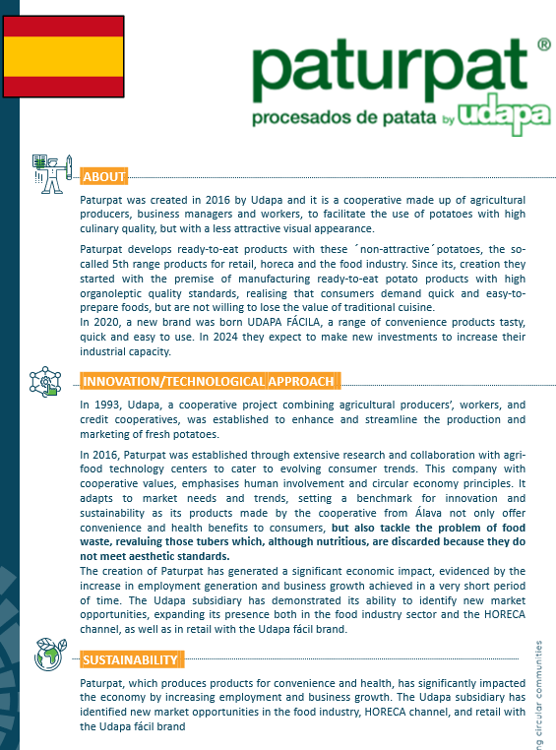

Be inspired…
Paturpat develops ready-to-eat products with the ´non-attractive´potatoes, the so-called 5th range products for retail, horeca and the food industry. It adapts to market needs and trends, setting a benchmark for innovation and sustainability as its products offer convenience and health benefits to consumers while also tackling the problem of food waste, revaluing those tubers which, although nutritious, are discarded because they do not meet aesthetic standards.
Featured in our Good Practice Compendium, this initiative is part of innovations like upcycling surplus food into new products that aims to create value while reducing waste.
Visit their website for more information!

Slide 29

04
Disadvantages of Strict Food Standard Regulations

Slide 30
Disadvantages of Strict Food Standard Regulations
Strict food standard regulations, whether at the EU or national level, are intended to ensure food safety, quality, and environmental sustainability. However, they come with some disadvantages that impact businesses, consumers, and economies:
Increased Costs for Producers
Compliance Expenses: Producers must invest in infrastructure, certification processes, and testing to meet stringent EU standards. Eg. Farmers and food manufacturers may need to upgrade equipment or adopt new farming methods, leading to higher operational costs.
Impact on Small Producers: Small and medium-sized enterprises (SMEs) may struggle to afford these compliance measures, putting them at a disadvantage compared to larger competitors.
Market Entry Barriers
Challenges for Imports: Non-EU countries face significant challenges exporting to the EU due to complex regulations, which may include bans or additional testing on products that do not meet EU standards. Eg. Developing countries often find it hard to meet EU pesticide residue limits, reducing their ability to compete in the EU market.

Slide 31
Disadvantages of Strict Food Standard Regulations
Complexity and Bureaucracy
Administrative Burden: Producers face extensive paperwork, audits, and reporting requirements to prove compliance with EU standards. This is especially difficult for businesses operating across multiple EU member states due to variations in their interpretation.
Impact on Small Producers: Small and medium-sized enterprises (SMEs) may struggle to afford these compliance measures, putting them at a disadvantage compared to larger competitors.
Trade Disputes
Conflict with Non-EU Standards: The EU’s strict regulations sometimes conflict with international standards, leading to trade tensions. Eg. The EU’s ban on certain genetically modified organisms (GMOs) has created friction with countries like the US.
Potential for Food Waste
Strict Quality Criteria: High standards for the cosmetic appearance or size of fruits and vegetables often result in perfectly edible food being discarded. Eg. Imperfectly shaped produce might not make it to the market, contributing to food waste.

Slide 32
EU Food Standard Regulations
Genetically Modified Organisms (GMOs):
The EU has stringent regulations on GMOs, limiting their use in food production compared to global standards.
Pesticide Residue Limits:
The EU enforces strict Maximum Residue Levels (MRLs) for pesticides, which many non-EU producers struggle to meet.
Animal Welfare Standards:
EU regulations require higher welfare standards, increasing costs for meat and dairy producers.
While strict food standard regulations promote safety, sustainability, and consumer confidence, they also create challenges for producers, economies, and trade. Striking a balance between safety and economic feasibility is crucial to ensure that regulations protect public health without stifling innovation, market accessibility, or affordability…and food waste also needs to be considered.

Slide 33
Learner’s Reflection exercise:
Propose an Initiative:
  Reflect on your own local context. What initiative could realistically be implemented to reduce food surplus at the community or municipal level?
Regulation Debate:
  Do you believe that current EU food safety regulations strike the right balance between safety and waste reduction? Why or why not?
Climate Connection:
  Describe how climate change could both increase and decrease food surplus depending on the region and infrastructure.

Slide 34
This module delved into the redirection of food surpluses and climate change, defining and exploring different strategies for the redistribution of these surpluses in the business environment.
It shows various initiatives that have been implemented to reduce food waste, promoting innovative and sustainable solutions that encourage the reuse and redistribution of surpluses, in line with the principles of circular economy and sustainability.
It also highlights the challenges associated with this process and the drawbacks of strict food regulations, both at European and national levels.
Final remarks

Slide 35
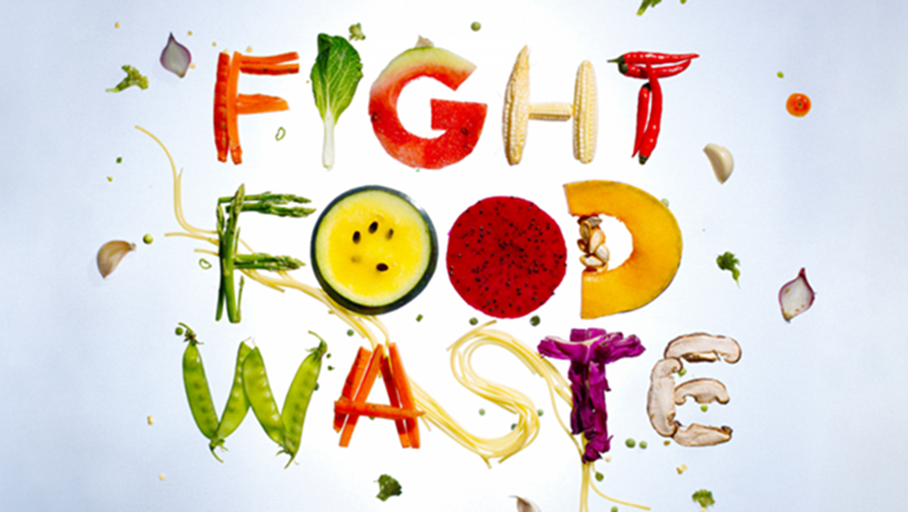

Slide 36
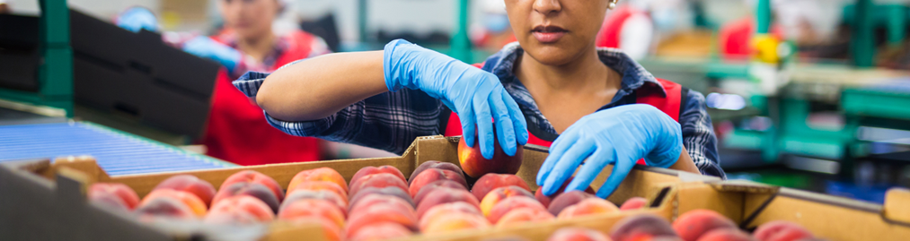
Follow our journey
li
in
yt
www.waste2worth.eu

