Slide 1
MODULE 3
SUPPLIER COLLABORATION
SUSTAINABLE SOURCING & PROCUREMENT

Slide 2
CONTENTS
This module aims to deepen the concept of sustainability and procurement and will define and explore different strategies for integrating sustainable procurement processes in food business.
Additionally, it would place relevant emphasis on partnerships and the importance of establishing strong networking relations, as a practice to enhance green and socially responsible strategies in product development and consumption.
01
Sustainable Sourcing
02
Defining Factors in Partnerships
03
Strategies for Sustainable Sourcing
04
Challenges for Sustainable Procurement

Slide 3
01
Sustainable sourcing

Slide 4
Basic concepts
Supply chain collaboration plays an essential role in the overall success of food SMEs and food businesses in general. Supply chain collaboration occurs when different businesses actively support each other, working towards shared benefits (Chauan, 2022)
One of these major benefits is the creation of favourable conditions for pursuing sustainable sourcing practices, making easier for food SMEs to align their operations and food procurement with environmental, social and economic standards.
Engaging in sustainable procurement refers therefore to the integration of environmental, social and economic considerations into the purchasing to promote positive outcomes across the supply chain procurement process (Jean, 2024).

Slide 5
What is Sustainable Procurement?
Sustainable Procurement: It’s Not Just About Being Green
Consultant Sharon Croom from the Oxford College of Procurement, explains through this lecture, what are key pillars of sustainable procurement, based on the 3P’s principle: People, Profit, Planet.
As she describes, sustainable procurement is much more than ‘buying green’, as it represents a growth strategy for businesses.
In doing so, she goes through the drivers that motivate sustainable procurement, its associated challenges (which will be discussed later on), and most importantly, its benefits and its implementation.

Slide 6
What is Sustainable Procurement?
Mastering Sustainable Procurement: Essential Skills You Need to Know
This is a short interview, Sanae Alaoui, industry expert and consultant, addresses the main skills needed for adopting successful sustainable sourcing practices.
Her interesting insights reflect the importance of knowledge and collaboration

Slide 7
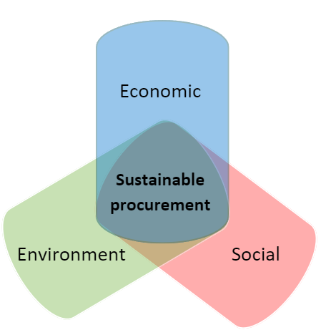
Key elements of Sustainable procurement
Notes:
Link for translation: https://www.canva.com/design/DAGey6-xMwA/6giDlpIERgcaupUW5V8qQg/edit?utm_content=DAGey6-xMwA&utm_campaign=designshare&utm_medium=link2&utm_source=sharebutton

Slide 8
Key elements of Sustainable procurement
Environmental Considerations: Minding the environment is fundamental for sustainable sourcing. Complying with international standards, using biodegradable materials, avoiding water and energy waste, and minimising pollution
Social considerations: Refers to ensuring ethical practices, fair labour conditions and well-being. This is done by ensuring that human rights have been respected throughout all the process. It can include supporting local suppliers, minorities and fair causes
Economic considerations: This concept aims for an economic sustainability that fosters long term financial value achieved progressively. Elements such as priorising quality products that aim for long term savings, aiming for a stable supply chain, ensuring ethical business practices and transparency, are crucial.

Slide 9
Be Inspired...
The Ricehouse Benefit Corporation (RBC) is an example of how sustainable sourcing provides stability and benefits while simultaneously producing a positive impact on society. RBC started as a small startup in 2016 with the idea of developing building products by exploiting rice agriculture processing. As of 2024, RBC has entered the world of design.
Their sourcing is almost fully local raw materials, involving local businesses in the procurement process. This creates a positive impact in their community by supporting local (social considerations) while also reinforcing green practices as they use all rice by-products and therefore avoid food waste (environmental considerations). Thanks to this approach, they have gradually grown to become one of the most important sustainable and profitable agents in the Italian industry (economic considerations), winning several prizes and increasing their recognition. For more information check out the W2W Good Practice Compendium or their website

Slide 10
Journey Map
Learners exercise
Think about a product you use everyday
Develop a journey map, reflecting on:
Where does it come from?
Are there any environmental impacts?
Who makes it?
How is it transported?
What happens once used?
Once you have answered this questions,
What alternatives can you consider to reduce these impacts in your sourcing decisions?
Notes:
Solution: C – Formal agreements exists but they focus only on specific issues

Slide 11
02
DEFINING FACTORS IN PARTNERSHIPS
Notes:
Link for translation: https://www.canva.com/design/DAGebkF7Ofs/Xb_KCkuG0tbOmXIsJ4TxDg/edit?utm_content=DAGebkF7Ofs&utm_campaign=designshare&utm_medium=link2&utm_source=sharebutton

Slide 12
Defining factors in partnerships
Partnerships are usually the result of complex relations and interconnections between interested parties, that above all, act on behalf of their own interests. McNamara (2012) categorised the different types of partnerships into three main areas:
cooperative partnerships,
coordinative partnerships and
collaborative partnerships.
This framework has been identified as the cornerstone for studying and understanding the main elements that define partnership. Zarei et.al., (2023),
Cooperative
Collaborative
Partnerships
Coordinative

Slide 13
Defining factors in partnerships
All these elements can be found in partnerships at a different level, varying its importance or intensity. The level of intensity of these characteristics defines if the partnership is more likely to engage in sustainable sourcing procurement, and therefore if the partnership is cooperative, coordinative or collaborative.
Research (Zarei et.al., 2023) suggests that cooperative partnerships are less effective in sustainable sourcing while coordinative and collaborative are more effective
Key Personnel
Information Sharing
Formality of the Agreement
Organisational Design
Decision-Making
Conflict Resolution
Resource Allocation
System Thinking

Slide 14
INFORMATION
SHARING
KEY PERSONNEL
Key personnel:
Those individuals within organisations that are crucial for initiating and sustaining partnerships.
They often possess specialised knowledge and authority.
Their level of involvement determines the type of partnership and their probability for sustainable sourcing
Information sharing:
Relates to the level of exchange of; data, knowledge, and insights between partners, and determines the levels of transparency and trust.
Title One
Title Two
Title Three
Title Four

Slide 15
FORMALITY OF THE
AGREEMENT
ORGANISATIONAL DESIGN
Formality of the agreement: refers to the extent to which terms and conditions are established between parties. They help to reduce misunderstandings and provide clarity
Organisational Design:
Refers to the structure and roles, hierarchy and procedures that the organisation has, establishing how tasks are controlled and coordinated
Title One
Title Two
Title Three
Title Four

Slide 16
CONFLICT-RESOLUTION
DECISION - MAKING
Decision-making:
Refers to the mechanisms for choosing the course of action and strategies to uphold within organisations. The more integrated these mechanisms are, the more effective for achieving Sustainable Sourcing within the partnership.
Conflict resolution:
Relates to the procedures undertaken to handle disagreements and disputes. Similarly to decision-making, the more integrated the procedures are, the more effective a partnership is in achieving Sustainable Sourcing
Title One
Title Two
Title Three
Title Four

Slide 17
RESOURCE ALLOCATION
SYSTEMS THINKING
Resource allocation:
This element is crucial as it involves selecting where and how resources are going to be placed or used
Systems thinking:
This is probably the most fundamental element as it refers to the capacity of the partnership for thinking long-term and adopting a holistic mindset, rather than pursuing merely individual interests
Title One
Title Two
Title Three
Title Four

Slide 18
Learners exercise
Reflect and select which of the 8 elements defining partnerships that you think is the most important?
Why?
Would you consider some elements more important than others relating to the food sector?
Notes:
Solution: C – Formal agreements exists but they focus only on specific issues

Slide 19
03
STRATEGIES FOR SUSTAINABLE SOURCING

Slide 20
Environmental
Secure supplies that comply with international standards, establish them in the supply agreements and conduct regular audits
Standards
Ensure your supplies are delivered in renewable and biodegradable materials, as well as opting for reusable containers and avoiding plastic
Packaging
Select energy-efficient supply sources, incentivise carbon reduction and energy conservation
Minimise Waste
Implement a circular economy, following the main principles, and ensuring green practices in all supply processes
Title Four
Holistic approach

Slide 21
Social
Prioritise local products, aiming to boost the regional economy and create more opportunities for the community.
Support Local
Set procurement directives, sourcing from businesses owned by individuals with fewer opportunities and underrepresented communities
Diversity approach
Ensure that work conditions are safe and fair, guaranteeing living wages for sourcing employees
Fair conditions
Title Four
Foster upskilling among your suppliers' employees by providing training opportunities
Training

Slide 22
Economic
Evaluate the long-term costs, investing in durable and reparable items/products. Aiming at extending the vision towards a stable future
Long Term Savings
Invest in ethical supply by carrying out supplier audits, ensuring adherence to a strict code of conduct, and using formal standards and certifications
Ethical Business
Establish traceability, regular supplier assessments and performance reports, by designating specialised or trained personnel
Accountabillity
Title Four
Diversify suppliers, reducing supply outage and allowing continuity
Stability

Slide 23
Learners exercise
Choose the correct answer:
1. Which of the following is an example of economic sustainability in procurement?
Choosing the cheapest supplier
Selecting durable products
Buying only from large corporations
Ignoring supplier stability as long as prices are low
2. What a key principle of social sustainability?
Ensuring suppliers follow fair labour practices
Reducing transport emissions
Choosing female-led supply businesses
3. Which decision best supports environmental sustainability?
a) Buying from a supplier that reduces water waste
b) Purchasing plastic packaging as it is the cheapest option
c) Choosing the fastest supplier, to reduce logistic pollution
Notes:
Solutions:
B
A
A

Slide 24
04
CHALLENGES FOR SUSTAINABLE SOURCING

Slide 25
Sustainability vs Procurement
The biggest challenge for sustainable procurement is merging both concepts effectively – sustainability and procurement- as they are based on opposite generic concepts.
Sustainability
Procurement
Title One
Long term impact
Immediate business needs
Social/environmental effects
Click to type
Financial & corporate needs
Click to type
Often expensive and complicated processes
Straightforward processes
Strongly relying on public policy
Leaning on private procurement
Procurement does not understand sustainability, as it is based on fixed mechanisms (cost-efficiency)
Sustainability does not understand procurement, as it is based on flexible mechanisms (variant conditions)

Slide 26
Sustainable vs Procurement
Strategies to address these challenges:
1. Ensure strong collaboration with suppliers. Building a stable relationship with suppliers allows for the introduction of non-cost-effective sustainable solutions without undermining product/service supply. These solutions can be in the interest of both parties to co-develop, as they both could use it outside the partnership. Moreover, a strong relationship could result in long-term contracts and bulk purchases, that could lower the cost of sustainable products.
2. Enhance public-private collaboration. Staying updated with the latest environmental regulations can lead to additional funding through grants, tax benefits, or funding for innovation. Having all green labels and environmental standards followed in your products can further attract investors and open new sources of revenue.

Slide 27
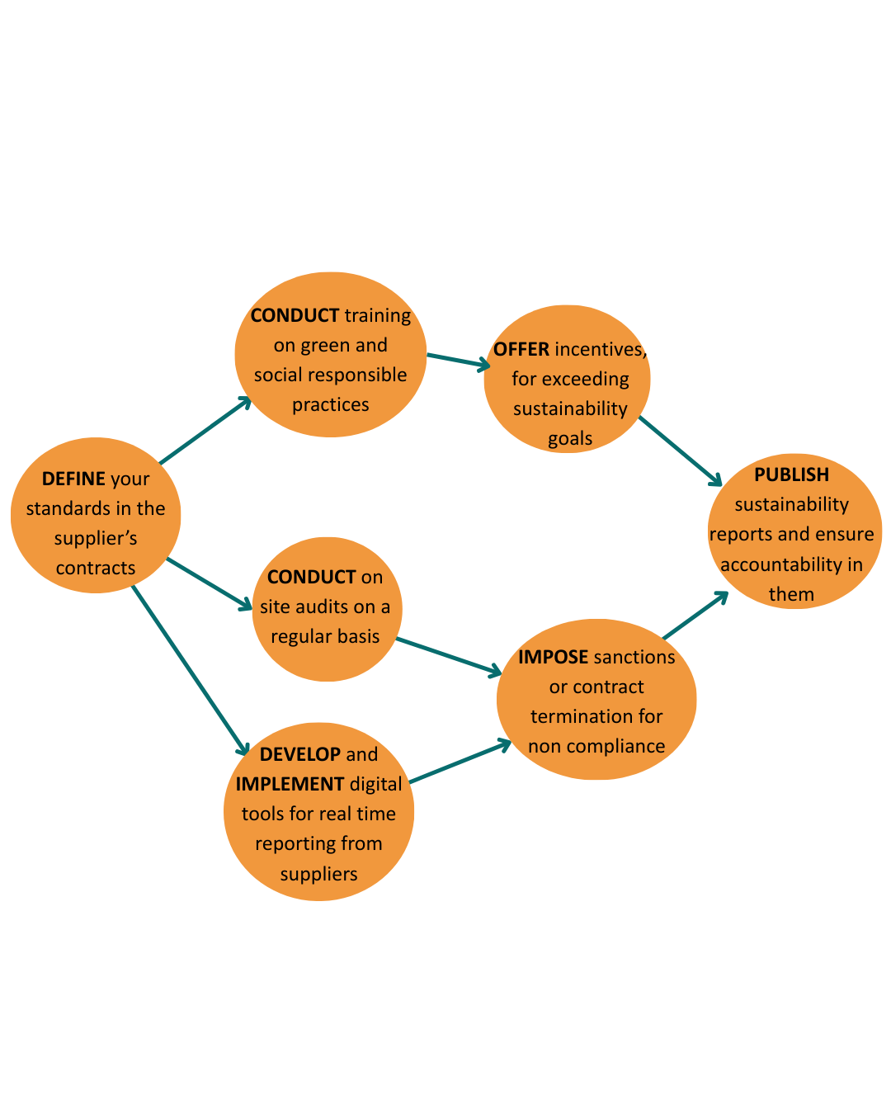
Tracing sustainability
How do we ensure that our suppliers comply with environmental and social standards?
Notes:
Link for translation https://www.canva.com/design/DAGfpFvsfH8/arQTZc_g98n4cS0qK7R05Q/edit?utm_content=DAGfpFvsfH8&utm_campaign=designshare&utm_medium=link2&utm_source=sharebutton

Slide 28
Learners exercise
In the following situation:
You are a food SME owner/producer, trying to adopt sustainable sourcing techniques. However, your budget is tight, your suppliers are inconsistent, and certifications are expensive.
What barriers would you face?
What compromises might you be tempted to make?
How would you explain your choices to your customers?
Reflect on the following questions and write down your thoughts

Slide 29
Final remarks
As observed, sustainable procurement is a fundamental concept for securing an efficient, green and responsible source of supply.
Embracing this concept is crucial when engaging with partners and building trusting relationships
Sustainable procurement is strategic, balancing economic, social and environmental considerations.
Engaging with this practice requires critical thinking and commitment to improvement, which aligns with the main objectives of the Waste 2 Worth project

Slide 30
BETTER SOURCING, BRIGHTER FUTURE

Slide 31
Follow our journey
li
in
yt
www.waste2worth.eu

