Slide 1

MODULE 2
RESOURCE EFFICIENCY

Slide 2
CONTENTS
01
What is Resource Efficiency?
Module 2 explores the concept of Resource Efficiency, focusing on strategies for food businesses to optimise the use of materials, water, and energy while minimising waste and environmental impact. Through key principles such as the 3Rs (Reduce, Reuse, Recycle), sustainable resource management, and energy efficiency, you will gain insights into practical solutions, policies, and incentives that promote a more sustainable future.
02
The 3Rs: Reduce, Reuse, Recycle
03
Sustainable Use of Raw Materials & Water
04
Energy Efficiency: Saving, Green Energy & Smart Management
05
Incentives & Policies for Resource Efficiency

Slide 3

01
WHAT IS RESOURCE EFFICIENCY?

Slide 4

DEFINITION
“Resource efficiency refers to the sustainable management and use of natural resources to minimise environmental impacts and waste, while maximising economic and social benefits.”
– United Nations Environment Programme (UNEP)
➔ Maximising resource efficiency in food production and consumption helps reduce waste, conserve water and energy, lower costs, and ensure more equitable food distribution.

Slide 5
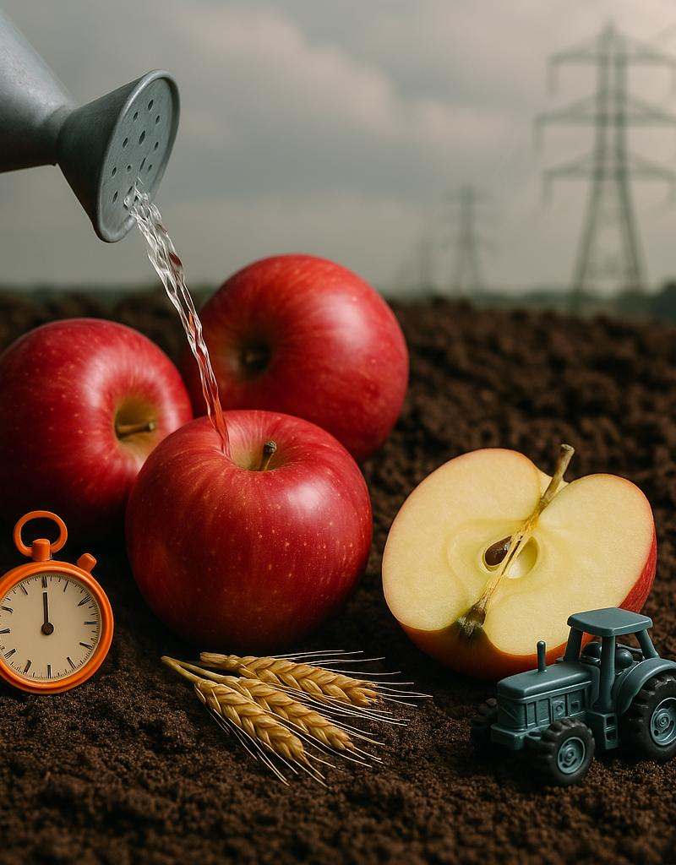
Impact on Resources
Food waste isn't just about the food we throw away—it's also about all the resources that were used to produce it.
When food goes uneaten, the water, energy, land, labour, and money that went into growing, processing, transporting, and storing that food are also wasted.
Reducing food waste is one of the simplest ways to protect our planet’s resources.

Slide 6

How Food Waste Valorisation can lead to Resource Efficiency
This video shows simply how Food waste valorisation converts food waste into valuable products or energy, reducing environmental impact. It promotes resource recovery, biogas production, composting, food redistribution, and nutrient recovery, contributing to a circular economy. This process minimises landfill waste and pollution while fostering innovation and sustainable solutions for a resilient food system.
What is Food Waste Valorization and How Does it Contribute to Sustainable Solutions?

Slide 7
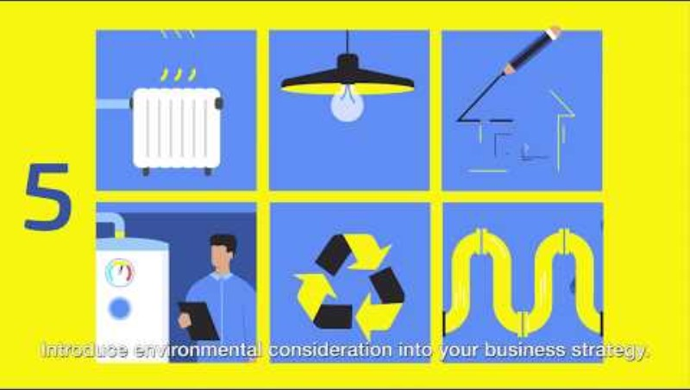
EREK - European Resource Efficiency Knowledge Centre
EREK stands for the European Resource Efficiency Knowledge Centre. It is an initiative supported by the European Commission to help businesses, especially SMEs, become more resource-efficient, competitive, and sustainable.
EREK provides tools, guidance, and case studies to support companies in:
Reducing material, water, and energy use
Minimising waste and emissions
Improving product design and circular practices

Slide 8


Key Principles of Resource Efficiency
Identification of Risks and Opportunities
Food SMEs and producers must assess the risks and opportunities of transitioning to circular and resource-efficient models, considering technological advancements, market competitiveness, and reputational risks along their value chains.
Transition to Resource-Efficient Business Models
Food SMEs and producers should integrate circular economy principles into existing and new business models, focusing on reducing primary resource consumption, minimising environmental impacts, and optimising product life cycles, design, and material usage.

Slide 9


Key Principles of Resource Efficiency
Multi-Stakeholder Partnerships and Engagement
Cross-sector collaboration, including partnerships between primary food producers, food communitiies, bioeconomy stakeholders, regional development agencies, and consumers, is key to maximising resource use and enhancing circularity. Public-private partnerships should support circular economy solutions.
Enhancement of Monitoring and Reporting
It’s crucial for food producers to incorporate circular economy and resource efficiency into their information disclosure practices, ensuring transparency about their progress and impact through sustainability reports and other channels.

Slide 10

Key Principles of Resource Efficiency
Integration with Environmental Goals
Circular economy and resource efficiency should align with decarbonisation, biodiversity, and pollution reduction strategies to support broader environmental and Sustainable Development Goals.
Leadership for Resource Efficiency Strategies
Companies should demonstrate top-level leadership commitment to circular economy and resource efficiency, embedding these principles into their strategies and raising awareness throughout the business.

Slide 11

02
THE 3RS: REDUCE, REUSE, RECYCLE

Slide 12
Food Waste in Europe…
In 2021, more than 58 million tonnes of food waste were generated in the European Union (source: eufic) - SMEs account for 42% of this food waste!
131 kg
€132
252,000,000
or
or
PER PERSON
BILLION
TONS OF CO₂

Slide 13
The 3Rs and their Role in Reducing Waste
Food waste is a growing global issue with serious environmental, economic, and social consequences. Nearly one-third of all food produced is wasted, leading to resource depletion, increased greenhouse gas emissions, and considerable financial losses.
The 3Rs framework—Reduce, Reuse, and Recycle—provides a structured approach to managing food waste.
REUSE
RECYCLE
REDUCE
Preventing food waste before it happens is the most effective solution.
Composting and bioenergy production ensure that waste is reused sustainably.
Redirecting surplus food to new uses, such as donations or upcycling, extends its value.

Slide 14
Reduce – Minimising Waste at the Source
Restaurants and consumers can reduce waste by serving appropriate portions.
Portion Control
Banner
Infographic
The best way to manage food waste is to prevent it from occurring in the first place. Businesses can take proactive steps to minimise food loss at every stage of the supply chain.
Reducing food waste benefits the environment by decreasing landfill use and lowering methane emissions, while also cutting costs for businesses and households.
Inventory Management
Businesses can use AI to predict demand and prevent overproduction.
Farm-to-Table Efficiency
Reducing food loss during harvesting, transportation, and storage.
Consumer Awareness
Education on food storage, expiration dates, and responsible consumption.

Slide 15
Reuse – Repurposing Surplus Food
Food Donations
Surplus food can support those in need.
Banner
Infographic
When food cannot be prevented from being wasted, the next best option is to reuse it. Businesses can repurpose food creatively to extend its value and reduce waste. Educating consumers is also key.
Food waste can be used for animal feed, lowering demand for traditional feed and keeping waste out of landfills. Reusing food waste benefits both the environment and the economy.
Transforming food byproducts into new ingredients.
Upcycling
Animal Feed
Repurposing food scraps as livestock feed.
Collaborating with food banks and farms to maximise food use.
Partnerships

Slide 16
Recycle – Composting & Bioenergy from Food Waste
Composting
Converting food waste into nutrient-rich soil.
Banner
Infographic
The final step is to recycle food waste which helps return nutrients to the soil, generate renewable energy, and keep organic waste out of landfills.
Businesses can integrate recycling into their operations by conducting food waste audits and finding ways to use that waste.
Biodegradable packaging boosts recycling by reducing contamination and improving efficiency.
Anaerobic Digestion
Producing biogas and fertiliser from organic waste.
Food Waste Audits
Identifying waste sources and improving recycling efforts.
Biodegradable Packaging
Designing materials that simplify food waste recycling.

Slide 17

THE 3Rs IN MY BUSINESS
Reflect on how the 3Rs apply to your daily business practices. On paper, create three columns labeled Reduce, Reuse, Recycle.
List actions you currently take in each category and think of one new way to improve each area.
Challenge yourself to make a change this week!

Slide 18

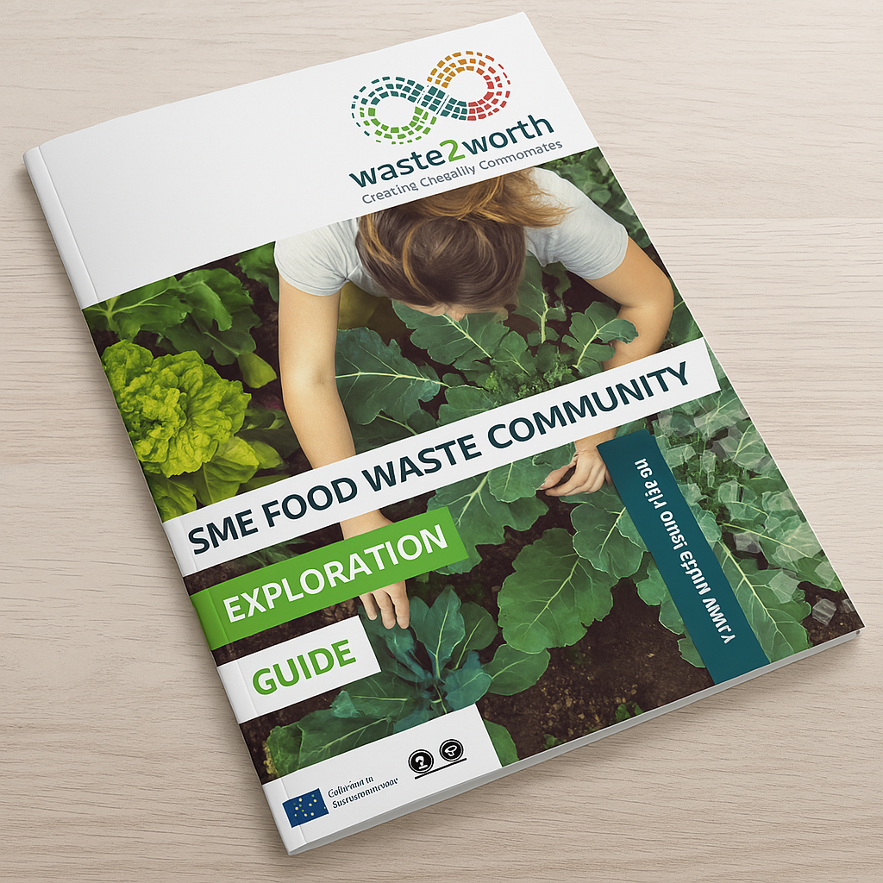
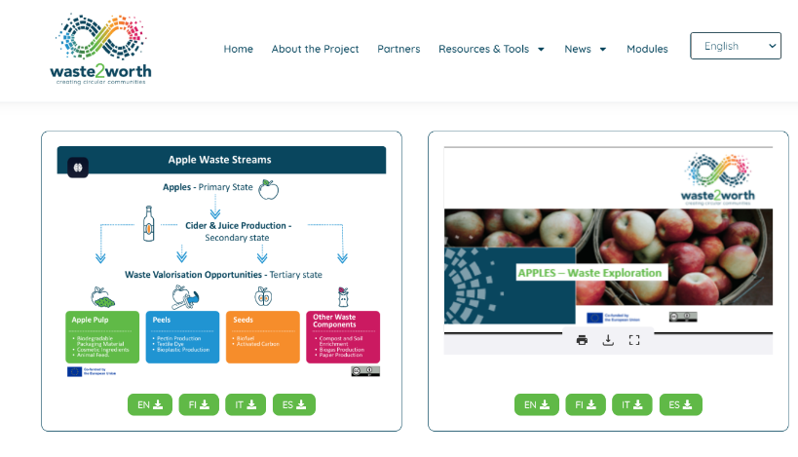
Be Inspired…
Check out the Waste2Worth website to discover the SME Food Waste Exploration Guide and Regional Community maps…designed to build awareness and motivation in the benefits of circular communities

Slide 19

03
SUSTAINABLE USE OF RAW MATERIALS & WATER

Slide 20

Challenges of Resource Extraction & Overconsumption
The rapid overconsumption of resources is depleting natural reserves and contributing to environmental degradation, including the unsustainable impact of food production.
Environmental Degradation: Resource extraction drives deforestation, land degradation, and climate change.
Food Production Strain: Agriculture heavily contributes to water scarcity, soil erosion, and biodiversity loss.
Global Inequities: Rich nations consume far more resources, exacerbating social inequality and environmental damage in poorer regions.

Slide 21


EXPLORING SOLUTIONS
Explore The Food Fight an EIT-Food Podcast series. In this episode they spotlight- ReThinkResource on creating value from food waste.
The podcast team introduces Linda Grieder of RethinkResource, a company looking at ways in which food waste and side-streams can be turned into profit. She also explains how RethinkResource's new platform – Circado – is working to connect industries to make the most out of food waste opportunities.
Click here and tune in!

Slide 22
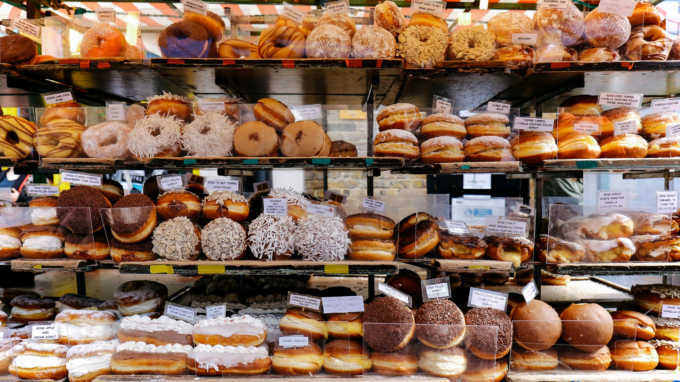
Companies don’t always know that they can sell their waste streams, or what price to ask for it
- Linda Grieder, founder of Rethink Resource

Slide 23

Sustainable Sourcing & Material Substitution
Sustainable sourcing and resource-efficient practices can significantly reduce environmental impact while boosting competitiveness for food SMEs:
Source locally & shorten supply chains to reduce carbon emissions (an impact of transportation) while supporting local producers & building stronger community ties.
Material Substitution: Switching to biodegradable or reusable packaging minimises plastic waste and lowers the environmental impact.
Improve resource efficiency by cutting energy, water & material use—reducing costs and boosting SME competitiveness, SMEs are positioned as leaders in innovation and sustainability and attractive to conscious consumers.

Slide 24

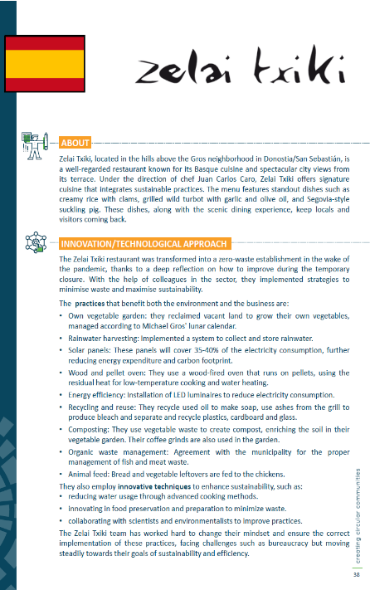

Be inspired…
…by Zelai Txiki, a Basque restaurant that turned the challenges of the pandemic into an opportunity for sustainability, transforming into a zero-waste establishment with its own vegetable garden, solar panels, rainwater harvesting, and innovative waste management practices.
Featured in our Good Practice Compendium, this initiative exemplifies how responsible farming, material substitution, and resource efficiency can help restaurants reduce their environmental impact while maintaining culinary excellence.
Visit their website for more information!

Slide 25

“THE FIRST RULE OF SUSTAINABILITY IS TO ALIGN WITH NATURAL FORCES, OR AT LEAST NOT TRY TO DEFY THEM.”
Paul Hawken

Slide 26

04
ENERGY EFFICIENCY

Slide 27

Why Energy Efficiency Matters…
Energy efficiency is essential for food SMEs, helping to cut operational costs while reducing environmental impact. In kitchens, production lines, distribution and storage areas, optimising energy use can significantly lower energy bills and reduce emissions —see example practices in the following slides.
Being energy-efficient not only supports climate goals but also improves business resilience and competitiveness in a sustainability-driven or green market.

Slide 28
BENEFITS OF ENERGY EFFICIENCY
Energy efficiency plays a crucial role in helping food SMEs become more resilient, manage rising material and energy costs, and stay competitive. Reducing energy consumption leads to long-term financial savings, lower production costs, and greater stability in the face of fluctuating energy prices.
Reduced operational costs through smarter energy use, helping food SMEs boost profitability
Stronger market competitiveness by aligning with sustainability standards & consumer expectations
Improved community well-being through lower emissions, cleaner air & support for local resilience

Slide 29




How can YOU contribute to an energy-efficient future?
Efficient Refrigeration
Reducing Energy in Food Transport
Using advanced refrigeration systems with improved insulation and eco-friendly refrigerants can significantly reduce energy consumption in food storage.
Utilising low-energy vehicles and optimising delivery routes can lower energy consumption in food transport.
Optimising Food Storage
Energy-Efficient Cooking and Processing
Storage facilities with better insulation, temperature controls, and proper stock management help minimise energy use.
Adopting modern cooking equipment and heat recovery systems in food production reduces overall energy use.

Slide 30




How can YOU contribute to an energy-efficient future?
Raise Awareness Among Staff
Monitor & Measure Energy Use
Training staff to turn off equipment, use natural lighting, and unplug devices overnight reduces energy waste. An “Energy Champion” can monitor and promote best practices.
Smart meters and energy tracking tools provide real-time insights. Regular bill reviews help spot unusual spikes, and setting energy-saving goals encourages efficiency.
Enhance Operational Efficiency
Switch to Energy-Efficient Equipment
Upgrading to A-rated fridges, ovens, and fryers cuts energy use. Induction cookers, LED lighting, and low-energy motors boost efficiency, while better ventilation reduces costs.
Batch cooking optimises appliance use, while scheduling high-energy tasks during off-peak hours lowers costs. Streamlining workflows minimises idle equipment time.

Slide 31

„THE FACT IS THAT NO SPECIES HAS EVER HAD SUCH WHOLESALE CONTROL OVER EVERYTHING ON EARTH, LIVING OR DEAD, AS WE NOW HAVE. THAT LAYS UPON US AN AWESOME RESPONSIBILITY.”
- Sir David Attenborough

Slide 32


Green Energy Solutions
Here are two innovative ways in which energy solutions are being harnessed to tackle environmental challenges: biogas from food waste and micro-generation. These sustainable energy methods can contribute to waste management and greenhouse gas reduction but also offer significant cost-saving and energy independence benefits.
Biogas from Food Waste
Micro- Generation
Biogas is a renewable energy source derived from organic waste, including food scraps, agricultural waste, and animal manure, through a process called anaerobic digestion. This process captures methane, an energy-rich gas, which can be used for electricity generation.
Micro-generation refers to the small-scale production of energy on-site—often using solar panels, small wind turbines. For food SMEs, this means they can generate their own electricity, reducing reliance on the grid and insulating themselves from rising energy costs..

Slide 33
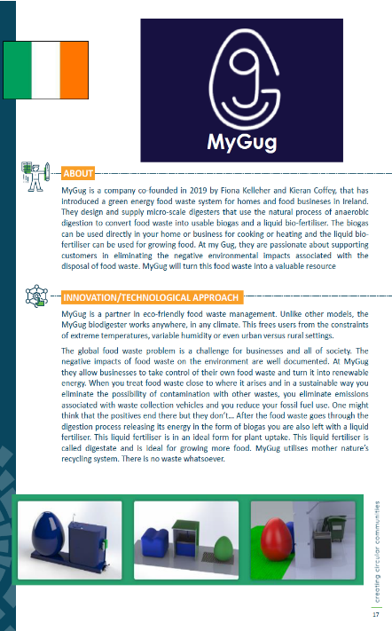
Be inspired…
…by MyGug, an Irish company that transforms food waste into valuable biogas and liquid bio-fertiliser through innovative micro-scale biodigesters. Their adaptable technology is being used to help businesses reduce emissions, lower waste collection costs, and generate renewable energy in any climate.
Featured in our Good Practice Compendium, this initiative highlights how sustainable waste management and resource efficiency can bring both environmental and economic benefits.
Visit their website for
more information!

Slide 34

05
INCENTIVES & POLICIES

Slide 35
EU INCENTIVES & SUPPORT MECHANISMS FOR ADVANCING RESOURCE EFFICIENCY
As mentioned in Module 1; The European Union has implemented various policies & initiatives to promote resource efficiency as part of its broader sustainability and economic strategies. However, key incentives and support mechanisms are also available at both the EU and national levels.
These incentives are delivered to encourage and assist innovation, improve production and consumption patterns, and ensure the security of essential resources while aligning with global sustainability goals.
Eurobarometer Insights: A recent Eurobarometer survey indicates that 93% of EU SMEs have implemented at least one resource-efficiency measure, such as energy conservation, waste minimisation, or recycling. This underscores the widespread commitment to sustainability among SMEs across Europe.

Slide 36
Irish Incentives:
Energy Efficiency Grant Scheme: The Irish government has increased the maximum amount available under this scheme to €10,000 and reduced the business contribution rate from 50% to 25%. This initiative aims to support SMEs in implementing energy-saving measures. ​Source
HomeGreen Enterprise Programme: This programme provides funding to organisations, including SMEs, to develop innovative projects that promote resource efficiency and the circular economy. ​Source

Slide 37
Italian Incentives:
Self-production of energy from renewable sources for SMEs: In December 2024: the Ministry of Business and Made in Italy engaged a measure to incentivise investments by SMEs. Alfonso Urso signed the decree which allocates 320 million euros for self-production of energy from renewable sources. 40% of the resources will be allocated to the South and to micro and small businesses. Source
Piano Transizione 4.0: The Italian government's advanced manufacturing incentive plan allocates €13.4 billion in tax credits for investments in capital goods, R&D, innovation, and training, supporting SMEs in adopting advanced technologies and improving resource efficiency. ​Source

Slide 38
Spanish Incentives:
National Energy Efficiency Fund (FNEE): This fund provides economic support, technical assistance, and training to improve energy efficiency across various sectors, including industry. Food SMEs can access financing for projects aimed at reducing energy consumption and enhancing sustainability. Source
Institute for the Diversification and Saving of Energy (IDAE): IDAE offers grants and financing options for energy efficiency projects. Food SMEs can benefit from programmes targeting the adoption of efficient technologies and renewable energy sources to optimise resource use. ​Source
Regional Incentives: Spain's autonomous communities manage specific grants focused on improving energy efficiency. Food SMEs should explore regional programs that may offer additional support tailored to local needs. ​Source

Slide 39
Finnish Incentives:
Energy Aid: This incentive supports companies and organisations investing in projects that improve energy efficiency or promote low-carbon energy systems. It can also fund renewable energy projects using new technologies, provided the aid significantly influences the project's launch. Eligible costs: €10,000+ (energy efficiency) or €30,000+ (renewables); up to €5 million. It is a non-repayable grant based on actual costs. Source
Material Efficiency Audits: The Finnish government provides economic incentives for companies to conduct material efficiency audits, helping businesses identify opportunities to reduce waste and improve resource utilisation. ​Source

Slide 40

01
ENERGY EFFICIENCY DIRECTIVE
The revised Energy Efficiency Directive (EU/2023/1791) strengthens the EU's commitment to reducing energy consumption, while prioritising energy efficiency across all sectors to enhance climate goals, energy security, and affordability.
02
A RESOURCE-EFFICIENT EUROPE
This flagship initiative under the Europe 2020 Strategy aims to boost economic growth while reducing resource consumption, ensuring sustainability, and enhancing competitiveness.
03
POLICY GUIDANCE ON RESOURCE EFFICIENCY
The OECD Policy Guidance on Resource Efficiency provides key strategies for achieving sustainable growth by reducing resource consumption, improving efficiency, and fostering international cooperation, building on commitments from the G7 and other global initiatives.

Slide 41

"THE ENVIRONMENT IS WHERE WE ALL MEET; WHERE WE ALL HAVE A MUTUAL INTEREST; IT IS THE ONE THING ALL OF US SHARE."
Lady Bird Johnson

Slide 42
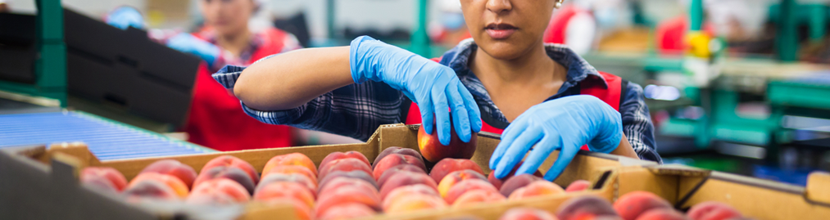
Follow our journey
li
in
yt
www.waste2worth.eu

