Slide 1
MODULE 1
INTRODUCTION TO
CIRCULAR ECONOMY

Slide 2
ABOUT OUR PROJECT
Welcome to the first module of the Waste2Worth project, an ERASMUS+ initiative dedicated to transforming food waste into valuable resources. This module equips SMEs and VET educators in the agri-food sector with the knowledge and tools to minimise waste, harness circular economy principles, and drive sustainable innovation.

Slide 3
CONTENTS
01
What is a Circular Economy in the Context of Food Waste?
This module explores the circular economy in food waste, highlighting sustainable solutions to reduce waste and maximise resource efficiency.
It examines historical and modern reduction approaches, SMEs' role in circular practices, and the regulatory landscape shaping the bio-based economy. Aligned with global sustainability goals, it emphasises the environmental, economic, and social benefits of circular food systems.
02
Learning from Our Past: Traditional Food Practices & Waste Reduction
03
Role of SMEs in the Circular Economy & Food Waste Reduction
04
EU Policies & Regulations on Food Waste & Circular Economy
05
Alignment with SDGs: Food Waste as a Global Sustainability Challenge

Slide 4
01
WHAT IS A
CIRCULAR ECONOMY

Slide 5
“CIRCULAR ECONOMY IS A MODEL OF PRODUCTION AND CONSUMPTION, WHICH INVOLVES SHARING, LEASING, REUSING, REPAIRING, REFURBISHING AND RECYCLING EXISTING MATERIALS AND PRODUCTS AS LONG AS POSSIBLE. IN THIS WAY, THE LIFE CYCLE OF PRODUCTS IS EXTENDED.”
- EUROPEAN PARLIAMENT

Slide 6
FUN FACTS
Did you know that…
the circular economy could create 700,000 new jobs in the EU by 2030!
Europeans generate 190 kg of packaging waste yearly—about the weight of three pandas!
80% of a product’s impact is determined at the design stage—smart design means less waste!
Recycling & reusing materials help cut greenhouse gas emissions & cool the planet!
The EU imports billions in raw materials—recycling reduces dependence and keeps resources circulating!

Slide 7
Understanding the Basics of the Circular Economy
In this video, Ellen MacArthur and Joe Iles break down the key principles of the circular economy using the "butterfly diagram" from the Ellen MacArthur Foundation. They explore how biological and technical cycles help minimise waste, regenerate natural systems, and keep materials in use for as long as possible.
⬅ Check it out!
Ellen MacArthur on the basics of the circular economy

Slide 8
Circular Economy in the Context of Food Waste
To build a more sustainable food system, we must embrace the 3Rs of the circular economy
—Reduce, Reuse, and Recycle—to minimise waste, maximise resource efficiency, and lower environmental impact.
REUSE
Repurposing surplus food and by-products within the food system creates value from what was once considered waste.
RECYCLE
REDUCE
Nutrient recycling, such as composting and bioconversion, transforms food waste into valuable resources for sustainable food production.
Cutting down food waste at every stage of the supply chain helps lower greenhouse gas emissions and conserve valuable resources.

Slide 9
REDUCE FOOD WASTE
The circular economy offers a transformative approach to tackling food waste by shifting from a linear - take-produce-consume-waste model to a system that maximises resource efficiency.
By reducing waste, reusing food and by-products, and recycling nutrients, we can create economic value while significantly lowering environmental impact.
See our Waste Stream Maps for inspiration!

Slide 10
SAVE THE ENVIRONMENT
Embracing circular economy strategies in food systems reduces environmental harm and fosters economic growth by creating new market opportunities for sustainable products.
As the EU pushes forward with its goal to halve food waste, innovation and collaboration across the supply chain will be key to building a more resilient and resource-efficient future.

Slide 11
The Power of Circular Economy in Food Waste Management
Turning Waste into Value Through Innovation
Businesses can reduce landfill waste and create sustainable revenue streams by repurposing food by-products into new products, animal feed, or bio-materials.
Reducing Waste to Cut Emissions and Save Resources
Food waste generates 8-10% of global emissions, similar figures to road transport. A circular approach minimises waste at every stage, preserving water, land, and energy while improving food security.
Be inspired by Ellen McArthur in her podcast on circular economy in the food waste context!

Slide 12
Self- Reflection
Reflect on your current food-related habits at home, at work, or in your community.
In what ways are you already contributing to a circular food system?
Where could you improve?
Identify one specific change you could make to reduce food waste or support circular practices—and think about how it aligns with environmental, economic, or social sustainability.

Slide 13
02
LEARNING FROM OUR PAST

Slide 14
Reviving Traditional Preservation Techniques for Waste Reduction
Food waste is a pressing issue with deep social, economic, and environmental consequences. Cultural and personal determinants shape how food is managed, including inventory control, meal planning, and handling leftovers.
By revisiting traditional food preservation methods, we can bridge historical wisdom with modern sustainability efforts, reducing food loss while respecting cultural values around abundance, hospitality, and ethical consumption.

Slide 15
Traditional Preservation Techniques
Fermentation
Pickling and Preserving
Fermentation preserves food by using beneficial bacteria, extending shelf life while enhancing nutrition. Rediscovering this method can help reduce spoilage of surplus vegetables, dairy, and grains.
Drying and Dehydration
Pickling extends food longevity using brine or vinegar while enriching flavours. It transforms surplus produce into long-lasting, ready-to-eat staples.
Controlled Storage
Root cellars once stored vegetables and dairy without refrigeration by maintaining stable conditions. Today, strategic storage solutions can help reduce premature spoilage in modern homes.
Drying removes moisture to prevent spoilage, keeping fruits, meats, and herbs viable for months. Modern dehydration techniques allow households to preserve excess produce efficiently.

Slide 16
Cultural Attitudes Toward Food Waste and Traditional Preservation
Cultural values like hospitality and scarcity influence food waste behaviours. Integrating preservation techniques into daily practices ensures efficient food use without compromising traditions.
Reviving fermentation, drying, pickling, and controlled storage can help households and businesses combat food waste. Combining these time-tested methods with modern technology fosters a more sustainable, waste-conscious food culture.

Slide 17
Be inspired…
…by DeliKatetxe, a Basque cooperative that transforms free-range hens into high-quality broths, reviving the once-valued tradition of using mature hens while minimising waste. By combining solar-powered cooking, local sourcing, and circular economy principles, they create nutritious products for both human and pet consumption, proving that innovation can go hand-in-hand with sustainability.
Visit the Waste2Worth Good Practice Guide or the DeliKatetxe website for more information!

Slide 18
03
ROLE OF SMES IN CIRCULAR ECONOMY

Slide 19
SMEs as KEY DRIVERS of CIRCULAR FOOD SYSTEMS
SMEs account for 42% of food waste in the EU and make up 90% of the food sector, positioning them as crucial players in circular transformation. Their role in sustainable food production, waste reduction, and supply chain optimisation is essential for reducing environmental impact and promoting a regenerative food system.
Transitioning to Circular Practices – SMEs can reduce waste through regenerative farming and closed-loop production.
Strengthening Local Food Systems – Sourcing locally strengthens food networks, cuts emissions, and boosts food security.

Slide 20
OVERCOMING CHALLENGES
How can SMEs implement innovative waste reduction solutions?
SMEs can drive waste reduction by integrating circular economy principles into their operations, focusing on efficiency, reuse, and sustainability. By minimising excess production, repurposing by-products, and adopting eco-friendly packaging, they can reduce waste while cutting costs.
Partnering with food banks or digital platforms helps redirect surplus food, while energy recovery solutions turn waste into valuable resources. Engaging consumers and collaborating with policymakers further strengthens the long-term impact, creating a more sustainable and resilient business model.

Slide 21
“TACKLING FOOD WASTE IS ONE OF THE SIMPLEST AND MOST EFFECTIVE WAYS TO COMBAT CLIMATE CHANGE.”
Dave Lewis

Slide 22
WASTE REDUCTION STRATEGIES FOR SMEs
Optimising Inventory and Production
Redistributing Surplus Food
01
Upcycling and By-Product Utilisation
03
Lean and Sustainable Packaging
02
Partnering with food banks, social enterprises (Food Cloud or Banco Alimentare)or digital platforms (e.g., Too Good To Go, Olio,) to donate or redistribute unsold edible food.
04
Using AI-driven demand forecasting and smart inventory systems to minimise overproduction and excess stock.
Transforming food waste into new products, such as repurposing fruit peels for natural dyes or converting surplus food into animal feed or compost.
Switching to biodegradable, reusable, or edible packaging to reduce waste at the consumer level.

Slide 23
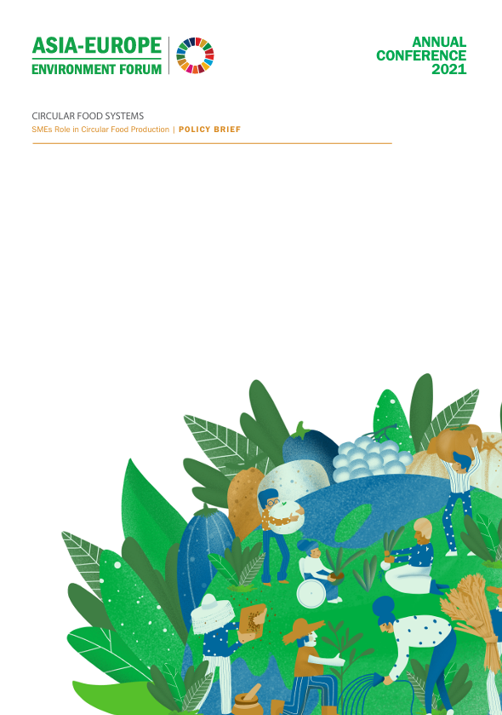
Discover the Role of SMEs in Circular Food Systems…
For further reading, check out the Asia-Europe Environment Forum (ENVforum) Annual Conference 2021, which explored the role of SMEs in circular food systems and food waste reduction. Discover key insights on bioeconomy, food upcycling, and sustainable practices.
Explore the full discussion to learn how SMEs can drive change in the food sector.

Slide 24
TIPS…
1. Keep it Local & Familiar Choose food products you regularly use.
2. Break Down the Food Journey…think about the entire lifecycle of the food product:
Where is it grown or produced?
How is it packaged & transported?
What happens to leftovers or scraps?
3. Think Circular at Each Stage…ask:
Can this be reused, reimagined, or redirected?
Is there a waste stream it could be diverted into?
Could a new product or community benefit come from it?
4. Keep It Simple Remember even small circular actions count—like composting peels, freezing portions, or using overripe fruit in smoothies.
Learner Activity…
Choose a common food product (e.g. Ice Cream, Bread, or Cooked Chicken) and trace its journey through the food system—from production to potential waste.
Then, brainstorm at least two circular strategies to reduce waste at different stages (e.g. reuse, compost, upcycling, donation).

Slide 25
04
EU POLICIES

Slide 26
Waste 2 Worth & EU Policy Alignment
Waste 2 Worth, promotes waste stream mapping & the valorisation of food waste, and consequently strongly aligns with multiple EU strategies focused on sustainability, the circular economy, and the bioeconomy. Its core aims mirror several high-level EU initiatives:
The European Green Deal
The Farm to Fork Strategy
EU Circular Economy Action Plan
EU Bioeconomy Strategy

Slide 27
The European Green Deal
What is the European Green Deal and why is it important?
The Green Deal sets the overarching framework for transforming the EU into a climate-neutral, resource-efficient economy by 2050.
A key priority is zero pollution and clean, circular economy, encouraging innovation in waste reduction & reuse.
Waste 2 Worth supports this vision by helping communities identify waste streams and repurpose them, thus closing resource loops and reducing landfill reliance.

Slide 28
The Farm to Fork Strategy
Sustainable Food Production
Food Loss & Waste Prevention
The F2F strategy is at the heart of the Green Deal and directly targets the sustainability of food systems.
It includes a strong commitment to halving per capita food waste at retail & consumer level by 2030, in line with SDG 12.3.
Waste 2 Worth operationalises this by engaging communities in identifying, preventing & transforming food waste, aligning with the strategy’s goal of creating resilient, fair, and circular food systems.
Farm to Fork
Sustainable Food Consumption
Sustainable Food Processing & Distribution

Slide 29
EU Circular Economy Action Plan
One of the main building blocks of the Green Deal, The 2020 Circular Economy Action Plan (CEAP) promotes a systemic shift in production & consumption, with waste prevention and product reuse at its core.
It identifies food waste as a priority area, promoting innovation in reuse, recycling, and bio-based materials.
Waste 2 Worth’s approach—transforming food waste into value-added products—is a clear example of circular economy in action

Slide 30
EU Bioeconomy Strategy
The updated Bioeconomy Strategy (2018) aims to scale up the bio-based sector, focusing on sustainable biomass sourcing and circularity.
The 2018 Strategy has five objectives:
Ensure food and nutrition security
Manage natural resources sustainably
Reduce dependence on non-renewable, unsustainable resources
Limit and adapt to climate change
Strengthen European competitiveness and create jobs
Source

Slide 31
Waste 2 Worth & the EU Bioeconomy Strategy & Other Initiatives
Valorising food waste as a bioresource supports the strategy’s pillars: food security, sustainable agriculture, & new jobs in the green economy.
Waste 2 Worth contributes by encouraging local actors to see waste as a resource, fostering local bio-based innovation, and by complementing Horizon Europe projects like FOODRUS, VALUEWASTE, and BIOPLAT-EU, by offering community-level engagement tools.
Jobs and growth in the EU bioeconomy

Slide 32
Waste Framework Directive (Directive 2008/98/EC)
Waste Hierarchy
The Waste Framework Directive sets the legal foundation for waste management in the EU as well as giving definitions related to waste management, including waste, recycling and recovery.
As of its 2018 amendment, EU Member States are required to:
Measure food waste at each stage of the supply chain.
Report food waste data annually using a common EU methodology.
Take preventive measures to reduce food waste at all levels.
Work towards SDG 12.3, which aims to halve per capita food waste by 2030.
PREVENTION
Product (non-waste)
Preparing for Re Use
Recycling
Recovery
WASTE
Disposal

Slide 33
05
ALIGNMENT WITH SDGs

Slide 34
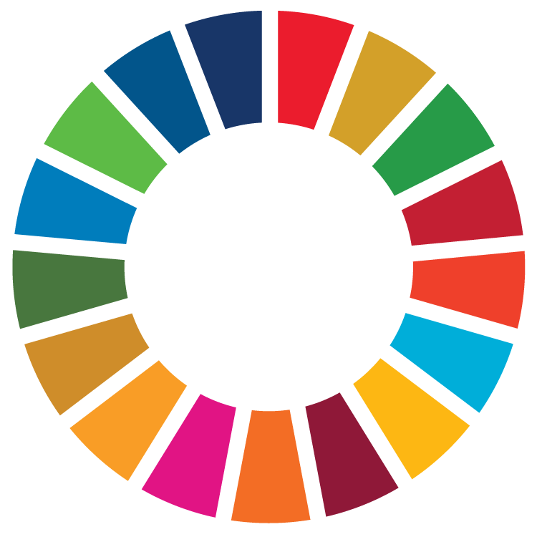
UN Sustainable Development Goals
Food waste reduction and the circular economy are essential for achieving the UN Sustainable Development Goals (SDGs), as they promote responsible resource management, climate action, and sustainable consumption and production. By shifting towards circular food systems that minimise waste, reuse by-products, and recycle nutrients, we can address key sustainability challenges such as food security, environmental degradation, and economic inefficiencies.
The EU has integrated these principles into its policies, aligning with global SDG targets to create a more resilient, low-carbon, and resource-efficient food system that supports both people and the planet.

Slide 35
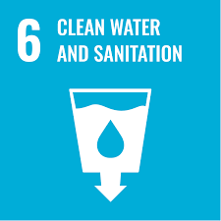
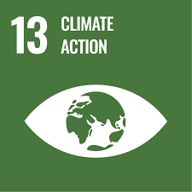
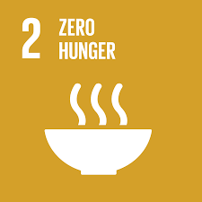
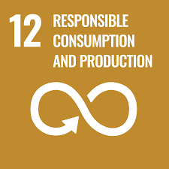
SDGs impacted by food waste & circular economy solutions
SDG 12: Responsible Consumption and Production
For more information, click on the SDG icons!
SDG 2: Zero Hunger
Reducing food waste can improve food security by making better use of existing food resources.
SDG 6: Clean Water and Sanitation
SDG 13: Climate Action
A circular economy promotes sustainable food production, waste reduction, and efficient resource use.
Minimising food waste reduces greenhouse gas emissions from food production, transport, and landfill decomposition.
Reducing food waste lessens water usage and pollution linked to food production.

Slide 36
Rethinking the Operating System…
When a circular economy is aligned with global sustainability goals, it highlights the environmental, economic, and social benefits of circular food systems.
Environmentally, it reduces waste, lowers emissions, and preserves natural resources by keeping materials in use for longer.
Economically, it creates opportunities for innovation, green jobs, and local enterprise through the transformation of food waste into value-added products.
Socially, it supports food security, community resilience, and equitable access to resources by promoting redistribution, sustainable consumption, and inclusive participation across the food chain.
Explaining the Circular Economy and How Society Can Re-think Progress | Animated Video Essay

Slide 37
“FOOD WASTE IS AN ATROCITY THAT WE CAN ALL ADDRESS—STARTING IN OUR OWN HOMES AND COMMUNITIES.”
Tristram Stuart

Slide 38
Follow our journey
li
in
yt
www.waste2worth.eu

