Slide 1
D A I R Y – Waste Exploration

Slide 2
Waste stream Maps
An Irish Perspective: Dairy

Slide 3
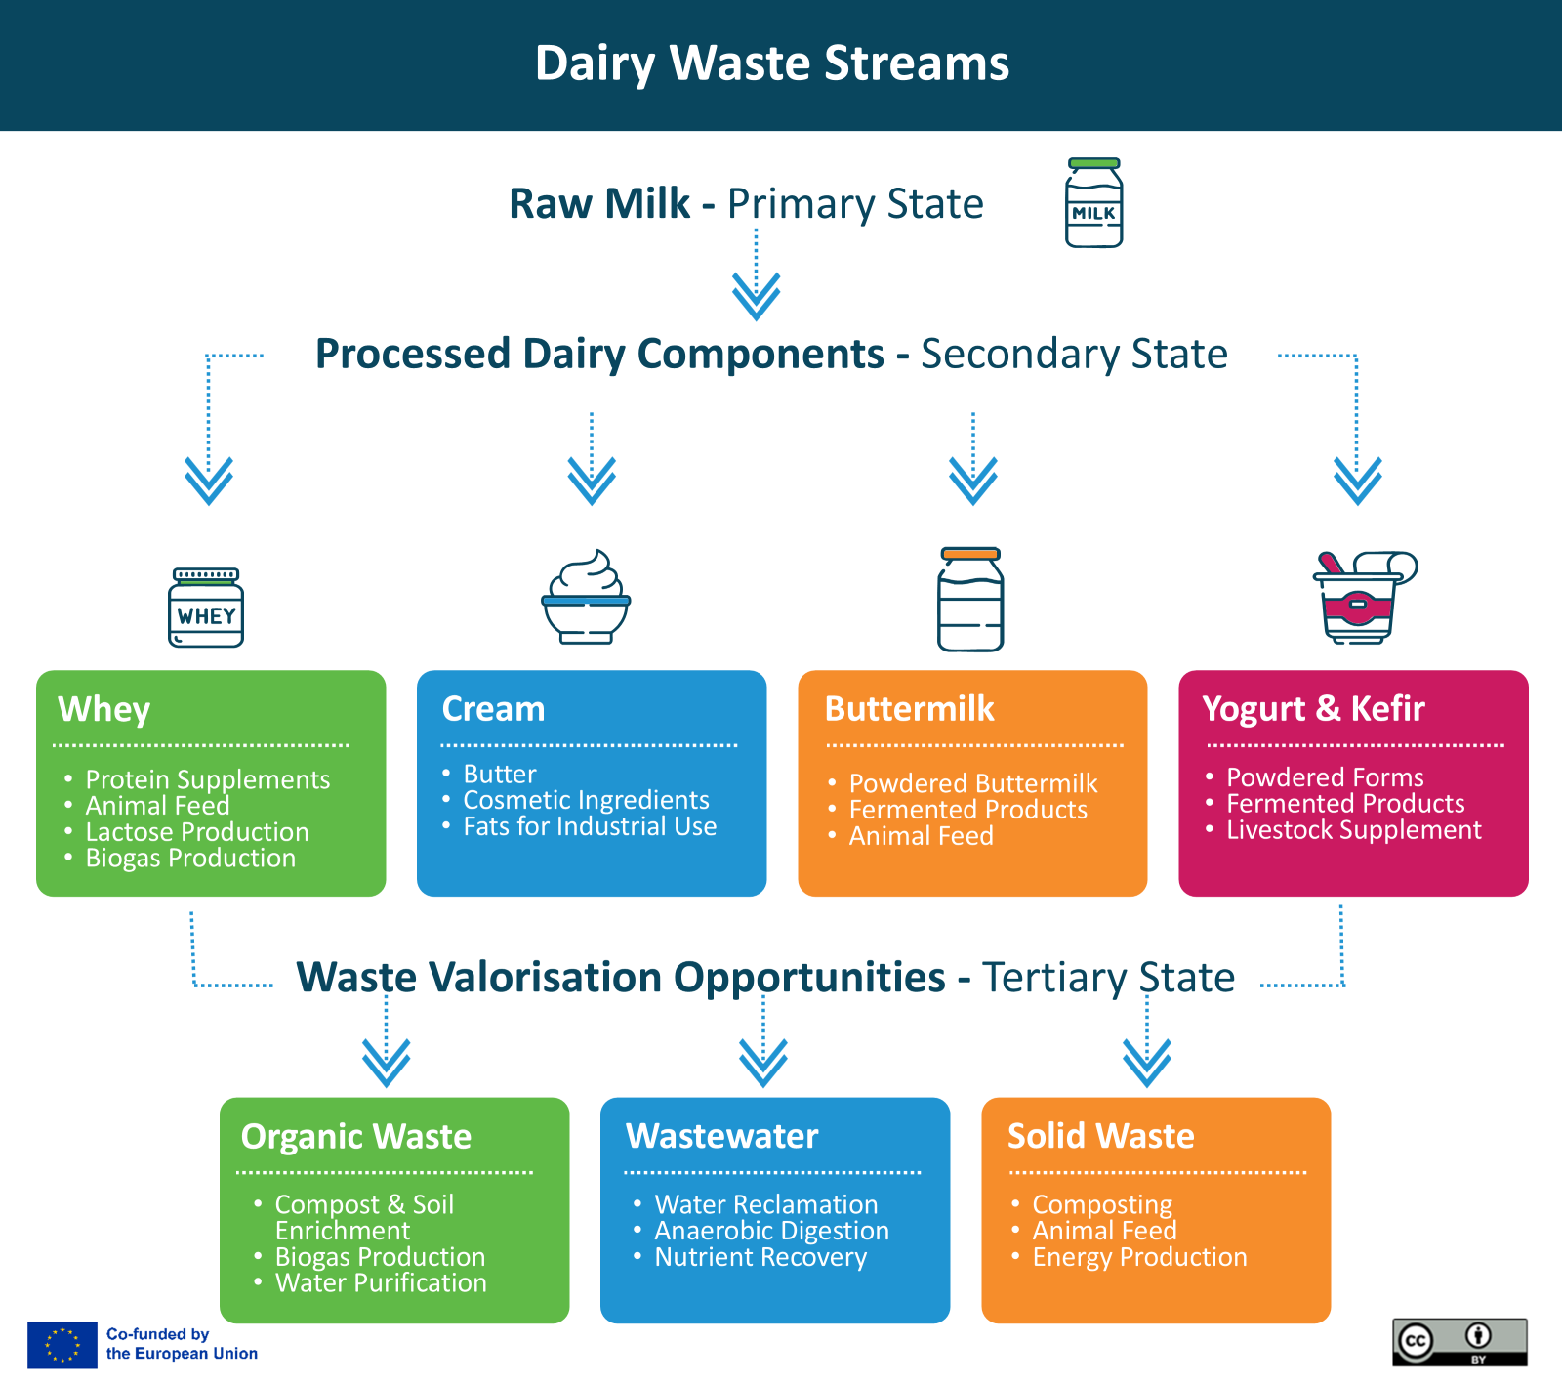
Dairy Waste stream
Highlighting key production stages and potential uses of dairy by-products, demonstrating the wide-ranging applications of dairy waste within a circular economy.

Slide 4
Primary State – Raw milk
The primary product from dairy production primarily focuses on milk, which is then processed into various products such as cheese, butter, and yoghurt.
Why Milk or dairy products as primary product?
Technological Advancements: Innovation in dairy processing has enabled Ireland to efficiently produce a wide range of dairy products.
Efficient Use: Many parts of the milk production process can generate by-products that are useful across industries.
Global Demand for Irish Dairy Products: Ireland produces far more dairy than it consumes domestically. Irish dairy, known for its high quality, is highly sought after globally, with significant exports to international markets. EU membership and trade agreements have further facilitated this.
Ideal Climate and Geography: Ireland’s mild climate and abundant rainfall make it perfect for grass-based dairy farming, allowing cows to graze for most of the year. This system is sustainable and cost-effective, resulting in high-quality milk production.

Slide 5
Secondary state – Process Dairy Components
Dairy offers various by-products from milk processing, which can be turned into valuable secondary products.
In the following slides, we offer some examples of products that can be made from
Whey
Cream
Buttermilk
Yogurt and Kefir

Slide 6
1. Whey
Protein Supplements: Whey protein is a popular supplement in fitness and nutrition.
Animal Feed: Whey can be dried and added to animal feed to provide additional protein and nutrients.
Lactose Production: Whey is processed to extract lactose used in pharmaceuticals.
Biogas Production: Whey can be utilised for biogas generation through anaerobic digestion.

Slide 7
2. Cream
Butter: Cream is a primary source for butter production.
Cosmetic Ingredients: Cream fats are used in skincare products for their moisturising properties.
Dairy Fats for Industrial Use: Cream can be processed to extract fats used in non-food products like lubricants.

Slide 8
3. Buttermilk
Powdered Buttermilk: Used in baking and as a food additive.
Fermented Products: Buttermilk is fermented to create probiotics.
Animal Feed: Buttermilk can be added to feed for livestock.

Slide 9
4. Yogurt and Kefir
Powdered Forms: Both yogurt and kefir powders are used in baking, smoothies, and as food additives for flavour and nutrition.
Fermented Products: Rich in live cultures, yogurt and kefir promote digestive health and are key ingredients in probiotic foods.
Livestock Supplement: Surplus yogurt and kefir provide probiotics and nutrients in animal feed.

Slide 10
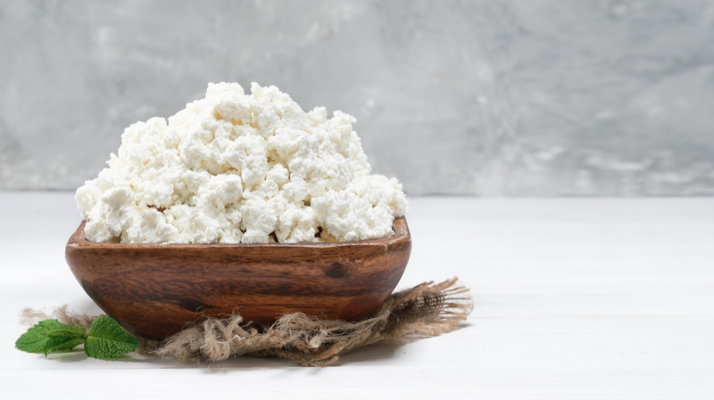
Tertiary state– By-products management
Dairy processed products generates various by-products that can be repurposed into valuable items or managed as waste streams. Some examples are:
Organic Waste
Wastewater
Solid Waste

Slide 11
5. Organic Waste
Compost and Soil Enrichment: Dairy waste can be composted as organic fertiliser.
Biogas Production: Waste from dairy farms and production facilities can be processed into biogas.
Water Purification: Dairy by-products, such as; Lactose, Casein and Whey can assist in water filtration systems.
Organic Waste = Materials that originate from living organisms, particularly plants, animals, and other biological sources.

Slide 12
6. Wastewater
Water used in cleaning, rinsing, and processing dairy products.
Water Reclamation: Recycling treated wastewater for reuse.
Anaerobic Digestion: To produce biogas and clean energy.
Nutrient Recovery: Extracting nutrients for use as fertilisers.

Slide 13
6. Solid Waste
Packaging materials, residual solids from dairy processing, and off-spec products.
Composting: Organic solid waste can be composted to create organic fertiliser.
Animal Feed: Residual solids can be converted into animal feed.
Energy Production: Solid waste can be incinerated for energy production.

Slide 14
A LITTLE PROGRESS EACH DAY ADDS UP TO BIG RESULTS

Slide 15
Follow our journey
li
in
yt
www.waste2worth.eu

