Slide 1
OATS – Waste Exploration

Slide 2
Waste stream Maps
A Finnish Perspective: Oats

Slide 3
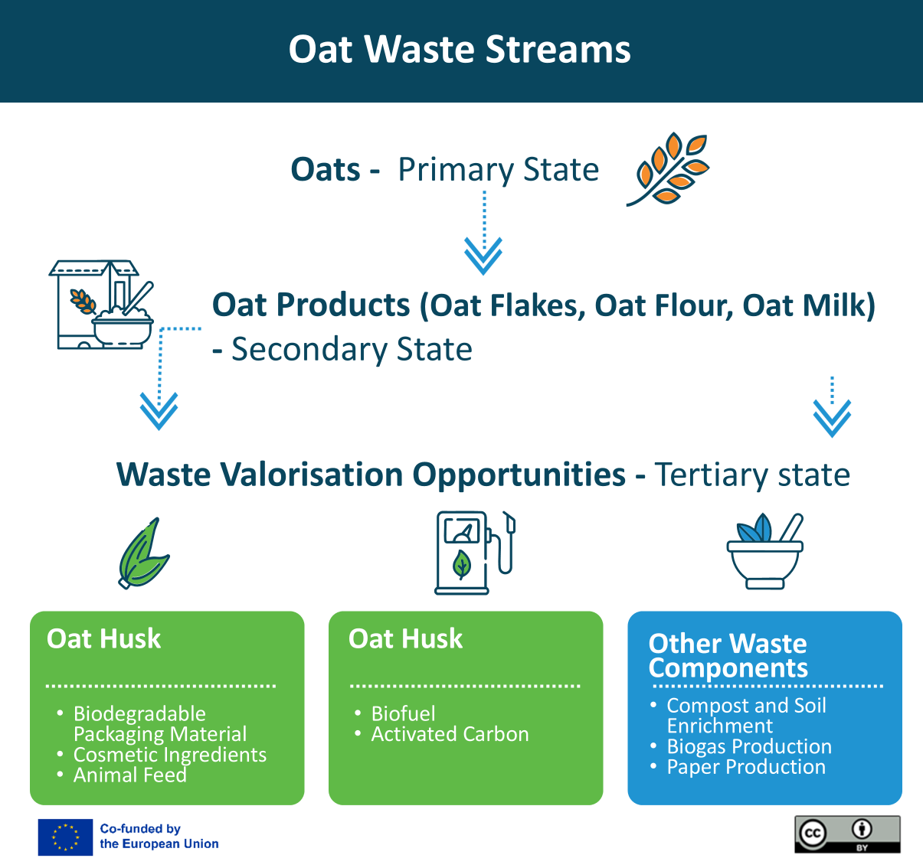
Oat Waste stream
Identifying the main production stages and the potential uses for oat by-products, showcasing the diverse applications of oat waste in a circular economy. ​

Slide 4
OATS – super grain
Oats are used to make oat bread, flakes for many different purposes, biscuits, drinks, yogurt-like products, meat substitutes such as rolled oats, oat flour and oat balls, oat pasta, various snacks, chocolate, licorice and ice cream. (The secondary stage products).
Why oats as a primary product?
Oat's properties and chemical composition, such as beta-glucan, protein, fatty and fatty acid concentrations, reinforce the view that oats can be used versatilely in both the food and feed sectors.
High market demand and basic food product: tasty, healthy, affordable, various product applications
Efficient use of oats: food supplements, packing material, cosmetics, pharmaceutical industry, animal feed, bio-fertilizer, bio-fuel, textile industry (The Tertiary stage products)
Versatility of by-products: by-products such as chaff, shell fractions and by-streams from the milling industry.

Slide 5
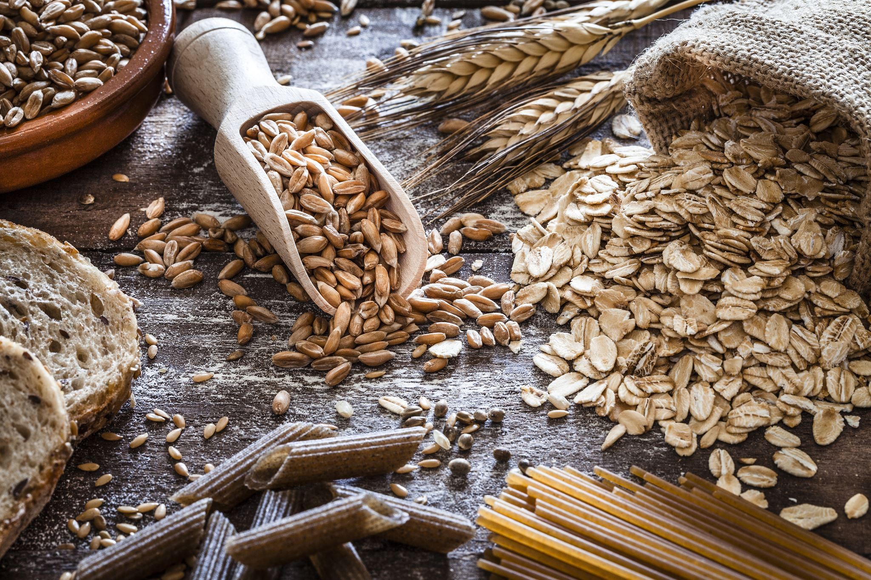
Oats offer a wide range of by-products that can be transformed into value-added products in addition to food and drink.
In the following slides, we can see some examples of products that can be made from oat waste, such as chaff, shell fractions:
food supplements
packing material
cosmetics
pharmaceutical usage
animal feed
bio-fertiliser
bio-fuel
textile applications
Oat Waste Streams

Slide 6
Oat waste as a raw material for other industries
Oat cuts and waste can be dehydrated and ground to produce oat flour, oat xylitol, which can be used in baked goods, sauces and as a thickener, emulsifier, texturiser, gourmet products
Supplements: Oats contain fibre, antioxidants and vitamins, making them useful in the production of food supplements.
Animal feed: Oat waste streams can be used as feed as long as they are properly processed to remove any toxins.

Slide 7
Oat waste as a raw material for other industries
Bio-fertilizer – back to a field
Biofuel: As an organic waste, oats can be used as a raw material to produce biofuels through fermentation processes.
Biogas production: Through anaerobic digestion, oat waste can be converted into biogas, which can be used as a renewable energy source.
Cosmetics: Oats has astringent & probiotic properties, used in natural face masks, scrubs, as from beard to face spray

Slide 8
Oat waste as a raw material for other industries
Pharmaceutical industry: Used in the formulation of tablets and capsules to facilitate dissolution.
Natural dyes: Oat parts, such as chaff, husk, can be processed to extract natural dyes that can be used in the food industry or in cosmetics.
Paper production: bio-packing material, such as from husks to package material
Textile industry: e.g.
Oat pillow: When warm, the pillow is suitable for relaxation, easing pain conditions and even for warming up cold feet! When frozen, you can use the pillow, for example, to ease a headache or as a first aid for muscle strains.

Slide 9
Example / Okara
Oat okara is created as a side stream of oat drink production.
It contains plenty of fibre, soft fat, vitamins, minerals and beta-glucan.
Applications as:
animal feed
raw material for biogas
new SGen oat protein (Sustainable Generation Protein):
as a protein supplement in any cooking, such as energy bars, cereals, plant-based yogurts, recovery drinks, protein powders and meal replacements, and as a raw material for meat substitute products.

Slide 10
READ MORE
That's how the oats got to the top and that's how it stays there
Fazer developed a new raw material from its side stream, the plant-based oat protein is suitable for many uses
From chaff to face spray, Fazer's oat xylitol spices up domestic natural cosmetics
Fazer's winning innovation xylitol from oat husks

Slide 11
READ MORE
Fazer's new oat cocoa whisks are created from production overruns and side streams
A bread bag made of chaff invented from oat husks, the circular economy of the weekday
The oats circulate back to the field as fertilizer
Oat xylitol birch bark and lacquer oil lumene utilizes industrial side streams
Fazer's latest innovation is plant-based oat protein for the food industry

Slide 12
READ MORE
Sidestream exchange
The side stream exchange is a platform where companies looking for and offering bio-based side streams meet.
Biomass Atlas
Biomass Atlas is an open service that collects location data about biomass under a single user interface.
Oat is Fazer’s supergrain – video:
When it comes to manufacturing oat products, Fazer is a unique pioneer in Finland. There are almost 200 products in which oats are used!

Slide 13
A LITTLE PROGRESS EACH DAY ADDS UP TO BIG RESULTS

Slide 14
Follow our journey
li
in
yt
www.waste2worth.eu

