Slide 1
POTATO – Waste Exploration

Slide 2
Waste stream Maps
A Spanish Perspective: Potato

Slide 3
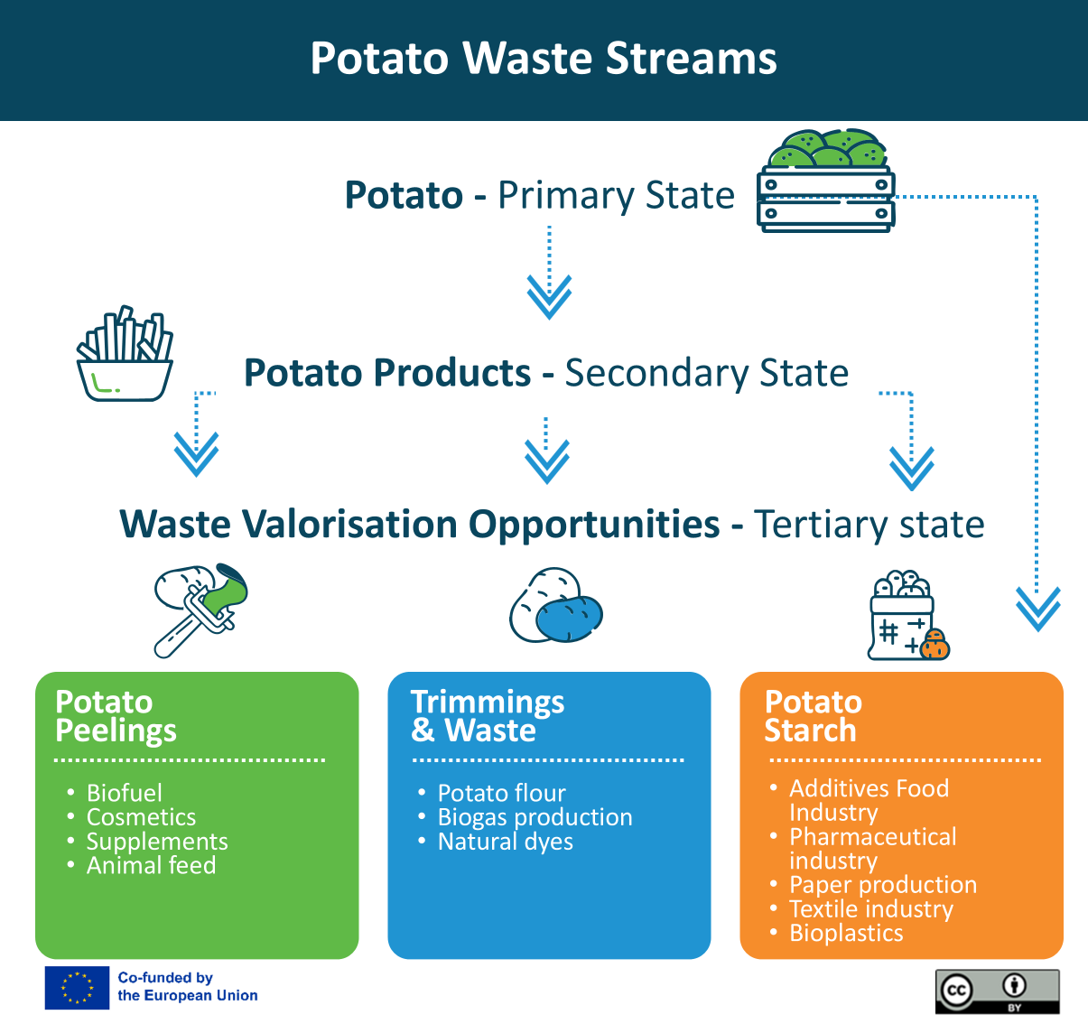
Potato Waste stream
Identifying the main production stages and the potential uses for potato by-products, showcasing the diverse applications of potato waste in a circular economy. ​

Slide 4
Potato🡪 5th range and other potato processed products
The main use of the potato is fresh, which is why the food industry has responded to the new consumption trends demanded by consumers and has generated 5th range potatoes. Other types of processed products such as potato crisps, mashed potatoes, gnocchis or snacks are also produced.
Why potato and its processed products as a primary product?
High market demand and basic food product: In cooking, it forms part of our traditional recipes, such as the famous Spanish Omelette. It is also a very versatile, economical and nutritious food.
Efficient use of potato: The processed production process makes efficient use of much of the potato, including potatoes that do not meet quality standards or surplus potatoes that may not be suitable for fresh sale.
Versatility of by-products: The production of 5th grade potatoes generates by-products such as SKINS, CUTS AND WASTE AND UNSUITABLE POTATOES, which can be further processed into value-added products such as animal feed, starch or biogas.

Slide 5
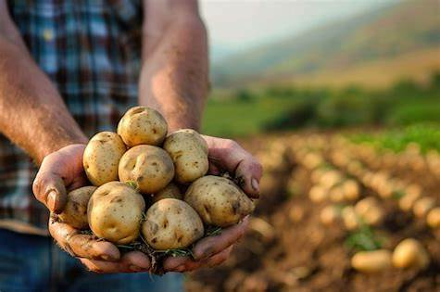
Potato Waste Streams
Potatoes offer a wide range of by-products that can be transformed into value-added products in addition to food and drink.
In the following slides, we can see some examples of products that can be made from:
Potato peelings
Potato trimmings and waste
Unsuitable potatoes

Slide 6
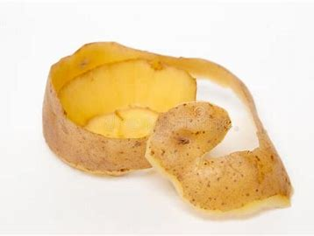
1. Potato peelings
Biofuel: As an organic waste, potato skin can be used as a raw material to produce biofuels through fermentation processes.
Cosmetics: Potato skin has astringent properties and can be used as an ingredient in natural face masks and scrubs.
Supplements: Potato skins contain fibre, antioxidants and vitamins, making them useful in the production of food supplements.
Animal feed: The skins can be used as feed as long as they are properly processed to remove any toxins.

Slide 7
2. Trimmings & waste
Potato flour: Cuts and waste can be dehydrated and ground to produce potato flour, which can be used in baked goods, sauces and as a thickener.
Biogas production: Through anaerobic digestion, potato waste can be converted into biogas, which can be used as a renewable energy source.
Natural dyes: Potato parts can be processed to extract natural dyes that can be used in the food industry or in cosmetics.

Slide 8
3. Unsuitable potatoes
Unsuitable potatoes: During sorting and processing, potatoes that do not meet quality standards due to damage, disease or aesthetic defects may be discarded. Where it is safe to do so, the STARCH can be extracted from the potato, which has a high value and a multitude of uses:
FI: Thickening, binding, emulsifying, texturising…
Pharmaceutical industry: Used in the formulation of tablets and capsules to facilitate dissolution.
Paper production: Improves paper strength and softness.
Textile industry: provides stiffness and improves appearance.
Bioplastics: Used for the production of compost bags.
…

Slide 9
A LITTLE PROGRESS EACH DAY ADDS UP TO BIG RESULTS

Slide 10
Follow our journey
li
in
yt
www.waste2worth.eu

