Slide 1
OLIVES – Waste Exploration

Slide 2
Waste stream Maps
An Italian Perspective: Olives

Slide 3
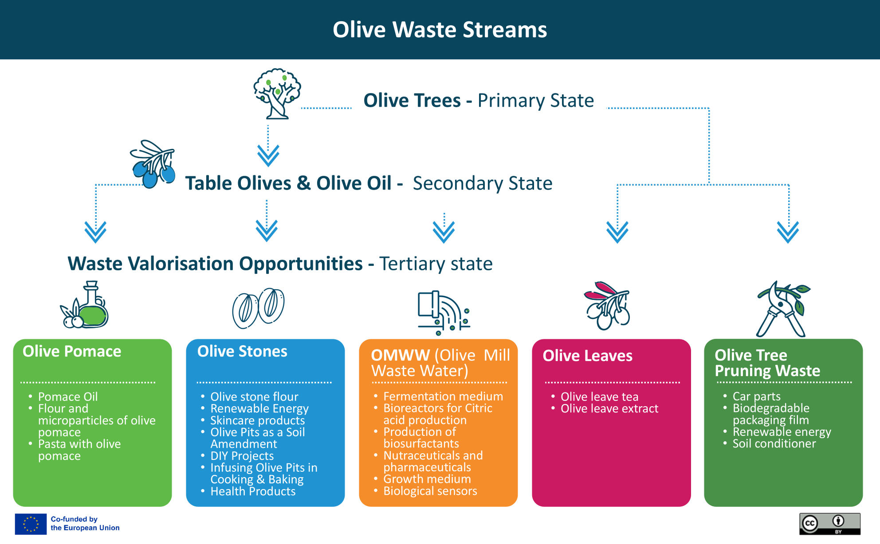
Olive Waste stream
Identifying the main production stages and the potential uses for OLIVE by-products, showcasing the diverse applications of olive tree waste in a circular economy. ​

Slide 4
Olive Trees → Table Olives or Olive Oils
The predominant products created from the olive tree are Olive Oil 80% and Table Olives 20%. The area used for olive trees in Italy has for years been around 1 million hectares. Oil production is strongly influenced by weather events, pathogen attacks and in recent years also by climatic change
Why Olives as Primary Resources?
High Market Demand: Olive oil is one of the most important food trends in the world. Its demand is constantly increasing thanks to its nutritional value and content of bioactive compounds
Efficient Use of Raw Material: Olives offer great potential for purely mechanical processing without the need for chemicals.
Versatility of By-products: by-products such as leaves, aqueous olive mill wastewater, and olive pomace, act as potential low-cost sources of phenols and antioxidants that can be extracted and used as natural additives in the food and drug industries. Olive branches and leaves offer byproducts, too.

Slide 5
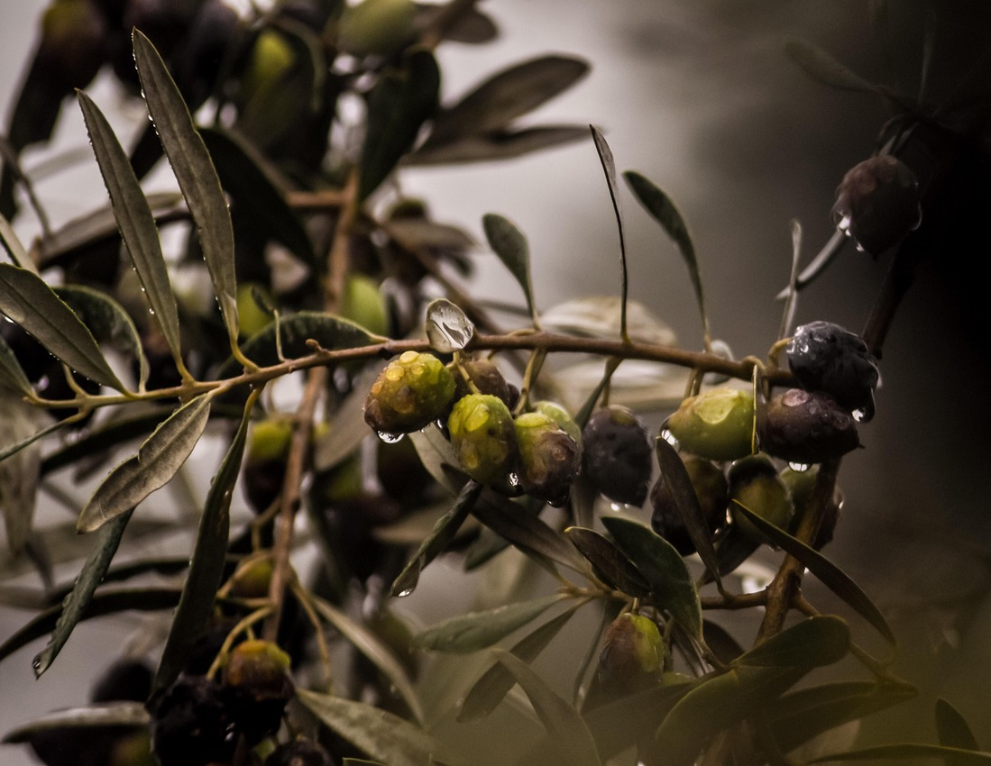
Olive Waste Streams
Olive waste and by-products can be converted into new and higher value-added products
In the next few slides, we offer some examples of products that can be made from:
Olive pomace,
Olive stones,
OMWW (Olive Mill Waste Water)
Olive leaves
Olive tree pruning waste

Slide 6
Pomace Oil: Olive pomace oil is olive oil that is extracted from olive pulp after the first press. It allows cooking at high temperature
Flour and microparticles of olive pomace: can be added to chitosan-based film by significantly improving in antioxidant capacity the tensile strength of films.
Pasta with olive pomace: it fortifies pasta by increasing the phenolic compounds and antioxidant capacity of both cooked and uncooked pasta, by decreasing the optimum cooking time, the rapidly digestible starch, the slowly digestible starch and resistant starch.
1. Olive Pomace

Slide 7
Olive stone flour: can be used as reinforcement filler of plastic materials. It enhances the textural strength and water barrier properties.
Renewable Energy:
Olive pits can be ground into pellets and used as fuel for stoves. They can even be used to generate electricity. Olive pits can also be burned in boilers to heat water, which can be used to heat your home.
Skincare products:
Olive pits can be ground into a fine powder and used as an exfoliant in facial scrubs and body washes. Products containing olive pits, can help to reduce the appearance of fine lines and wrinkles. Their polyphenols help reduce inflammation in the skin.
2. Olive Stones

Slide 8
Olive Stones as a Soil Amendment
Olive pits are rich in nutrients and minerals that are essential to plant growth, such as nitrogen, phosphorus, and potassium; they can also help improve soil structure and water retention; they can help deter pests such as slugs and snails. When scattered around plants, they create a rough surface that makes it difficult for pests to move around; They can also help regulate soil pH levels.
Olive Stones for DIY Projects
They can be turned into jewelry works of art. One example is creating a mosaic using different colored olive pits and home decor items.
2. Olive Stones

Slide 9
2. Olive Stones
Infusing Olive Stones in Cooking and Baking
Olive stone/pit powder can be steeped in oil to create a flavourful infusion that can be used for dressings, marinades, and dipping sauces.
Olive pit flour can be used instead of regular flour in baked goods. It can also be steeped in milk or it can be used as a seasoning for dishes. It adds a subtle nutty flavour that pairs well with meats and vegetables.
Health Products
Boiled in water to make a tea or olive stone extract, both are rich in antioxidants and help with digestion, reduce inflammation, and boost the immune system.

Slide 10
3. OMWW (Olive Mill Waste Water)
Nutraceuticals and pharmaceuticals: compounds such as polyphenols and antioxidants can be extracted
Growth medium: It serves as a growth medium for beneficial microorganisms used in bioremediation.
Biological sensors: Biotechnology can develop biological sensors for real-time monitoring of wastewater quality and treatment processes.

Slide 11
3. OMWW (Olive Mill Waste Water)
Fermentation medium: OMWW can be used as a fermentation medium to produce high-value products.
Bioreactors for Citric acid production: Studies have shown that they can be used in bioreactors for the production of citric acid and cellulase by fungi such as Aspergillus niger.
Production of biosurfactants: they are used as a carbon source to produce biosurfactants by bacteria such as Pseudomonas aeruginosa and Bacillus subtilis

Slide 12
4. Olive Leaves
Olive leave tea: Olive leaves have hypoglycaemic, diuretic and cholesterolitic properties. The beneficial properties are linked to the presence of a particular substance, oleuropein. This is a bitter glycoside responsible for very important health benefits.
Olive leave extract: is a concentrated dose of the nutrients in olive tree leaves. It’s a potent source of antioxidants that support your immune system.

Slide 13
Car parts: Ford is studying how to replace traditional plastic cladding parts with parts made from a mix of shredded olive trees and recycled plastic waste.
Biodegradable packaging film that can be used as a Food packaging biopolymer.
Renewable energy : from the production of wood chips to be used in an energy conversion plant
Soil conditioner: Biochar could be produced from olive tree pellets, and added, as a powerful soil conditioner, to horticultural potting soils. Shredded olive branches can be used to controls weeds and return organic matter to the biological cycle.
5. Olive tree pruning waste

Slide 14
A LITTLE PROGRESS EACH DAY ADDS UP TO BIG RESULTS

Slide 15
Follow our journey
li
in
yt
www.waste2worth.eu

