Slide 1
APPLES – Waste Exploration

Slide 2
Waste stream Maps
An Irish Perspective: Apples

Slide 3
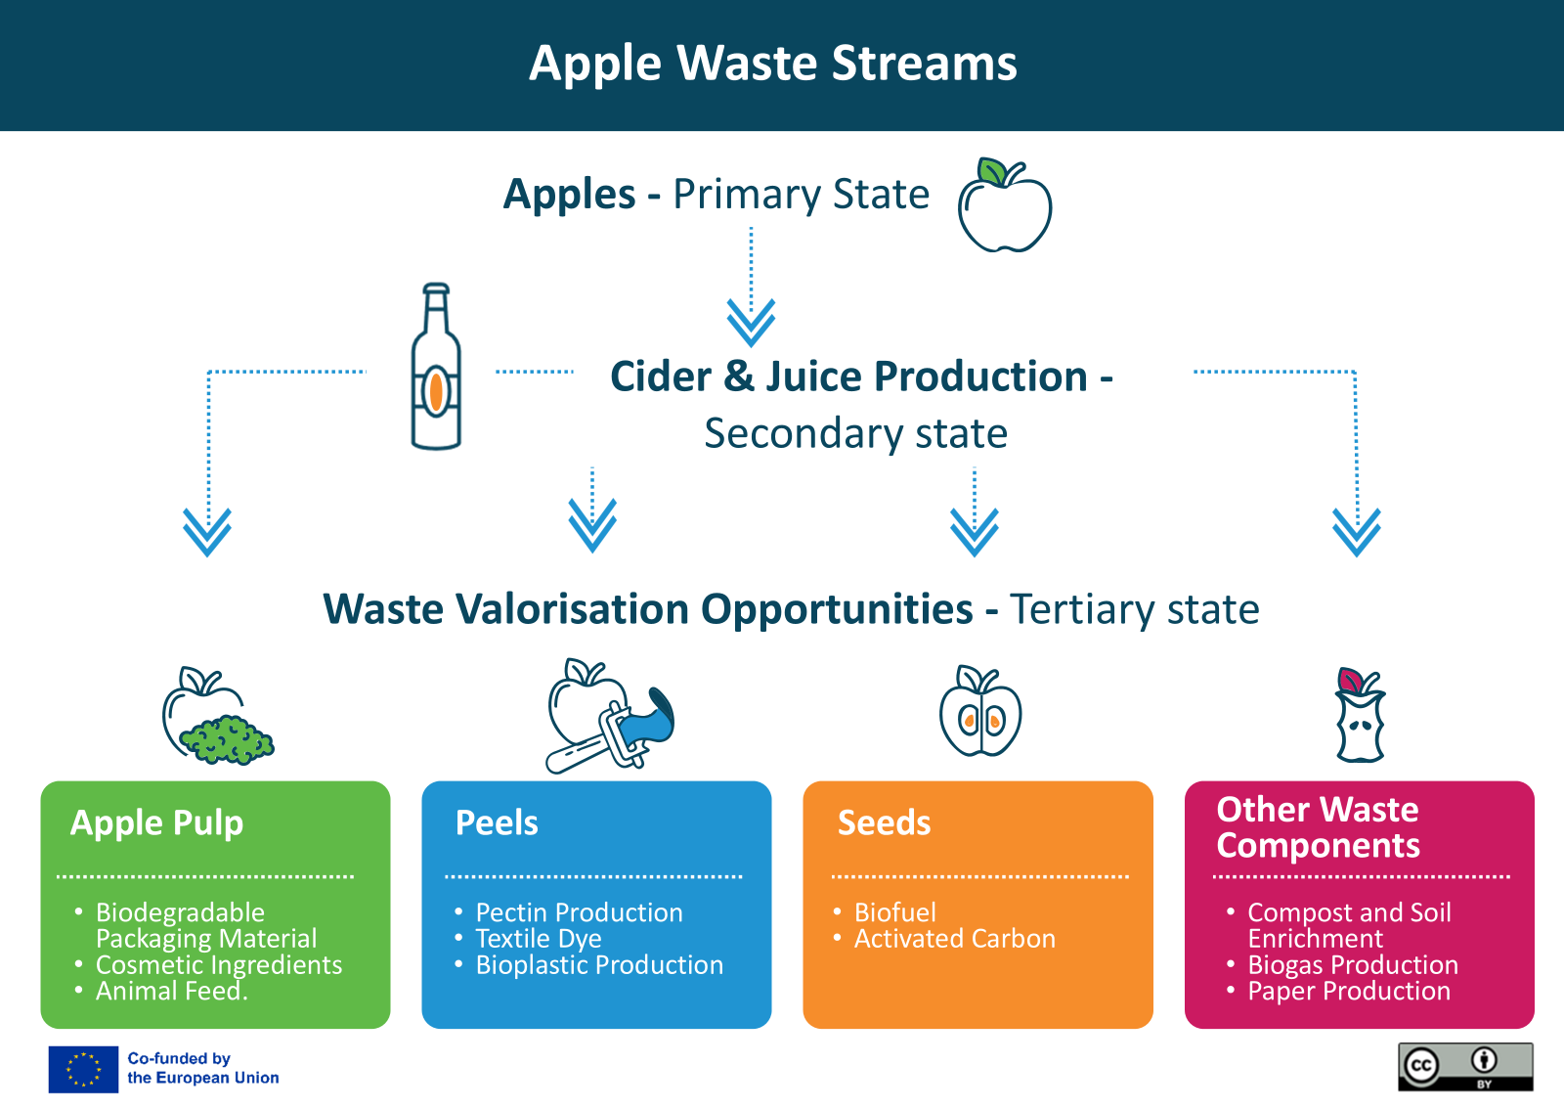
Apple Waste stream
Identifying the main production stages and the potential uses for apple by-products, showcasing the diverse applications of apple waste in a circular economy. ​

Slide 4
Primary state to Cider or Apple Juice production
The main product from apples would typically be apple juice or cider, as these are the most common and commercially valuable uses for apples, especially in regions like Ireland with a strong tradition of cider production.
Why Apple Juice or Cider as the Main Products?
High Market Demand: Both apple juice and cider have a consistent and high demand in the market, appealing to a wide range of consumers.
Efficient Use of Raw Material: The production process efficiently utilises a significant portion of the apple, including imperfect or surplus apples that may not be suitable for fresh sale.
Versatility of By-products: The production of juice or cider generates by-products like PULP, PEELS, AND SEEDS, which can be further processed into value-added products such as animal feed, pectin, or biogas. (Tertiary Products)

Slide 5
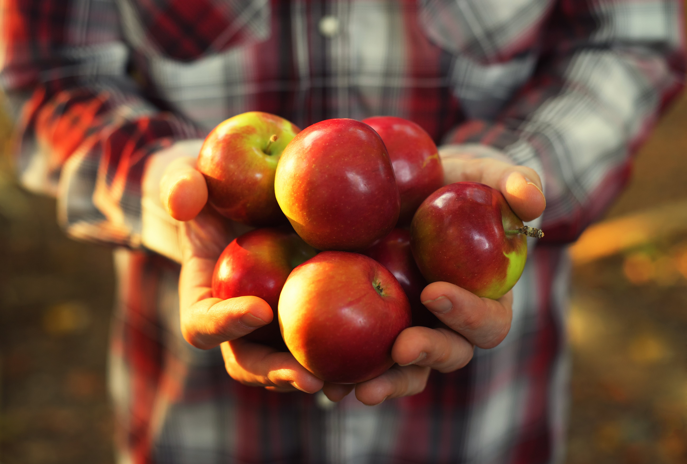
Tertiary State - Apple Waste Streams
Apples offer a versatile range of by-products that can be transformed into valuable items beyond food and drink.
In the next few slides, we offer some examples of products that can be made from;
apple pulp,
peels,
seeds, and
other waste components

Slide 6
1. Apple Pulp
Biodegradable Packaging Material: Apple pulp can be used to produce biodegradable packaging materials that serve as eco-friendly alternatives to plastic.
Cosmetic Ingredients: Apple pulp, rich in vitamins and antioxidants, can be used in scrubs, face masks, and creams for its exfoliating and skin-brightening properties.
Animal Feed: Apple pulp is often dried and used as a nutritious additive in animal feed, providing fiber and essential nutrients.

Slide 7
2. Apple Peels
Pectin Production: Apple peels are high in pectin, a natural gelling agent used in the food industry for jams, jellies, and as a thickener in various food products.
Textile Dye: Apple peels can be used to create natural dyes for textiles, offering an eco-friendly alternative to synthetic dyes.
Bioplastic Production: Extracts from apple peels can be incorporated into bioplastics, creating sustainable materials for various applications.

Slide 8
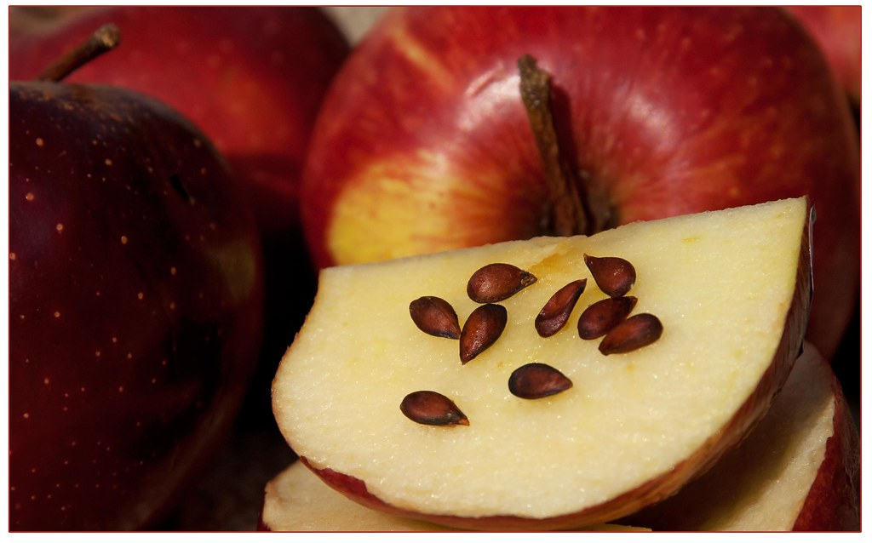
3. Apple Seeds
Biofuel: Apple seeds contain oils that can be extracted and used to produce biofuels, contributing to renewable energy solutions.
Activated Carbon: The high carbon content in apple seeds makes them suitable for conversion into activated carbon, used in filtration systems for water purification and air quality control.

Slide 9
4. Apple Pomace
Compost and Soil Enrichment: Apple pomace can be composted and used as an organic soil conditioner, enhancing soil fertility and structure.
Biogas Production: Through anaerobic digestion, apple pomace can be transformed into biogas, a renewable energy source that can be used for heating and electricity.
Paper Production: Apple pomace fibres can be used in the production of sustainable paper, reducing the reliance on traditional wood pulp.
Pomace = Pulp, Peels & Seeds COMBINED!

Slide 10
A LITTLE PROGRESS EACH DAY ADDS UP TO BIG RESULTS

Slide 11
Follow our journey
li
in
yt
www.waste2worth.eu

